Slide 1
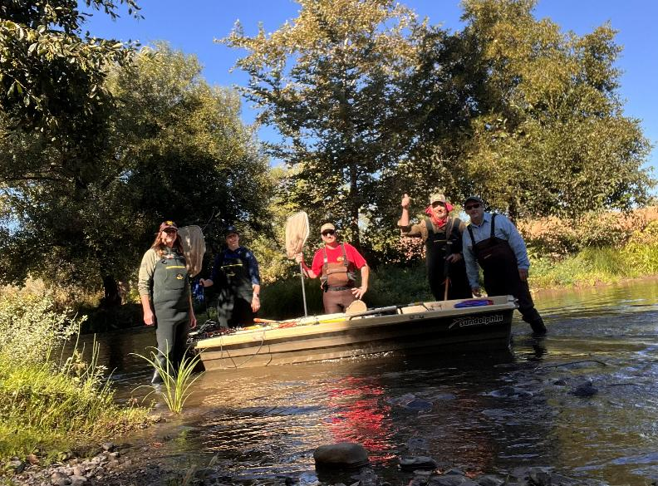
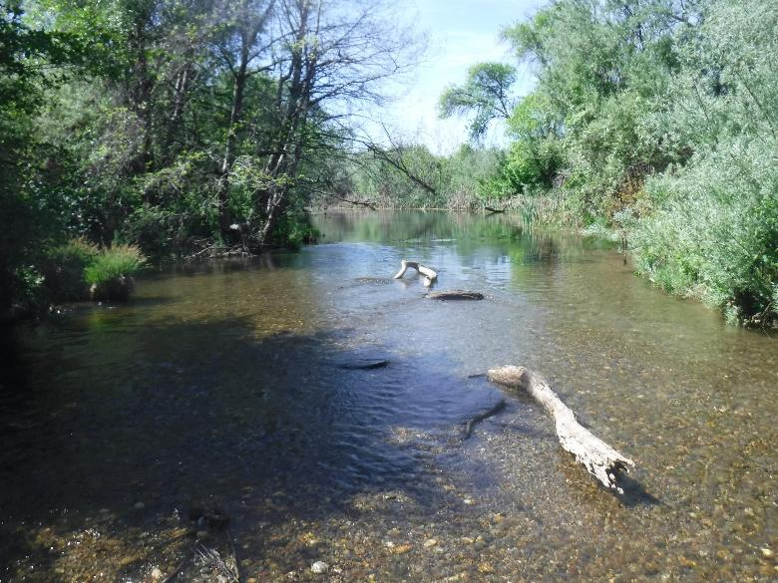


Long-Term Fish Monitoring & Water Temperature Data Records/Archives for Lower Putah Creek
TRPA Fish Biologists

Slide 2
TRPA Fish Biologists has accumulated data records from numerous surveys and data reviews on a wide range of issues in Putah Creek basin including long-term fish monitoring and water temperature records

Slide 3
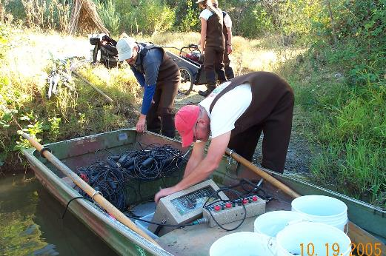
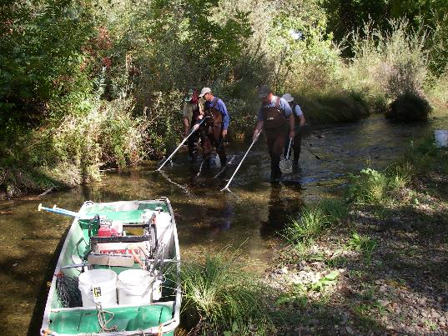
Putah Creek Fish Monitoring

Slide 4
TRPA has assembled Fish monitoring records include both Microsoft Excel and Access database format for 106 separate surveys along lower Putah Creek:
UC Davis WFC class sampling;
Trinity Fisheries Consulting (TFC) sampling;
TRPA Fish monitoring

Slide 5
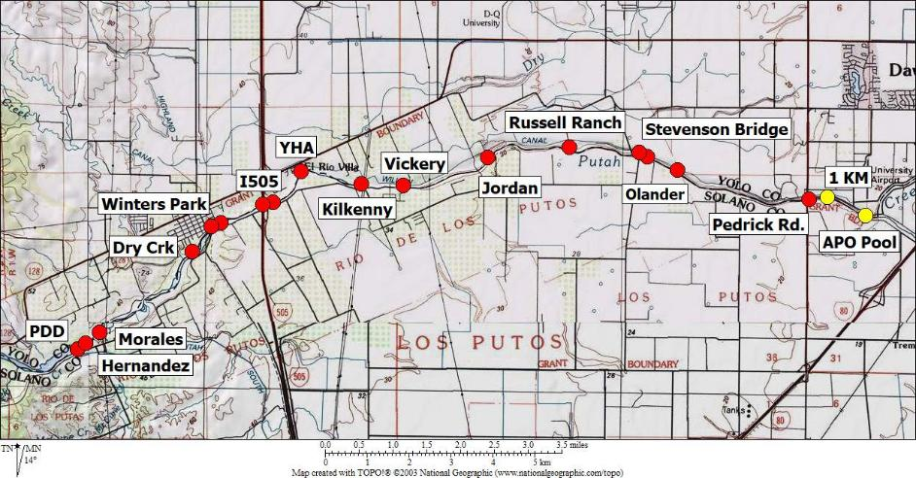
Sites Between PDD and Davis

Slide 6
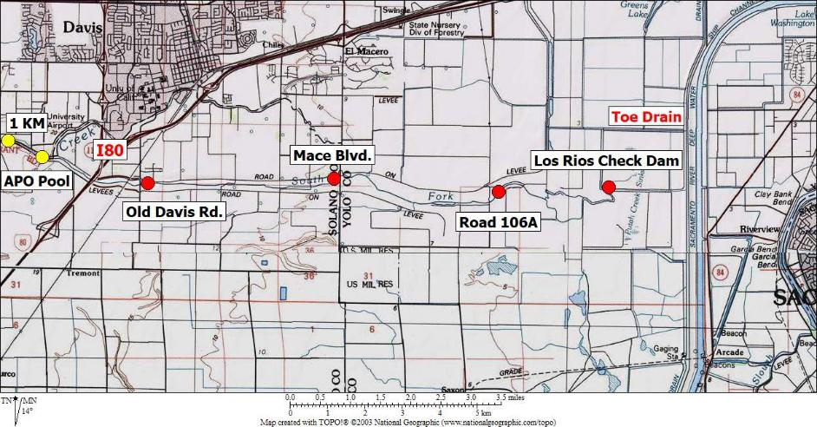
Sites Between Davis and Toe Drain

Slide 7
UC Davis WFC class sampling includes:
47 years of WFC 120 Class FALL sampling at APO Pool/above APO Pool (1KM) 1979-2025
10 years of WFC 100 Class SPRING sampling at APO Pool and above APO Pool (1KM) 2013-2024
2 years of misc. student surveys sampling at APO Pool 1979 & 2022

Slide 8
TFC sampling includes:
1 year (1990) of SUMMER & FALL sampling at 6 sites along lower creek during drought

Slide 9
TRPA Fish (and Normandeau) sampling includes between PDD and Toe Drain:
10 years of SUMMER sampling at 6-9 sites: 1991, 1993-2000, 2003;
32 years of FALL sampling at 6-12 sites: 1993-2008, 2010-2025
FALL 2005 fish rescue/relocation at Dry Creek channel restoration
SPRING 2016 opportunistic sampling for juvenile CHK at 4 sites

Slide 10
The SCWA/LPCCC Microsoft Excel spreadsheets and Access database includes 106 separate surveys and
139,824 organisms

Slide 11
139,824 organisms in database includes:
138,889 FISH from 41 species and 4 hybrid types; (including 116,913 individual measurements & 17,476 individual weights)
935 NON-FISH including clams, crayfish, shrimp, mitten crabs, bullfrogs and turtles

Slide 12
The SCWA/LPCCC Microsoft Excel spreadsheets and Access database
continually updated following surveys and when data is made available
archived on the SCWA FTP Site and provided to UCD researchers on request

Slide 13
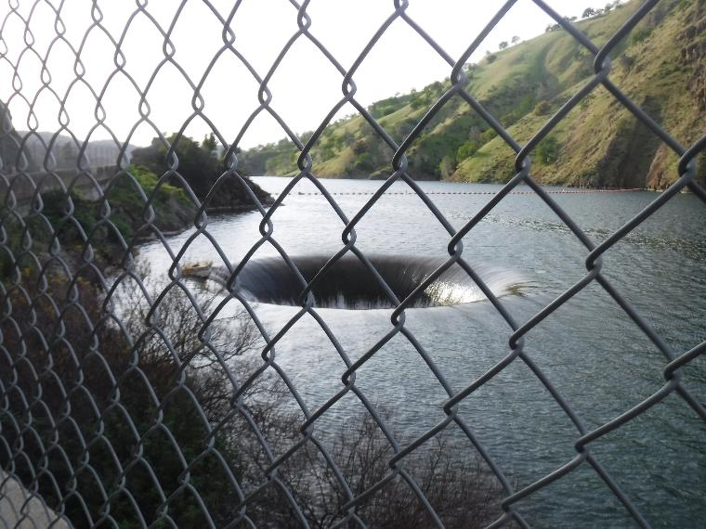
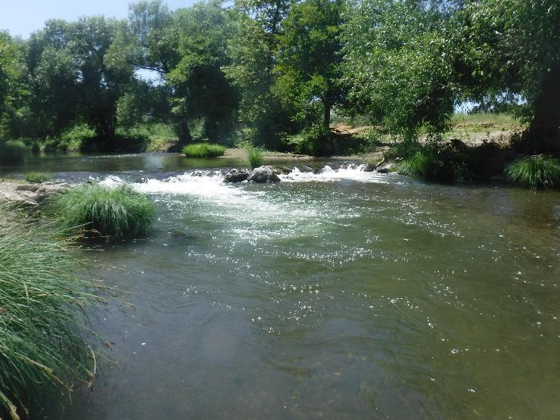
Middle and Lower Putah Creek
Water Temperature Records

Slide 14
Continuous Water Temperature Data
Monticello 11.7 years (2014-August 2025)
FA3 7.7 years (2018- 2014-August 2025)
PDD 18.7 years (1992-1994; 1998-2000;
2013-August 2025)
Pipes 4 years (1998-2001)
Pool 7 1 year (1994)
Wimmer 5.5 years (2018-June 2023)
Mertz BW 11 years (2006-2016)
Mertz MC 6 years (2012-2017)
PG&E X 2 years (1998-1999)
Winters Br 10 years (2006-2015)
WPCP 5 years (2012-2016)
I505 24.7 years (1992-2000; 2010-August 2025)
McNamara 7.7 years (2018-August 2025)

Slide 15
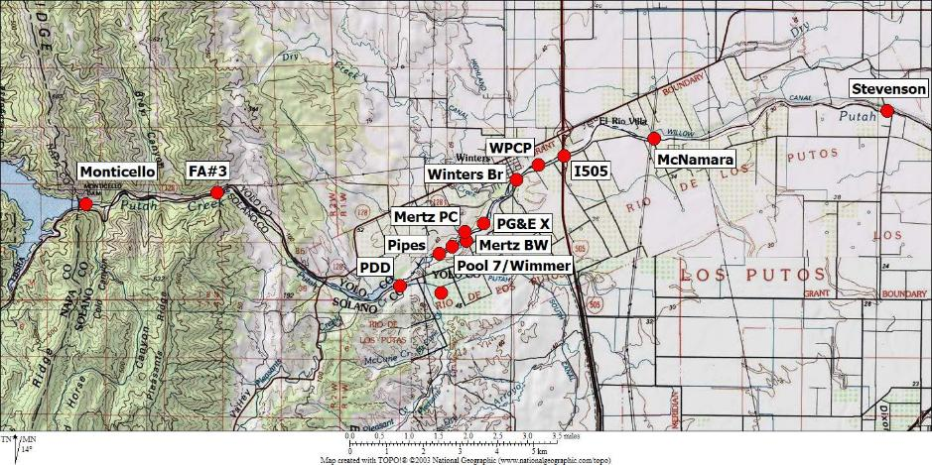
Sites Between Monticello and Stevenson Bridge

Slide 16
Continuous Water Temperature Data
Stevenson 27.5 years (1992-2002; 2007-June 2023)
TS Glide 2 years (1998-1999)
Pedrick 17.7 years (2007-2015; 2017-August 2025)
I80 12 years (1996-2002; 2006-2010)
Old Davis 17.2 years (2007-2022;
July 2023-August 2025)
Mace 16.7 years (2006-2008; 2012-August 2025)
LRCD 14.5 years (2001-2002; 2011-June 2023)

Slide 17
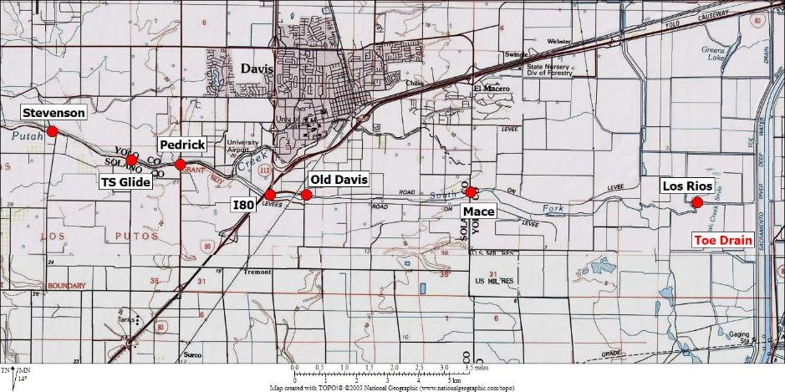
Sites Between Stevenson Bridge
And Toe Drain

Slide 18
The SCWA Water Temperature data
Mostly hourly data (some 15 and 30-minute records)
continually updated following logger downloads (12-18 months)
Data Qa/Qc (mainly shallow depths) and archived on the SCWA FTP Site and provided to UCD researchers on request

