Slide 1



Putah Creek’s Long-Term
Data Management
Christine Ann Parisek, Ph.D.
Postdoctoral Research Scholar
Data Manager | UC Davis Putah Creek Fisheries Data
Supported by Lucy Andrews, Ph.D.
Senior Environmental Scientist, Department of Water Resources
caparisek.github.io caparisek@ucdavis.edu

Slide 2
Putah Creek’s Long-Term
Data Management
Christine Ann Parisek, Ph.D.
Postdoctoral Research Scholar
Data Manager | UC Davis Putah Creek Fisheries Data
Supported by Lucy Andrews, Ph.D.
Senior Environmental Scientist, Department of Water Resources
caparisek.github.io caparisek@ucdavis.edu
Notes:
Intro: Christine
[Give context briefly for what a data manager is briefly]
The Data Manager role… is a new role for the Putah Creek program.
The job of a data manager is to
make sure management of long-term data are
constant and consistent
as the data continue to flow in,
so that there’s a point person who is responsible for the
life cycle of the data.
As well as to build a collaborative community encompassing data creators and data users.
Intro: Lucy

Slide 3
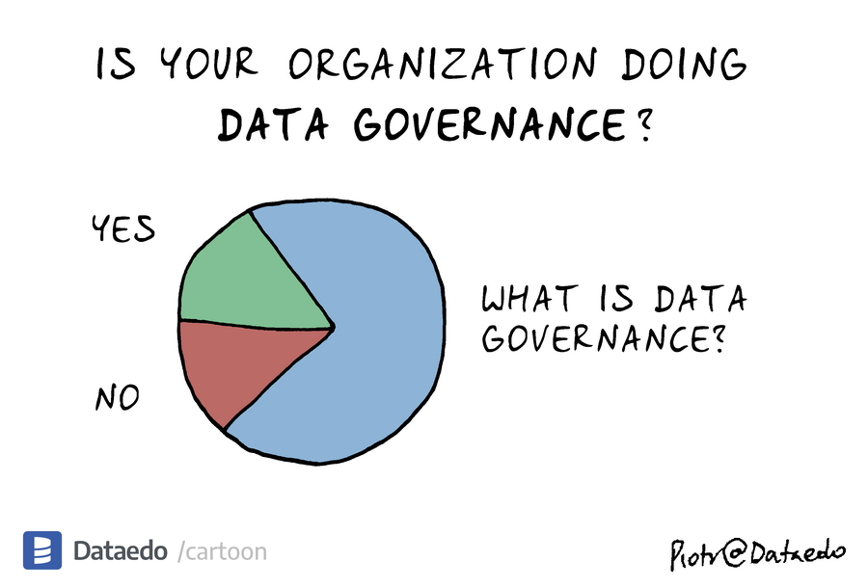
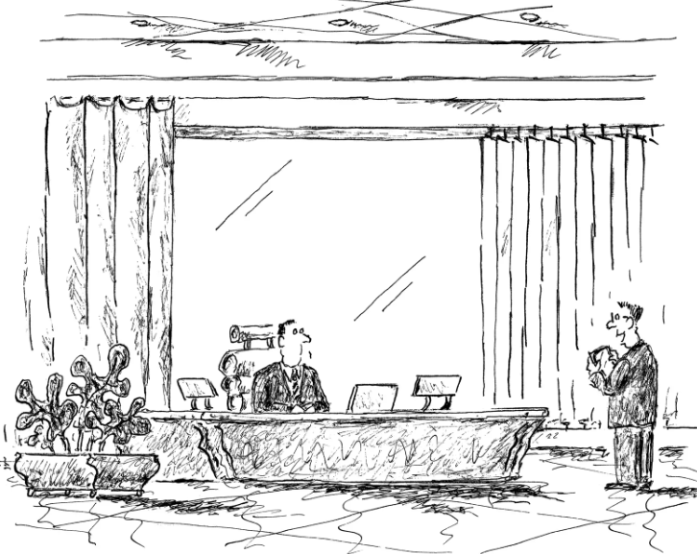
Why data management matters
Good data management turns monitoring into its long-term value
Without it, data are hard to find, hard to trust, and could be lost
“Better than an answer – I have a tremendous amount of data.”
Notes:
Proper data management matters because…
It helps get long-term value from our monitoring efforts and dollars
without it, data are harder to find, harder to trust, and there’s a risk that it (or its metadata) could be lost with time
It helps a program go from just having a lot of valuable data,
to being able to put that data toward our collective goals in a tangible and tractable way.

Slide 4
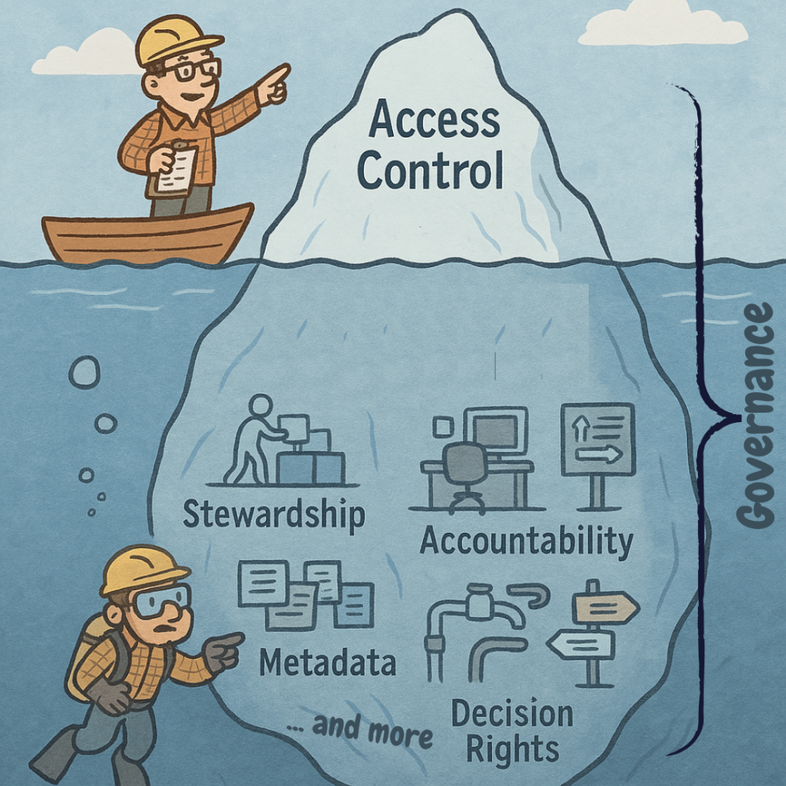
Why this matters
Data Summit, April 15
Long term & collaborative science
Regional planning
Support decision making
Notes:
Further,
Putah Creek’s data are increasingly being used beyond the project itself.
Everyone here knows it has tremendous value for…

Slide 5
User groups of Putah Creek’s monitoring data
Restoration Projects
Healthy Rivers & Landscapes
UC Davis Researchers
Other researchers & students
Flood & groundwater modelers
PGE, Construction Projects
Sediment transport, mercury loading, & construction workers
SCWA management staff for operation of the Putah Creek system itself
Etc.
Notes:
Data aren’t just used for the Accord’s minimum flow management.
As Max and Alex said, so many users are requesting these data
They are being used for restoration projects, modeling exercises, decision-making, and science.
And by all these different user groups
Including Healthy Rivers and Landscapes.

Slide 6
Healthy Rivers and Landscapes Science
55
hypotheses
Multiple spatial and temporal scales
100+ restoration project sites
150,000 AF to 800,000 AF annual environmental flows
100+ datasets and models
8 years
20+ public agencies
Open science

Slide 7
Healthy Rivers and Landscapes Science
Spawning hypothesis 3:
The density of salmonid redds will increase in habitat enhancement areas compared to proximate, non-enhanced areas.
Define benchmark and control sites
Identify anticipated effect size
Conduct monitoring power analysis
Monitor
Evaluate
Adaptively manage
Lots of data!

Slide 8
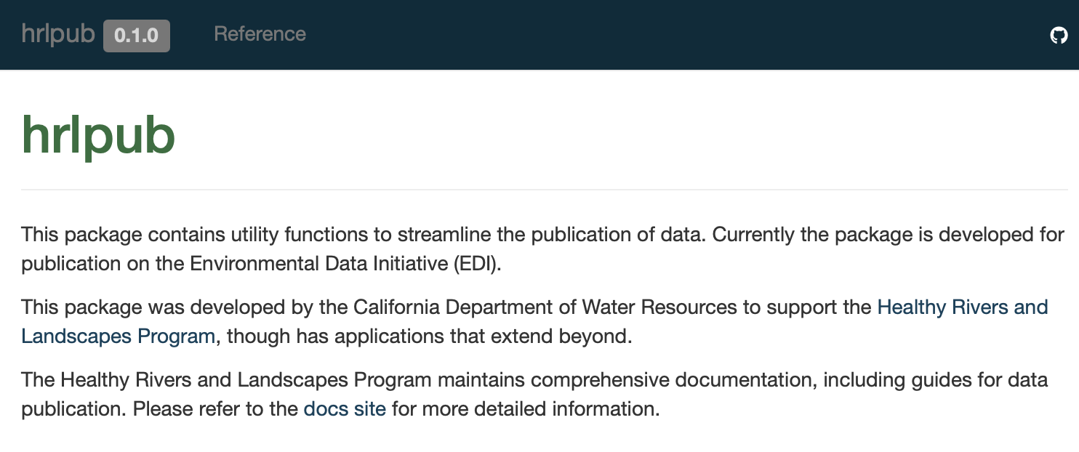
Beta testers welcome!

Slide 9
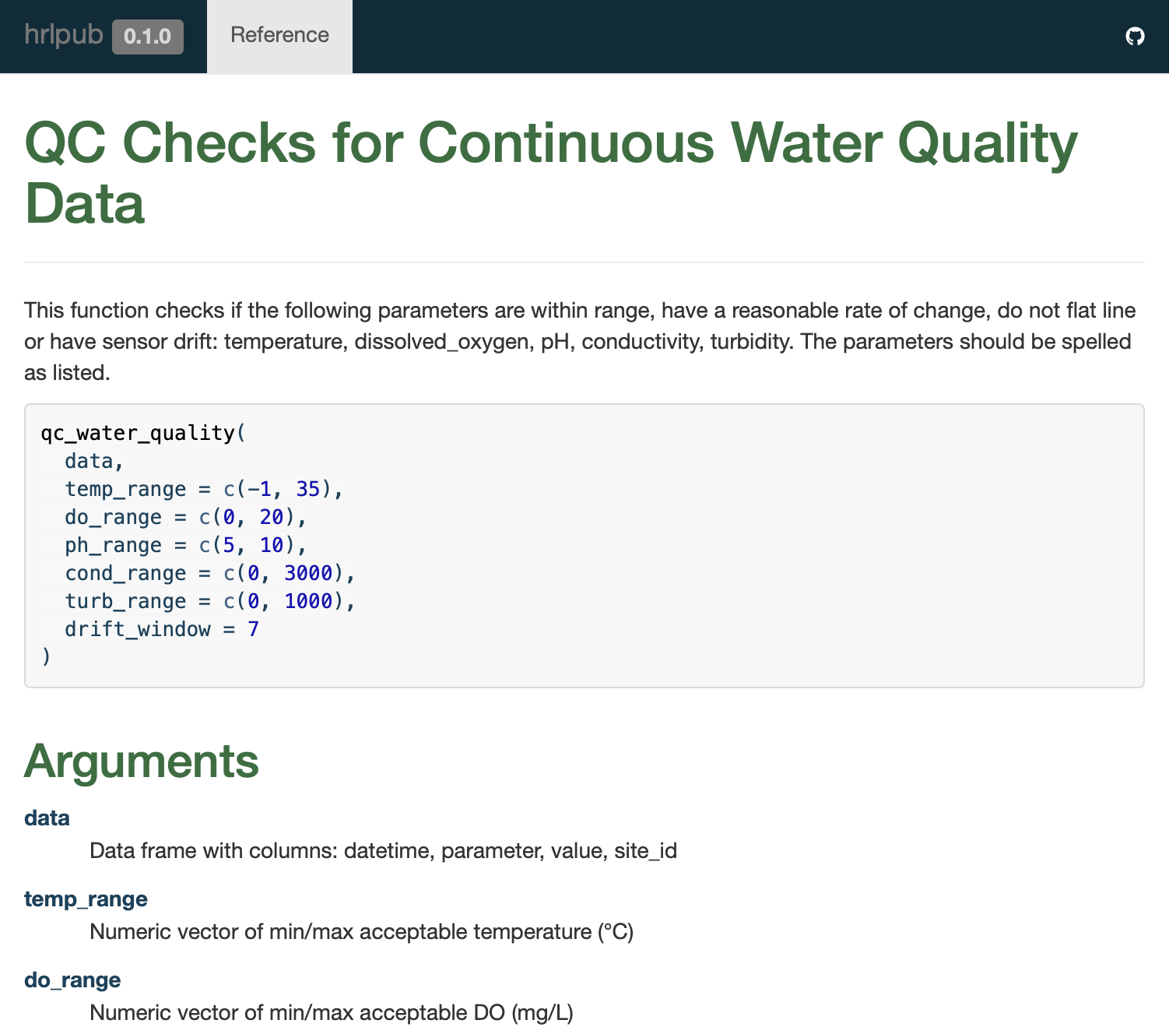
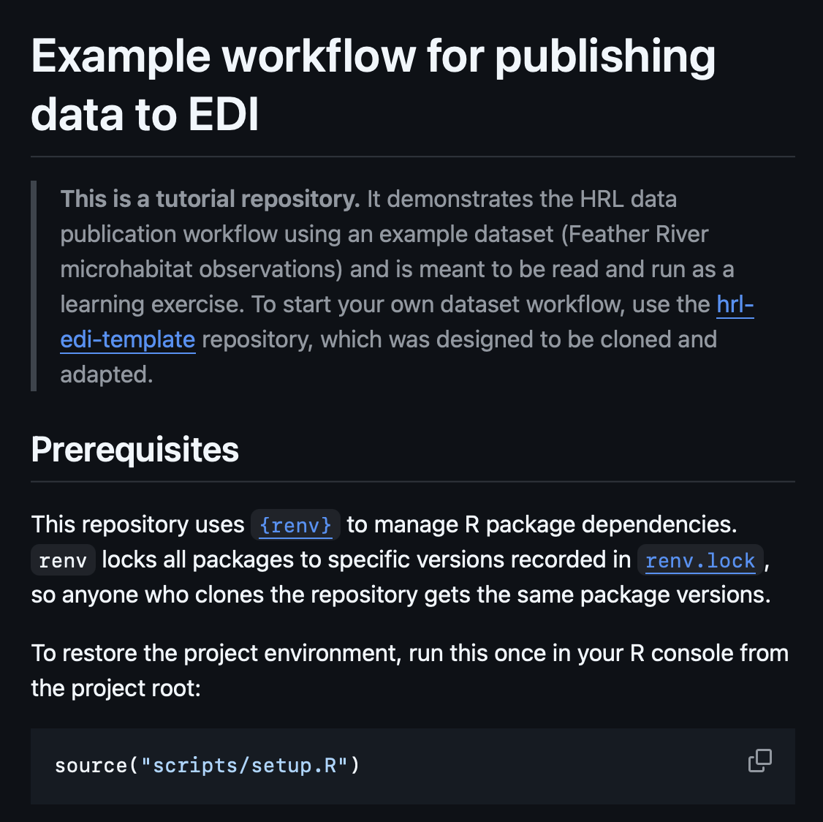

Slide 10
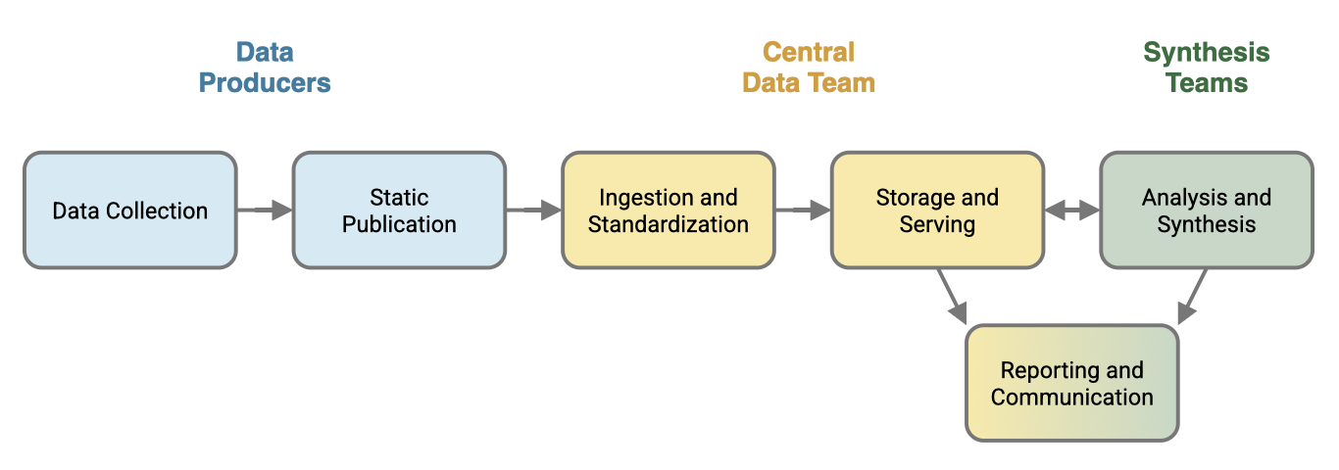
Healthy Rivers and Landscapes Science

Slide 11
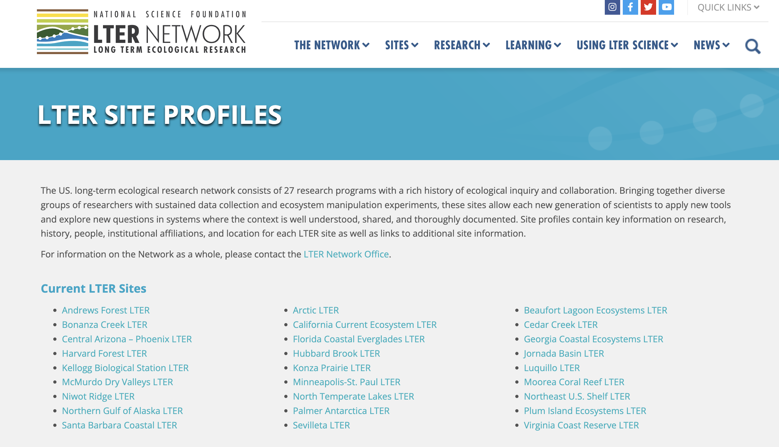
Long-term vision of data stewardship
Long-term ecological research (LTER) networks
We face common issues
Inconsistent data records , method heterogeneity, people phasing on/off projects
Notes:
Fortunately – We in this room – are not the first program to need a long-term vision of data stewardship.
Which means we don’t need to reinvent the wheel.
Similar in concept to Putah Creek, with it’s decades long data legacy,
Are what the National Science Foundation calls “Long Term Ecological Research Sites”.
These are sites that are… in a specific geographic location… and dedicated to studying ecological processes, over decades.
These sites manage data through
a standardized, open-access framework…
that emphasizes rigorous documentation…
and long-term archiving….
to ensure information remains accessible and comparable for future generations of users.
… And they face similar issues
Data could be in legacy formats
There are methodology shifts over time
There could be issues with data heterogeneity
Or there may have been funding interruptions for certain parts of a project.
And so with this new Data Manager position for Putah Creek, what we are trying to do… is what other long-term data networks do to keep their data safe, useable, and increase their value to others.

Slide 12
Receive data
Data processing
Data access, usage
Data Manager
Trainings & group meetings
Data support
Notes:
Like I mentioned earlier.
Data management is a long-term goal.
So it requires constant and consistent data stewardship
…as data continue to flow in.
And the data manager is
…a point-person who is responsible for this.
someone who:
- Builds a system and community around archiving and using these long-term data.
Addresses the risk of data loss from past and future projects.
And in doing these things, saves time for everyone

Slide 13
Data Collectors (QC, Submission)
Training
Data Manager
User Feedback
User Feedback
Central Data Repository
Data Management Structure
Notes:
The broad workflow for data management
Is a continuous feedback loop.
Where data creators and users have a chance to provide feedback and express needs.

Slide 14
Data holders
Contact | Role | Organization | Dataset
Dennis Cocherell | Staff Research Associate; Lab Manager | UC Davis | Salmon adult – carcass & weir total spawning est. Salmon juvenile – rotary screw trap Salmon otolith - natal fish studies Fish species diversity - WFC 120 class field trip Water temperature
Andrea Schrier | Faculty | UC Davis | eDNA for fish and mussels DNA genetic studies DNA - natal fish studies - parent based tagging
Andy Engilis | WFB Museum Curator | UC Davis | Songbird nestbox Avian surveys Bat surveys
Tim Salamunovich | Consultant | TRPA | Fish species diversity - TRPA barge efishing Salmon fry - snorkel counts Salmon redds - visual survey Water temperature
Jay Cuetara | Supervising Water Resources Engineer | SCWA | Water temperature Flow
Max Stevenson | Stream Keeper | SCWA
Christine Parisek | Postdoctoral Scholar; Data Manager | UC Davis
Robert Lusardi | Faculty | UC Davis
Notes:
To reorient you to Putah Creek’s long-term data collection landscape.
Here is a list of Putah Creek’s data holders
On the left we have primary contact names (and these names will naturally change over time)
Next is their role, and at which organization they're from.
And on the right lists the datasets they contribute.

Slide 15
Proposed annual data processing timeline
Contact | Organization | Dataset | Winter | Spring | Summer | Fall
Dennis Cocherell | UC Davis | Salmon adult – carcass & weir total spawning est. Salmon juvenile – rotary screw trap Salmon otolith – natal fish studies Fish species diversity – WFC 120 class field trip Water temperature | ~ January Annual Report Deadline | April 1 Give Data Manager data access, with update on QC status | August 1 Submit final QC’d data from last Annual Report to Data Manger
Andrea Schrier | UC Davis | eDNA for fish and mussels Genetic studies Natal fish DNA studies (parent-based tagging )
Andy Engilis | UC Davis | Songbird nestbox Avian surveys Bat surveys
Tim Salamunovich | TRPA | Fish species diversity – TRPA barge e-fishing Salmon fry – snorkel counts Salmon redds – visual survey Water temperature
Jay Cuetara | SCWA | Water temperature Flow
Max Stevenson | SCWA
Christine Parisek | UC Davis |  |  | Update, Apr 15 |  | Data to EDI, Dec 15
Robert Lusardi | UC Davis |  |  |  |  | Approval, Nov 15
Notes:
[explain table headers]
This new section on the RIGHT is a proposed annual calendar
And we do want everyone’s buy in and input on the schedule
I’ve already met with most of the folks on this list, and this currently reflects my most updated suggestion
But the idea is that cyclically everyone will have certain benchmarks that match their role in the data’s life cycle.
And... This helps to create... a community of people ...who are all working toward a common goal
… and also keeps some organization in the data governance process.

Slide 16
Forecasted budget for data management
Average Annual Cost
Direct (50% FTE; salary + benefits) | $60,000 – $90,000
Other | $5,000
Total | $65,000 – $95,000
Notes:
Now we know the tasks that need to be done,
And what we want to do to have good data management
But how do we formalize the process of managing our long-term data?
[Pass this now to Max...]

Slide 17
How to support data management?
 | Entity | Present (Annual Cost) | Future ? (Annual Cost)
Data Creators | UC Davis, Dennis Cocherell
 | UC Davis, Andrea Schrier
 | UC Davis, Andy Engilis
 | TRPA, Tim Salamunovich
 | SCWA, Max Stevenson
 | UC Davis, Christine Parisek
 | UC Davis, Robert Lusardi
Data Users | City of Davis |  | $4,333 – $6,333
 | City of Fairfield |  | $4,333 – $6,333
 | City of Suisun |  | $4,333 – $6,333
 | City of Vacaville |  | $4,333 – $6,333
 | City of Vallejo |  | $4,333 – $6,333
 | City of Winters |  | $4,333 – $6,333
 | County of Solano |  | $4,333 – $6,333
 | County of Yolo |  | $4,333 – $6,333
 | Riparian Landowners of Solano |  | $4,333 – $6,333
 | Riparian Landowners of Yolo |  | $4,333 – $6,333
 | Maine Prairie Water District |  | $4,333 – $6,333
 | Solano County Water Agency | ~ $67,000.00 | $4,333 – $6,333
 | Solano Irrigation District |  | $4,333 – $6,333
 | Putah Creek Council |  | $4,333 – $6,333
 | University of California, Davis |  | $4,333 – $6,333

Slide 18
Closing thoughts
Data governance is key to understanding what’s happening in our watershed
Without data continuity, we can measure fish – but still not understand the system
Putah Creek is more than a monitoring site, it’s a long-term ecological experiment in restoration and flow management
Notes:
[ ]
I’m a freshwater community ecologist by training
I care about
how species interact,
how ecosystems respond to change over time,
and how to maximize the use of long-term data so it can be used in data synthesis .
Without continuity and management of our data,
we can measure fish — but still might not understand the system.
Putah Creek is more than a monitoring site.
It is a living lab.
It’s a long-term ecological experiment in restoration and flow management. …

Slide 19
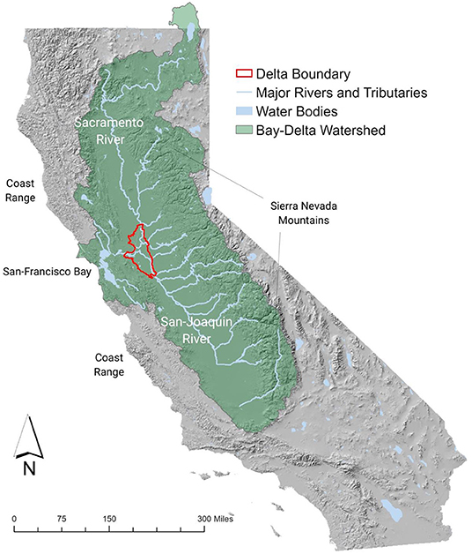
Closing thoughts
Open data and open science are the foundation of collaborative, whole-watershed adaptive management
Image credit: Alejo Kraus-Polk

Slide 20
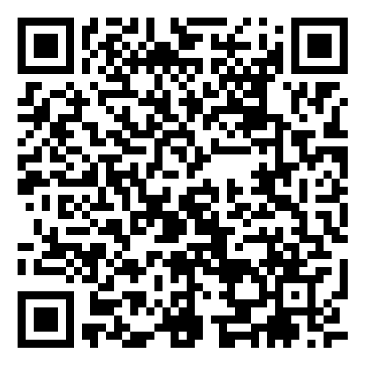
Thank You!
For more info on HRL science:
caparisek.github.io caparisek@ucdavis.edu

Slide 24
