Slide 1
4th Annual Putah Creek Long-term Monitoring Data Summit
April 15, 2026
International House, across Russell Blvd from UC Davis

Slide 2
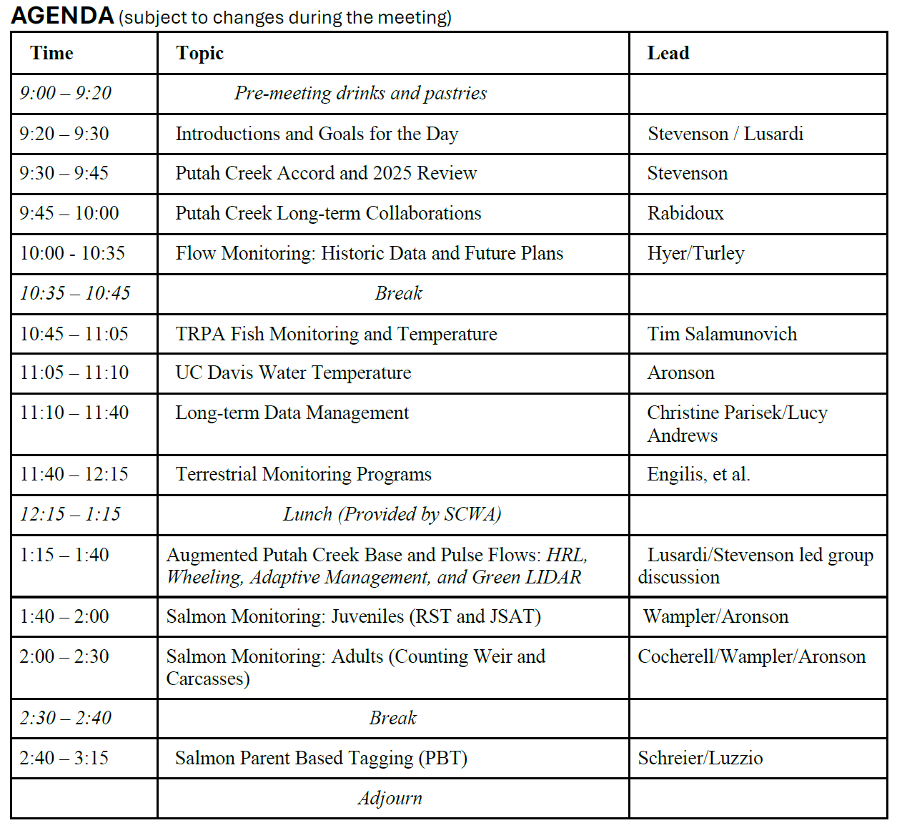
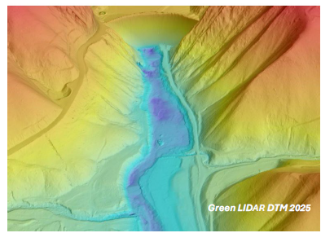
AGENDA
4th Annual Putah Creek
Long-term Monitoring
Data Summit
Apr 15, 2026

Slide 3
Introductions and Data Summit Goals
Coordinate Diverse Monitoring Programs
Develop Long-term Approaches (Foundational Monitoring)

Slide 4
Long-Term Data Sets
Fish Species Diversity (efishing) 34 years
Water Temperature 34 years
Bird NestBox Highway 24 years
Flow 65 years
Geomorphology 110 years
DWR Yolo Bypass Fish Mon. 22 years
Others: plants, bats, birds, BMI, PBT, otolith microchemistry

Slide 5
Three Types of Monitoring Data
Process Control real-time
Research Project a few years
Foundational in-perpituity

Slide 6
Three Types of Monitoring Data
Process Control real-time
Research Project a few years
Foundational in-perpetuity

Slide 7
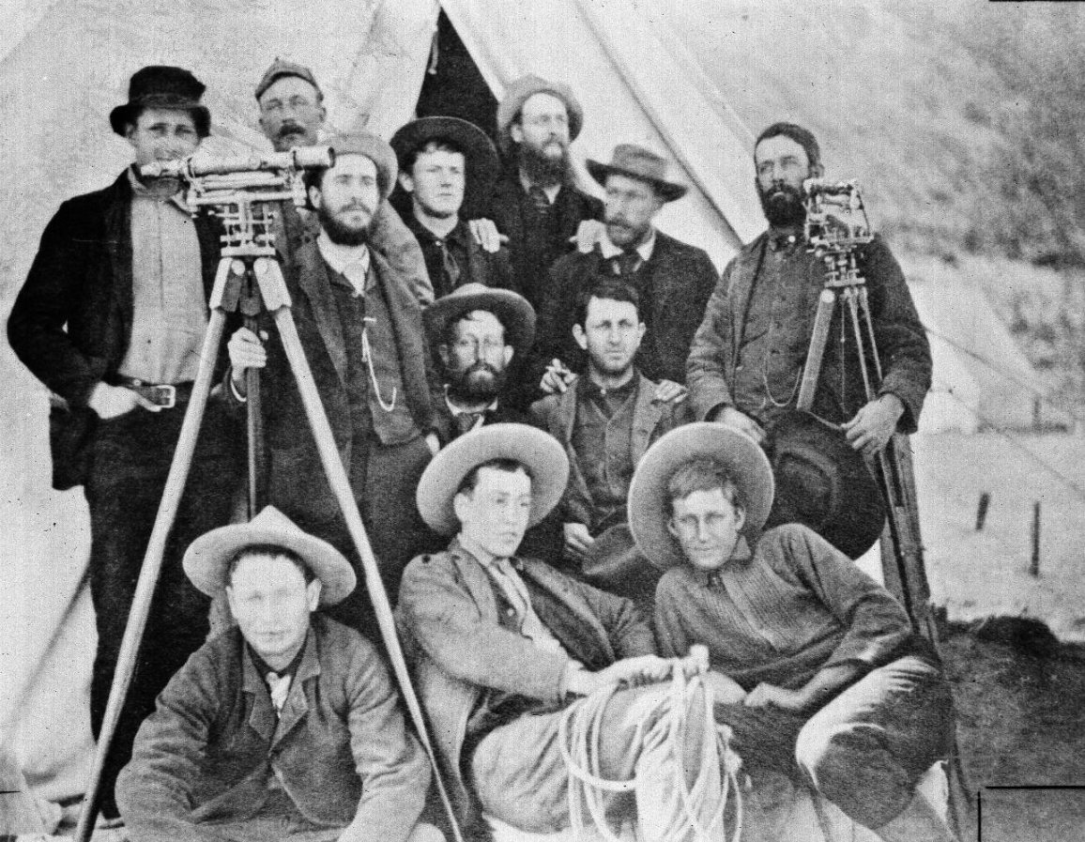
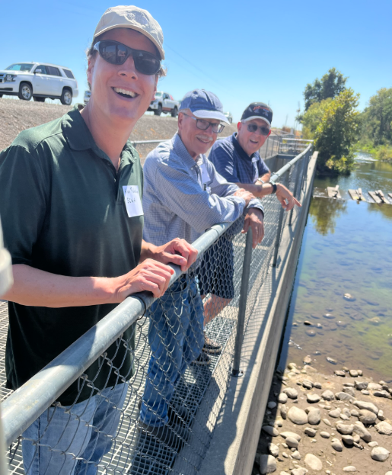
USGS 1889

Slide 8
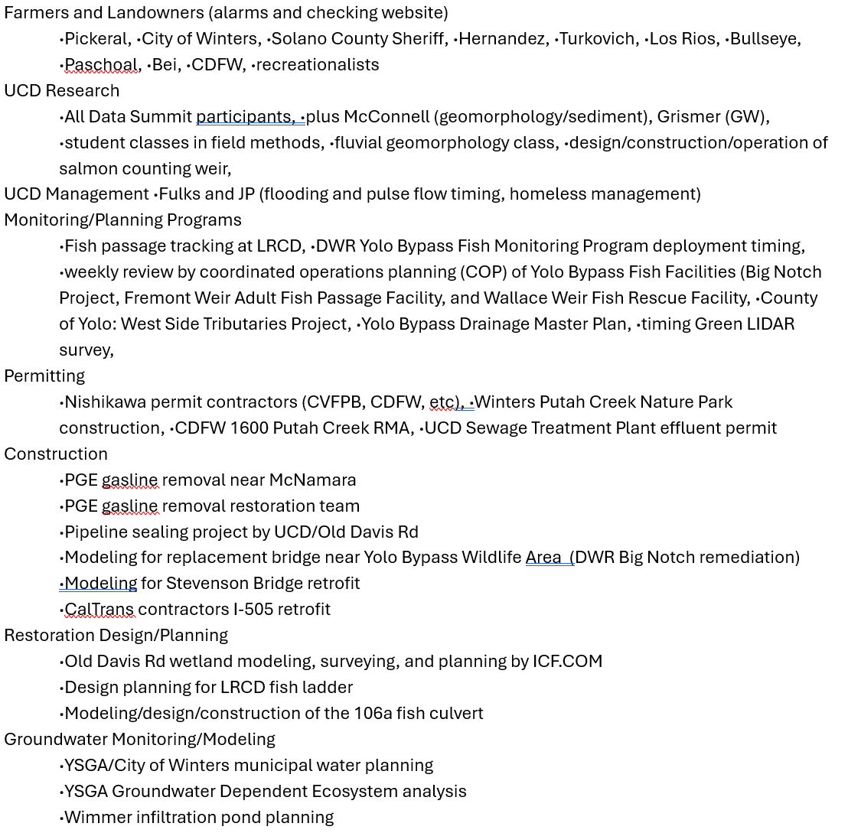
SCWA
Flow and Stage Data
40+ data requests!

Slide 9
Putah Creek Accord Background
1991 - Creek went dry
1992-1999 Lawsuit
2000 – Putah Creek Accord, additional flows and Streamkeeper
Lower Putah Creek Coordinating Committee oversees the Streamkeeper

Slide 10
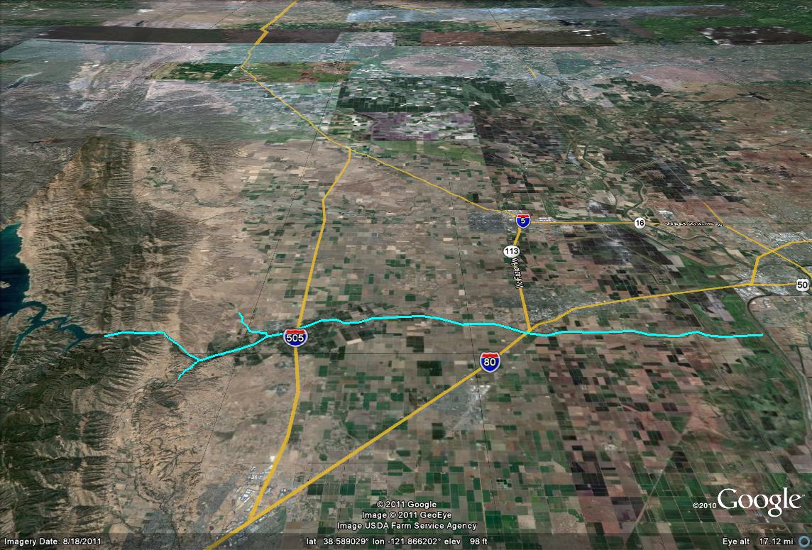
Accord Flow Compliance Locations (2000)
Davis
Winters
I-80
Toe Drain
Putah Diversion Dam

Slide 11
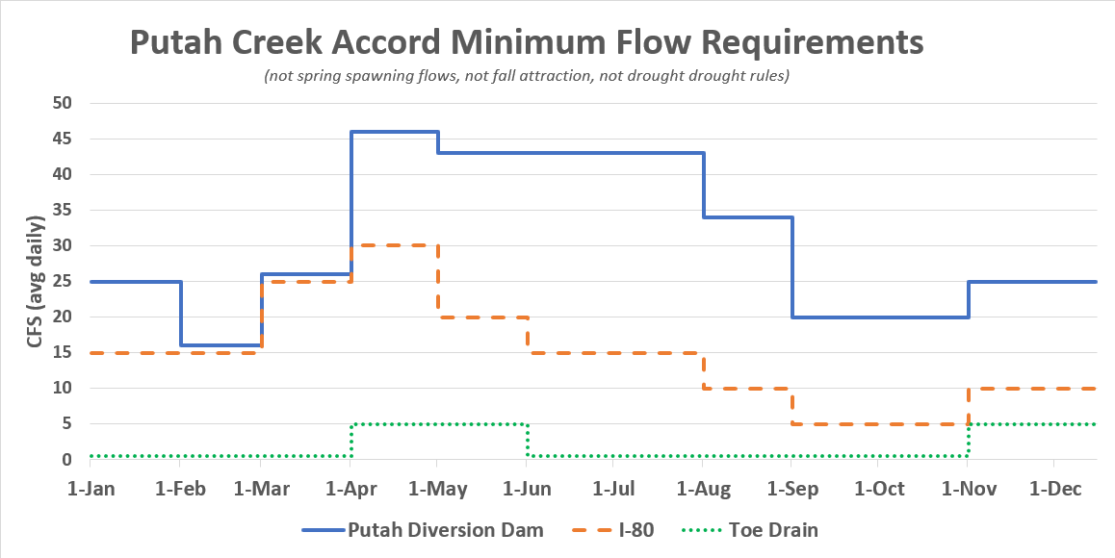
Accord Exhibit A - Solano Project Releases and Instream Flows for Lower Putah Creek
Notes:
Average losses i-80 to Mace 10 cfs in dry years
Average losses Mace to Toe Drain 5 cfs in dry years
Total losses 15 cfs below i-80
Expected flow at LRCD without diversions

Slide 12
2025 Review
Record Salmon Run (Adults)
400 tons of gravel
Green LIDAR Survey
PCWM 11 flowmeters – Pumper Maps
Low Dissolved Oxygen (30 adult Chinook)
Wallace Weir PBT – lost Putah Creek salmon?
Homeless increasing
Lunar Lander Legs for fish ladder
Six current restoration projects
Nishikawa
IDR
LRCD
106a
Old Davis Rd
Stevenson Bridge
Accord Archive to UCD Special Collections
Bridge Group fry releases

Slide 13
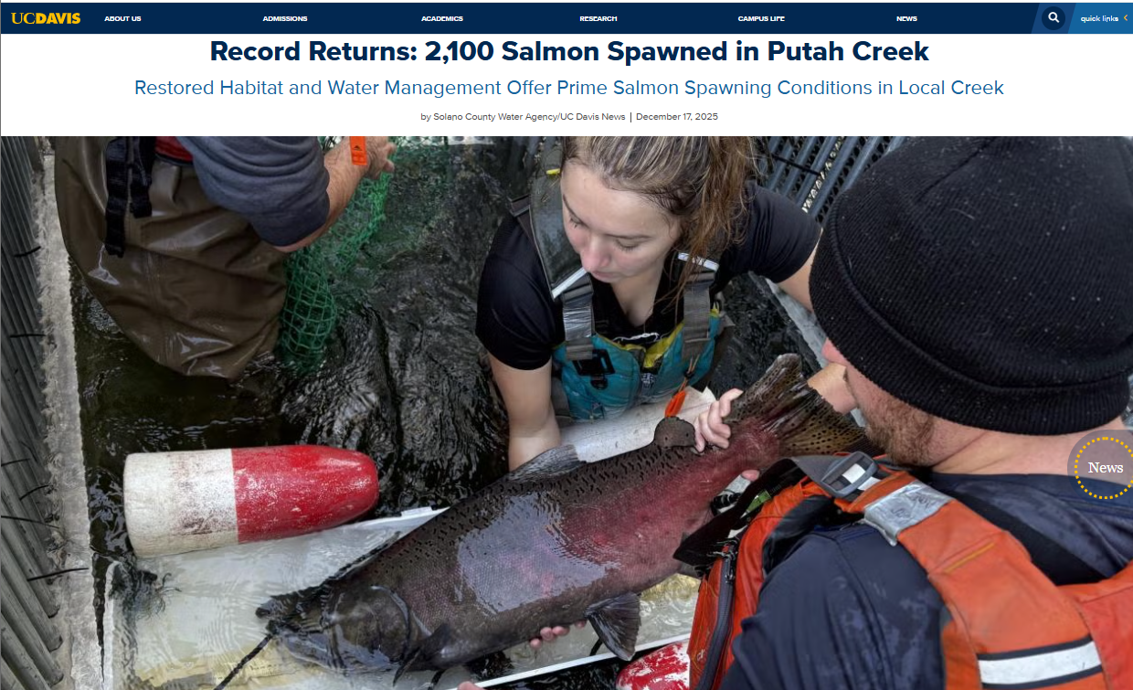

Slide 14
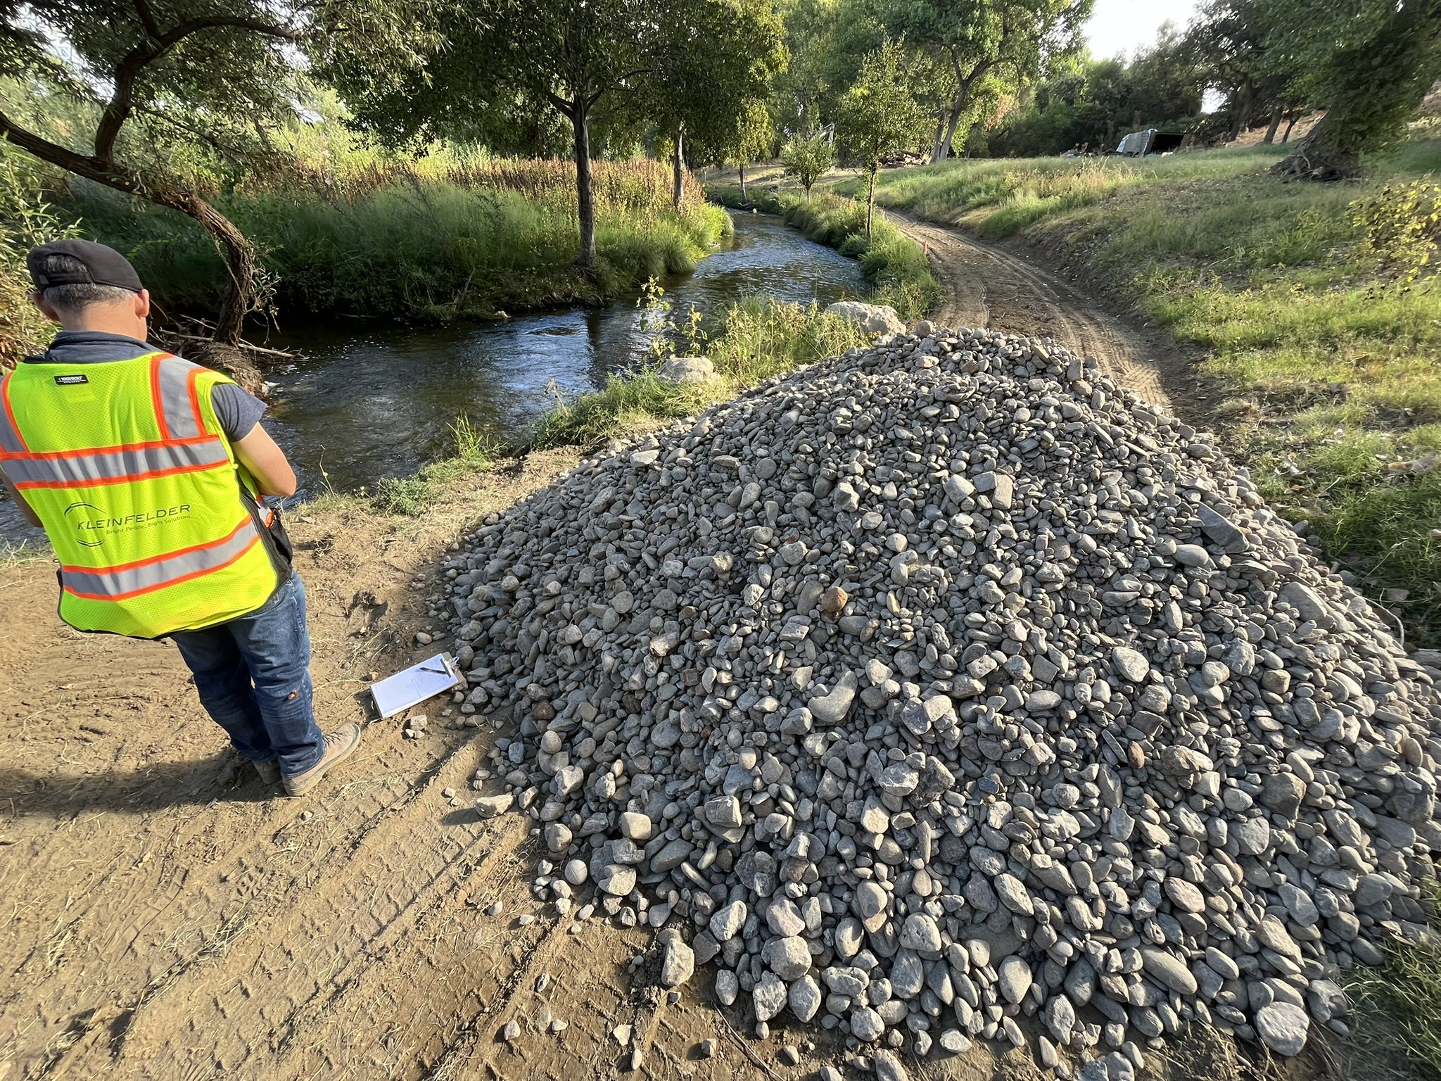

Slide 16
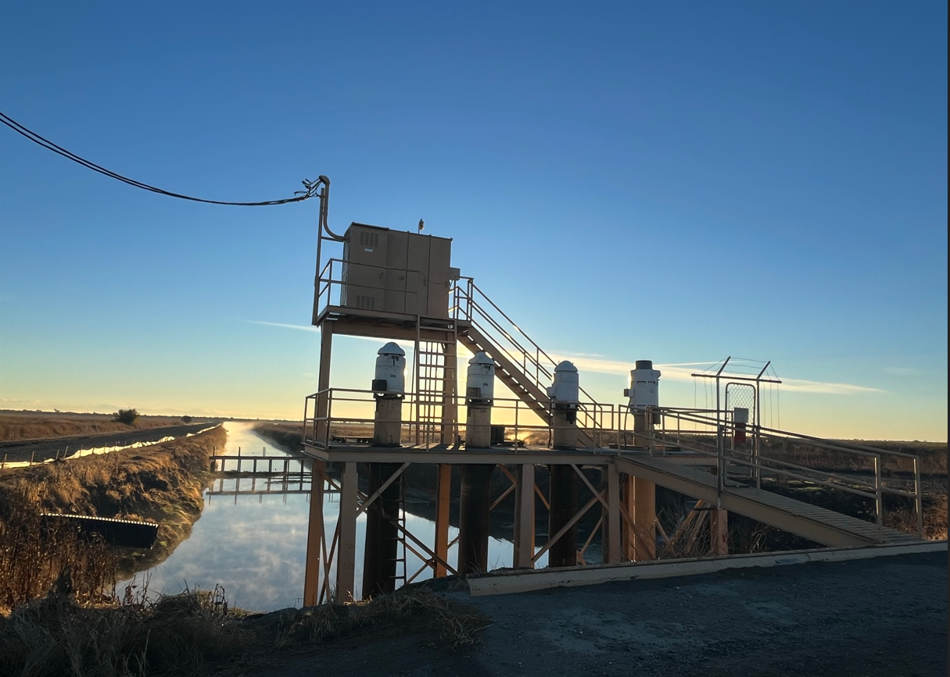
Wheeling and
Flowmeters

Slide 17
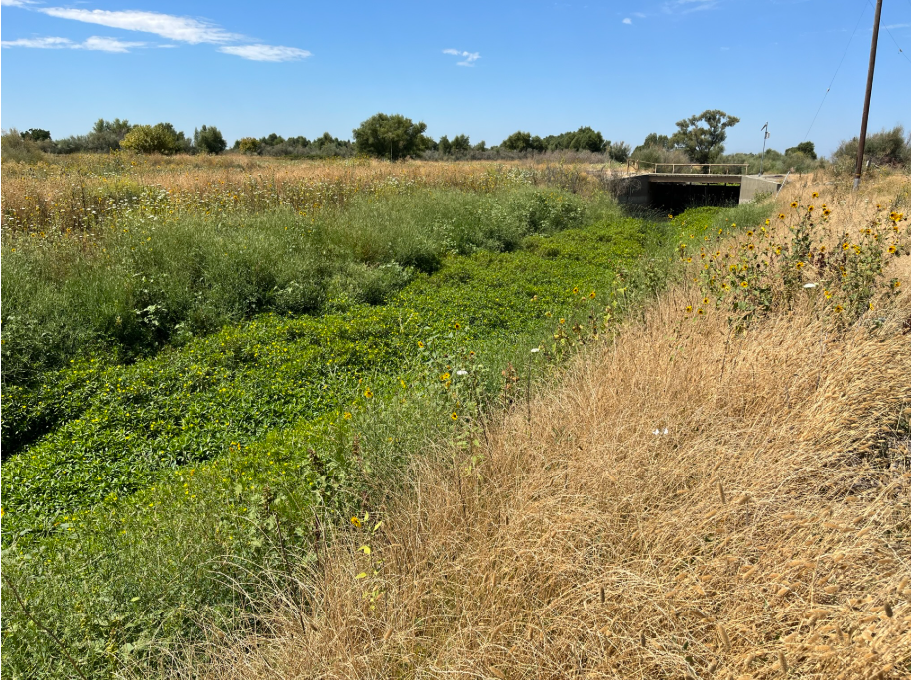
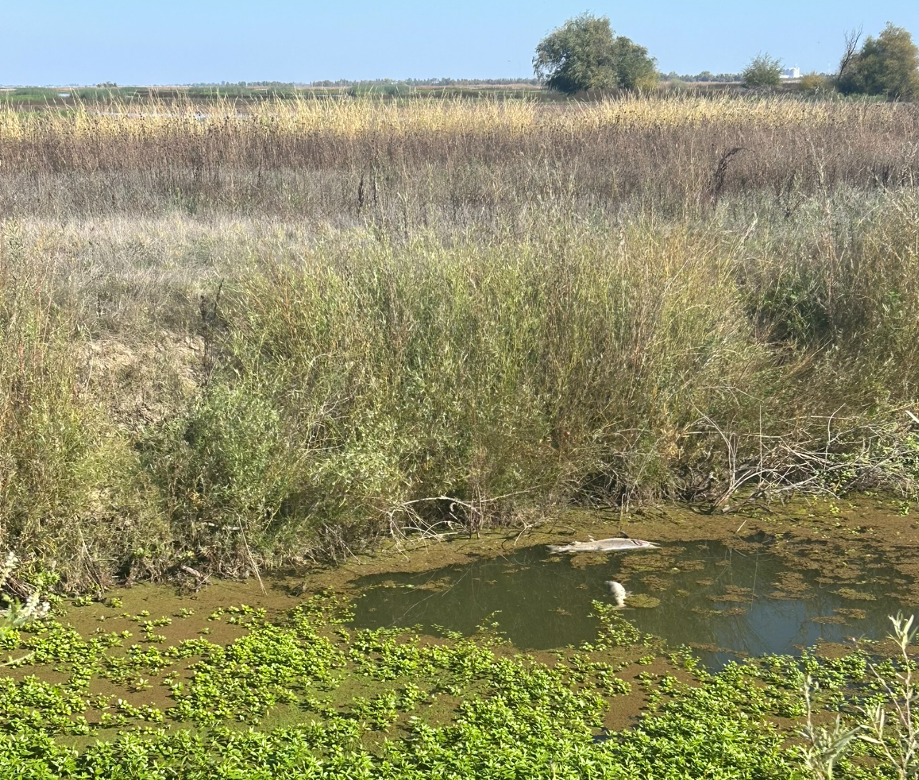
Low Dissolved Oxygen
30 dead adult Chinook Oct 23, 2025

Slide 18
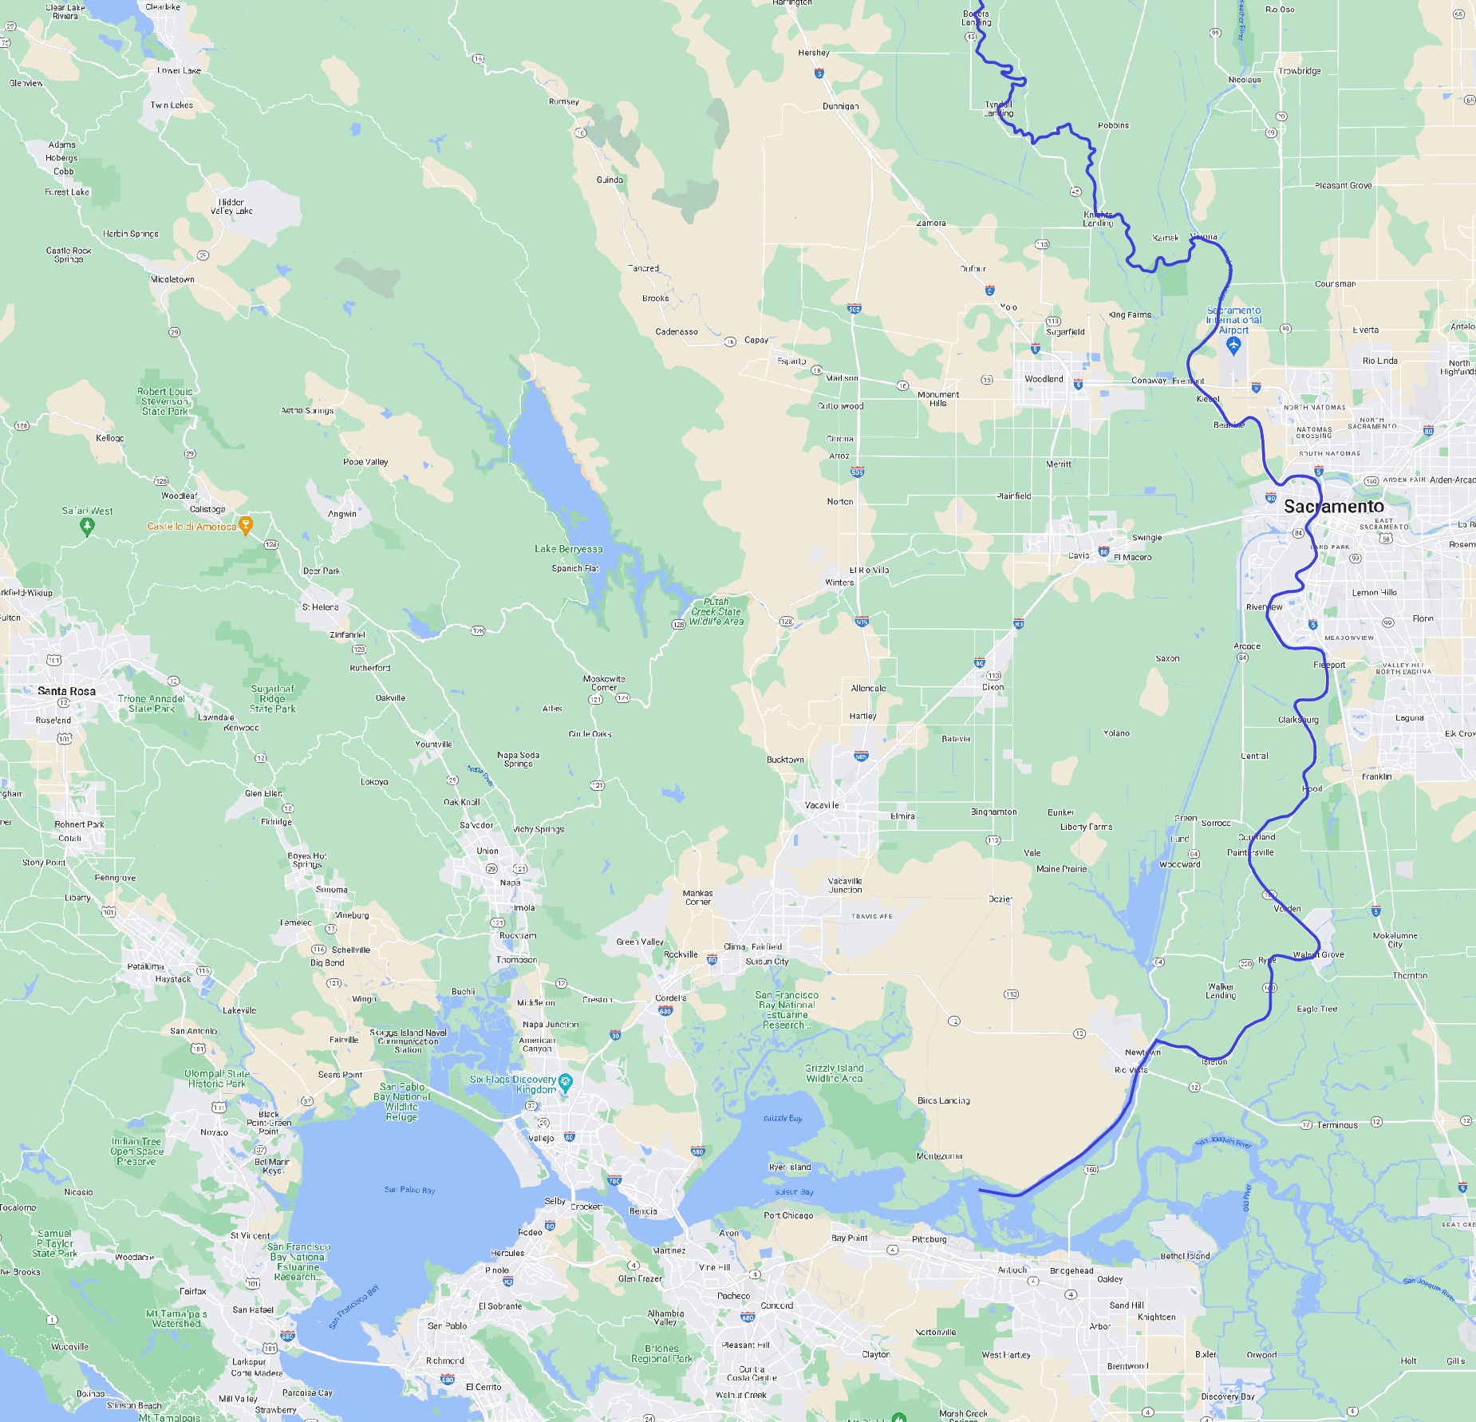

Wallace Weir Fish Rescue Facility Historic Samples PBT
Colusa Basin Drain
Wallace Weir
Ridge Cut
Toe Drain
Davis
Winters
Putah Creek
Toe Drain
Fairfield
Rio Vista
SF Bay

Slide 19
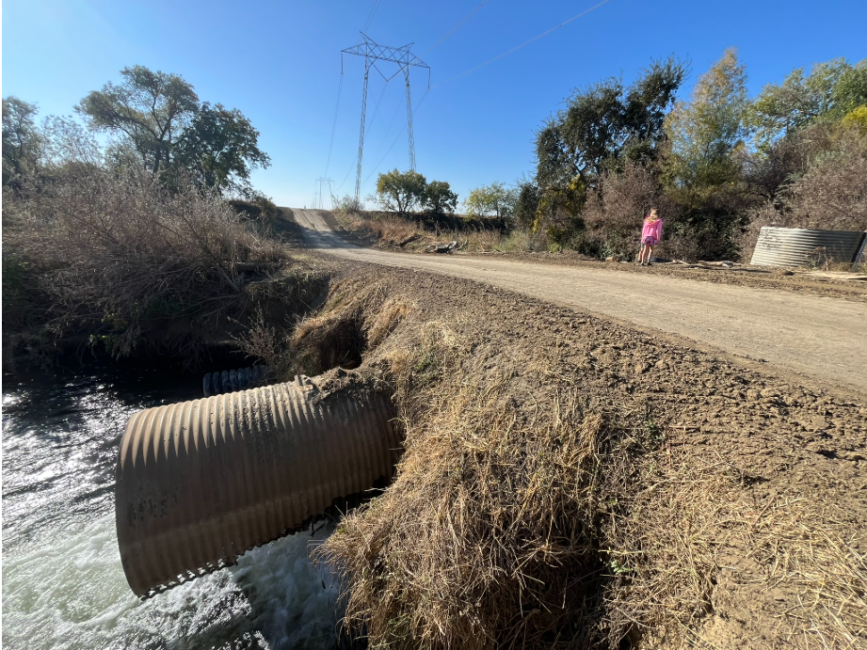
County Road 106a Crossing

Slide 20
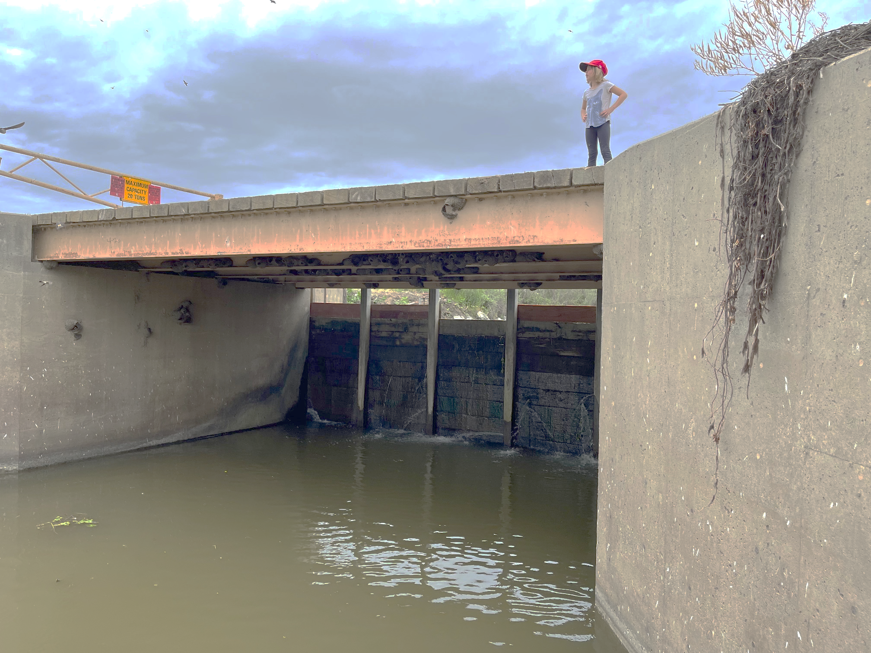
Los Rios Check Dam

Slide 21
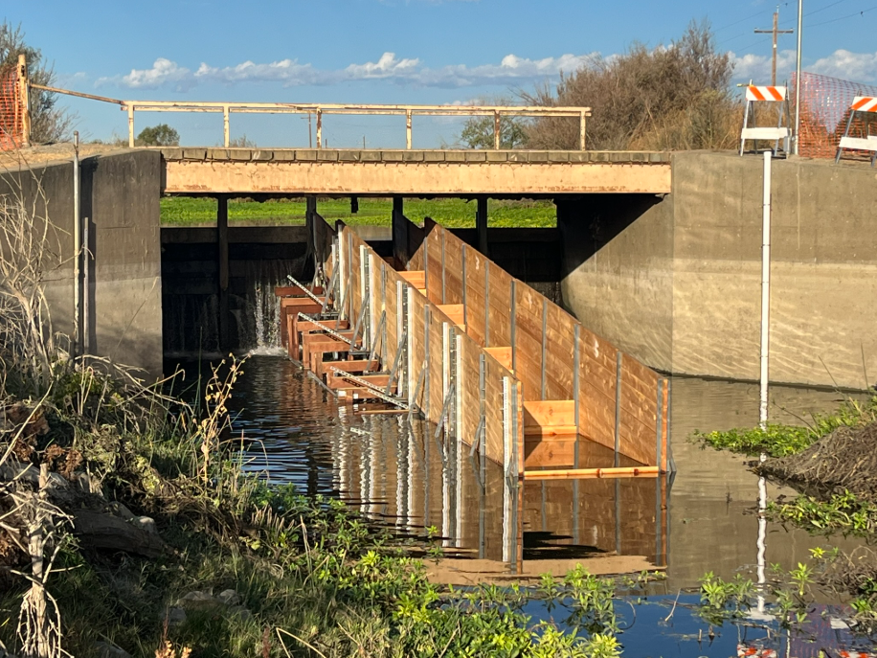
SCWA Field Team Built a Wooden Fish Ladder 2023

Slide 22
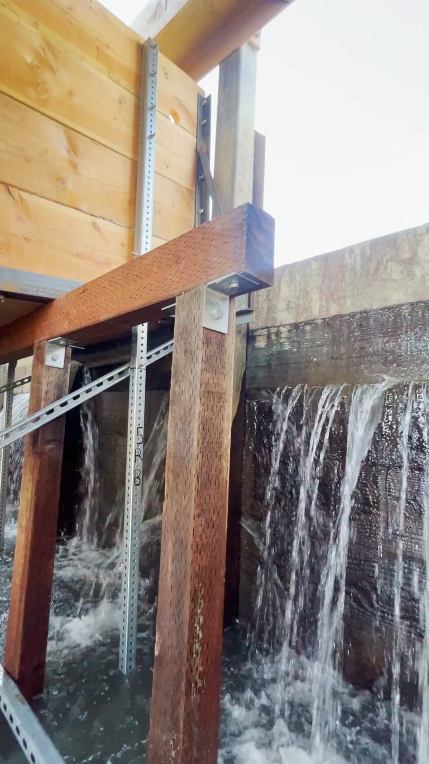

Slide 23
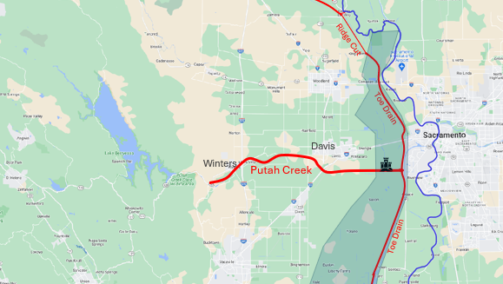
Six current restoration projects
IDR
Graffiti Bridge
Nishikawa
Old Davis Rd Wetlands
106a fish passage
Los Rios Check Dam fish passage
b
c
a
d
e
f

Slide 24
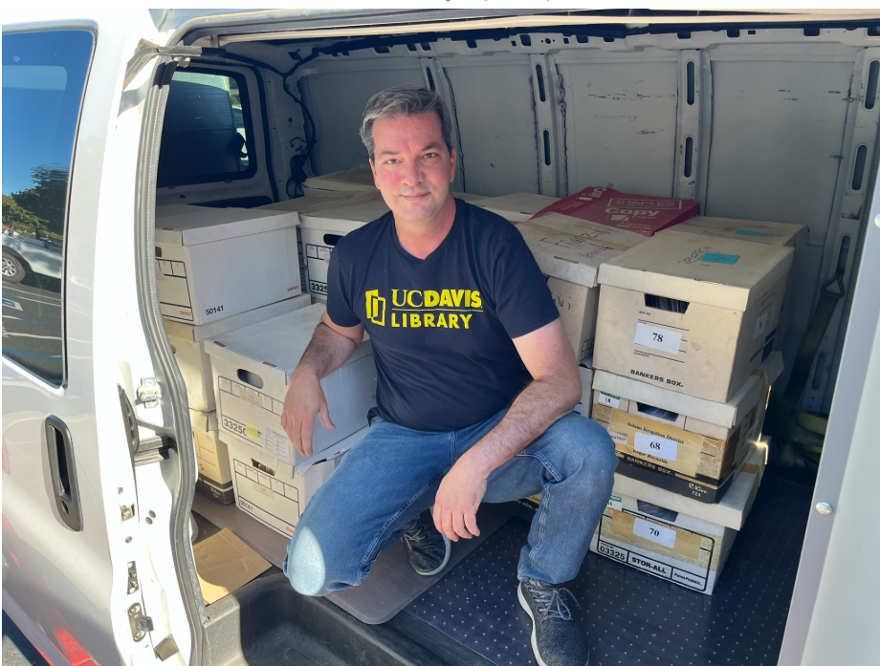
Both SCWA and
Putah Creek Council
Legal archives are
in UCD Library
Special Collections

Slide 25
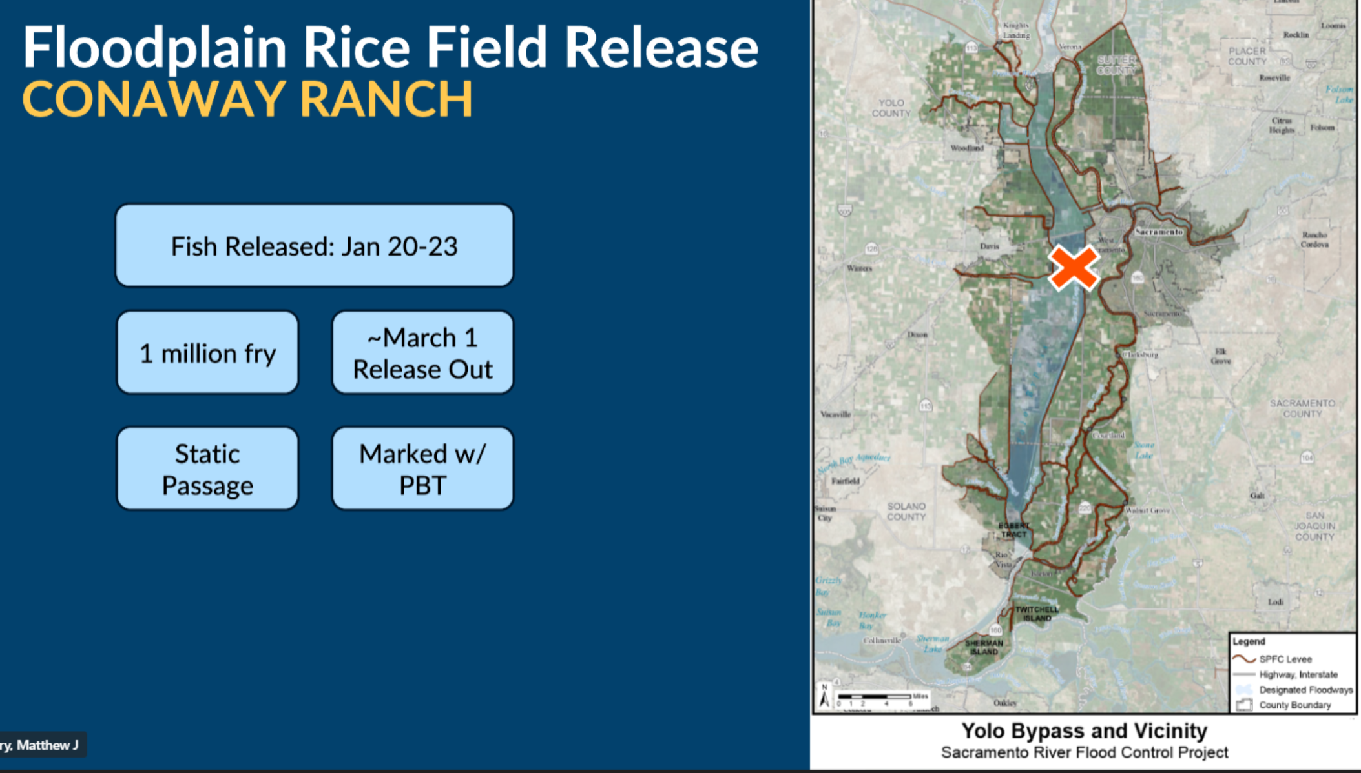

Slide 26
End of 2025 Year in Review

Slide 28
Putah Creek Salmon Management Priorities (from Draft HRL Putah Creek Tributary Science Plan)
Barriers to Fish Passage
High Juvenile Predation
Lack of Spawning Gravel
High Water Temp and Low Dissolved Oxygen
Pulse Flow Attraction Timing and Magnitude
Notes:
Downstream of I-80, flow experiments

Slide 29
CONCEPTS
Charismatic megafauna
Long-Term Monitoring vs Research
Ag Drains as habitat – Working landscapes
Focus Downstream

Slide 33
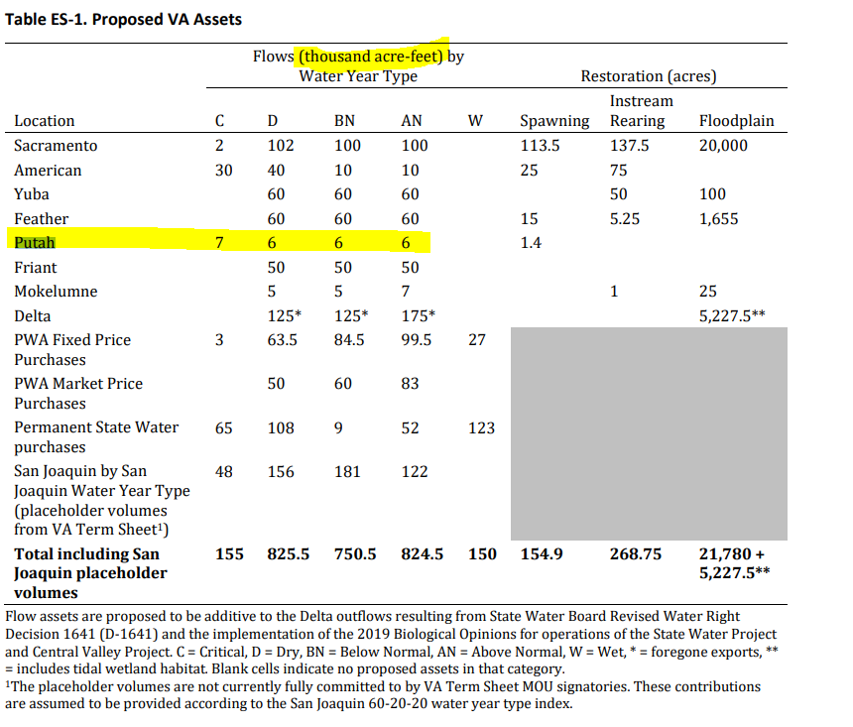
Water HRL 10-30 cfs for Putah
Unimpaired flows would be 500-800 cfs

Slide 34
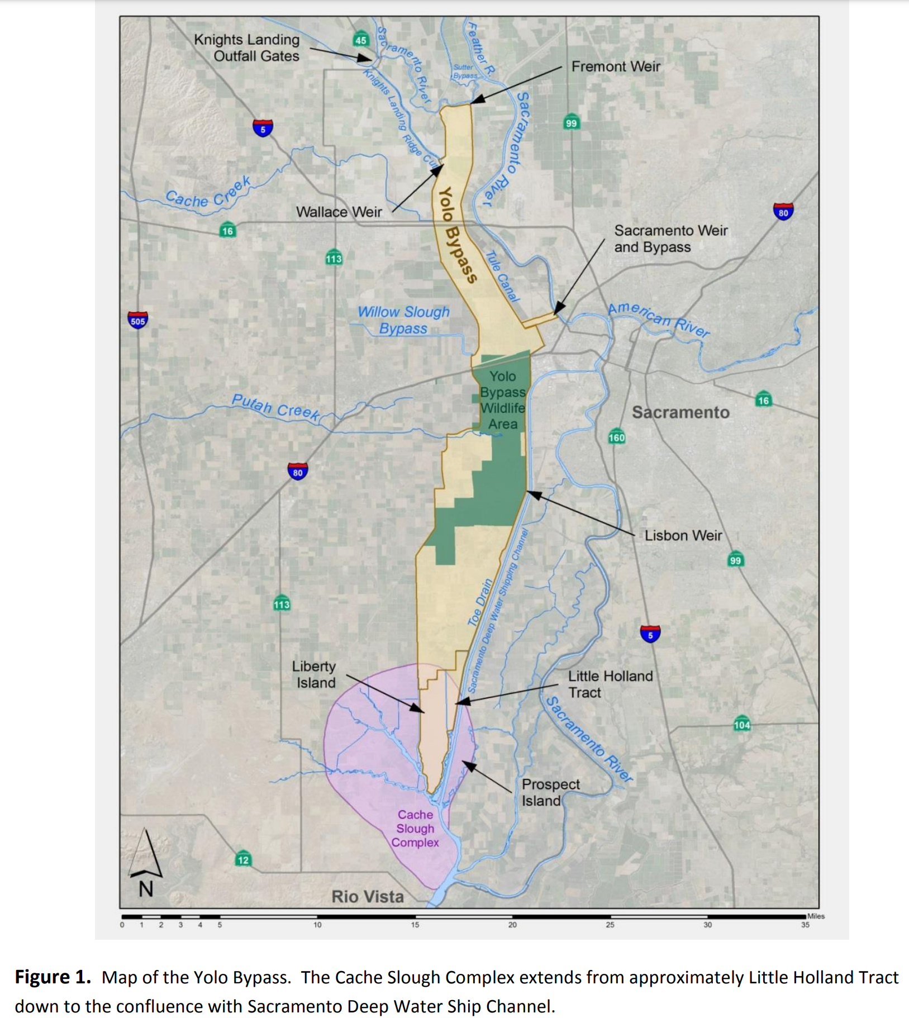
Notes:
file:///C:/Users/mstevenson/Downloads/CBD-Wallace%20Weir_Trapping%20and%20Relocation%20Efforts_2013-14_Final_8-1-2016%20(2).pdf

Slide 35
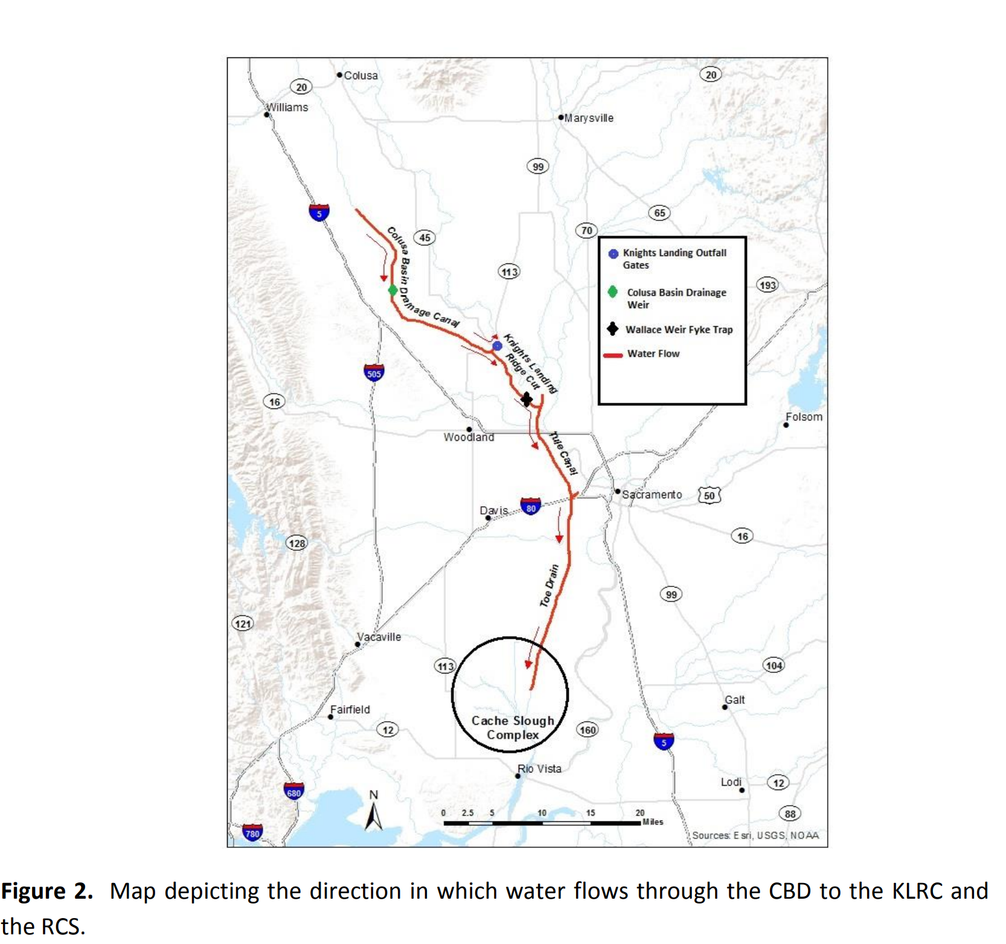
Notes:
file:///C:/Users/mstevenson/Downloads/CBD-Wallace%20Weir_Trapping%20and%20Relocation%20Efforts_2013-14_Final_8-1-2016%20(2).pdf

Slide 36
NEEDS FOR RESEARCH/Projects
Live car below LRCD
Pulse flow timing and size analysis
Bibliography Update
JPE – Juv Production Estimates

Slide 37
Colusa Basin Drain
Ridge Cut
Ridge Cut
Toe Drain
Davis
Winters
Putah Creek
Yolo Bypass
Lisbon Weir
Toe Drain
Fairfield
Rio Vista
SF Bay

Slide 38
Sac River Path
Colusa Basin Drain
Parallel Floodplain Path
Wallace Weir
Davis
Winters
Putah Creek
Los Rios Check Dam
Lisbon Weir on Toe Drain
Putah Creek Salmon Path to/from Ocean
Toe Drain
Fairfield
Rio Vista
SF Bay

Slide 39
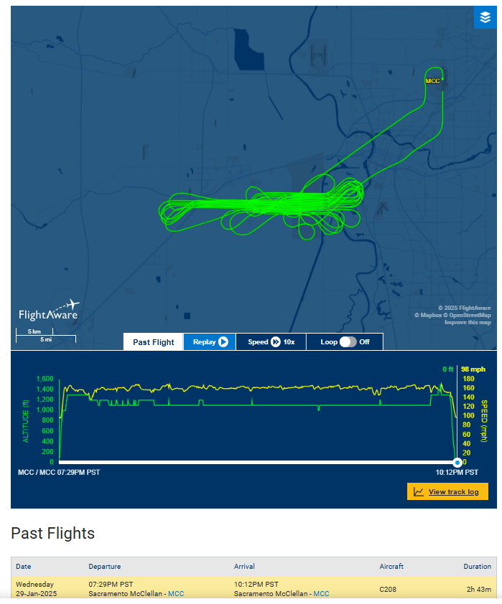

Slide 40
Agenda Item #6 Historic Fall Pulse Flow Timing and Salmon Attraction
Fall Pulse Main Variables
Timing (calendar)
Salmon arrival
Tidal cycle
Length (number of days)
Flow/size (cfs)

Slide 41
Improving Pulse Flow Effectiveness
Historic pulse flows timing and size
Putah Creek salmon run numbers
Mok salmon arrival timing and numbers
Wallace Weir arrivals and flow
Lis Weir flows, net tidal flow and monthly cycles
2023
2024

Slide 42
Ideas to Address about Fall Pulse Flows
Coordinate with tides?
Length (number of days)
Magnitude (peak and avg cfs)
Calendar timing of pulse
Lookout Slough influence
Operation of flap gates at Lisbon Weir
Does positive net tidal flow at LIS make a difference?
Did salmon arrive at Wallace Weir before 2014 (FRF built in 2016)?
September Outflow – Ag Practice Pulse

Slide 43
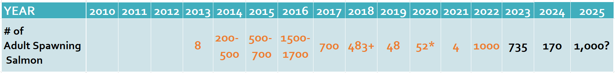
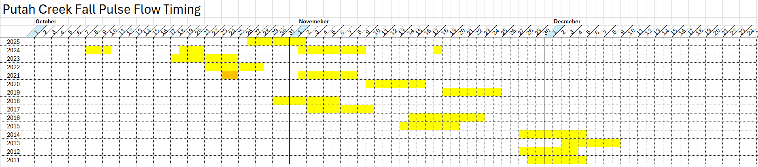
Recent Salmon Numbers
Carcass Surveys
Carcass Surveys
Counting Weir

Slide 45
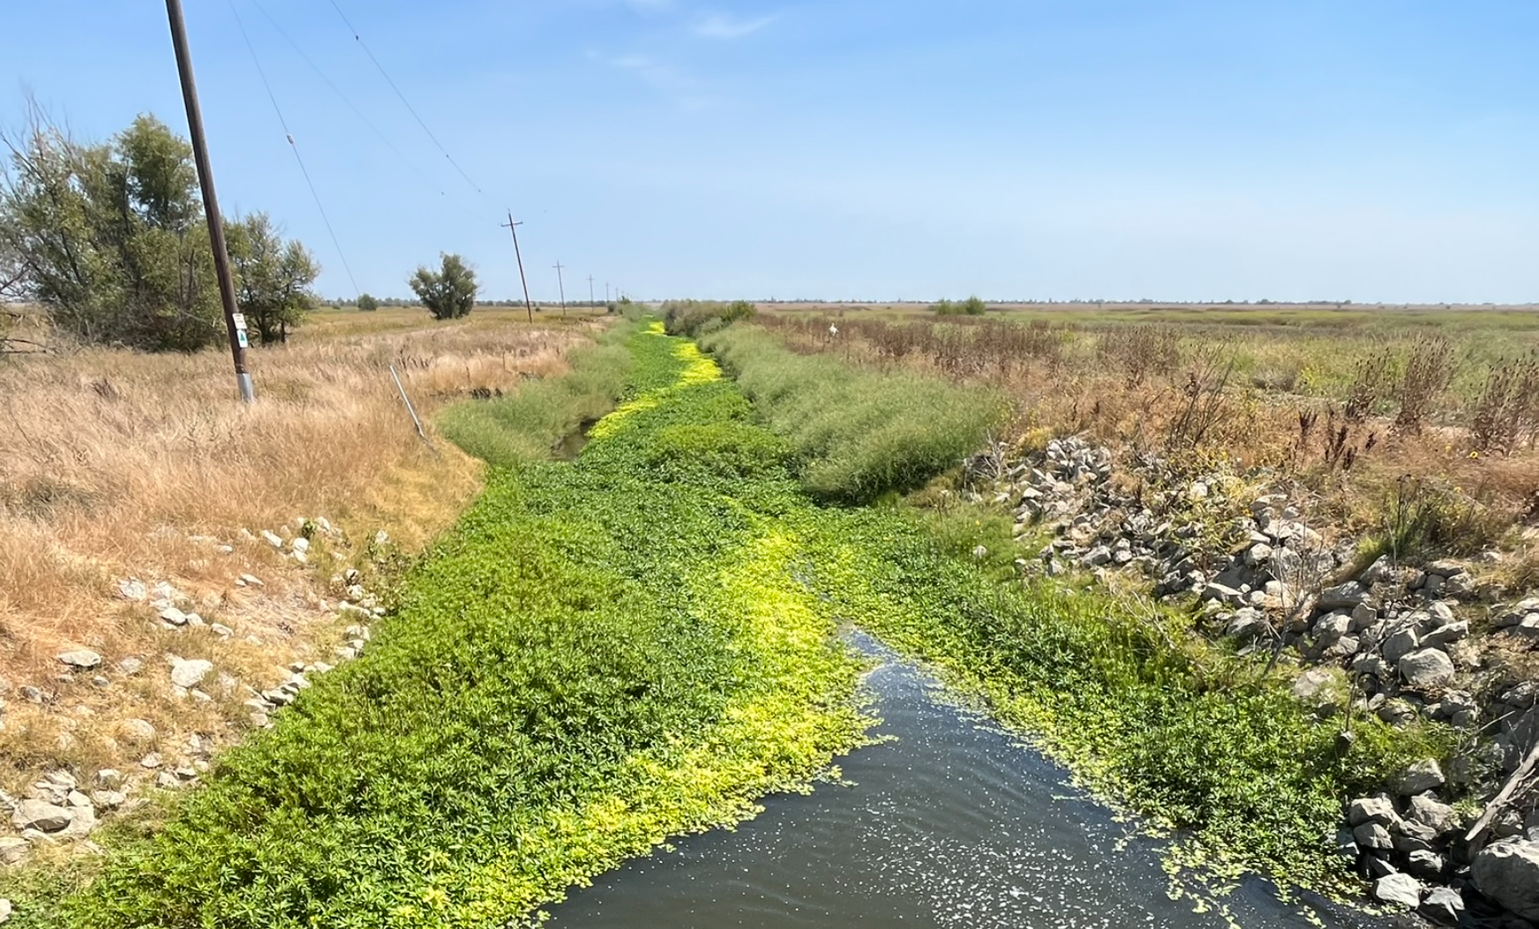
Putah Creek below Check Dam blocked by Aquatic Weeds
Aug 2025

Slide 46
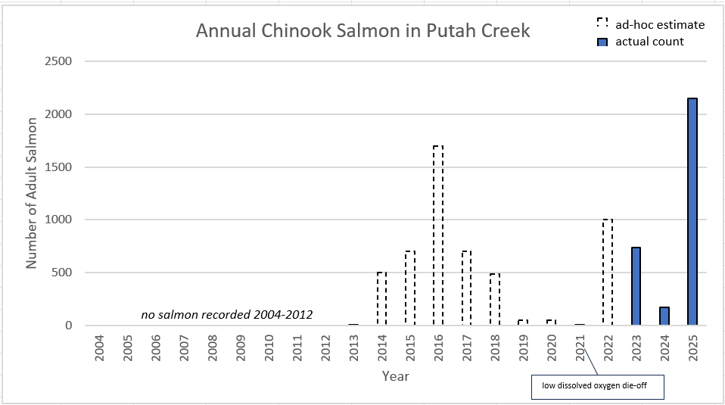

Slide 47
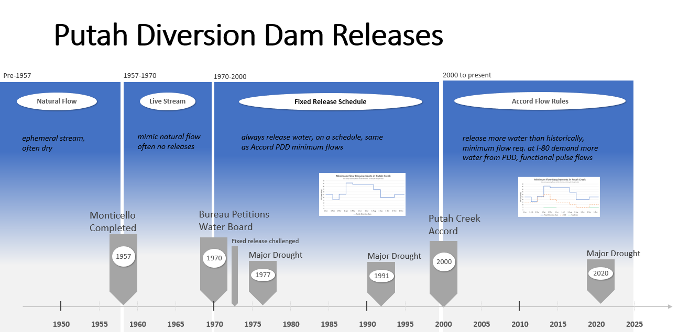

Slide 48
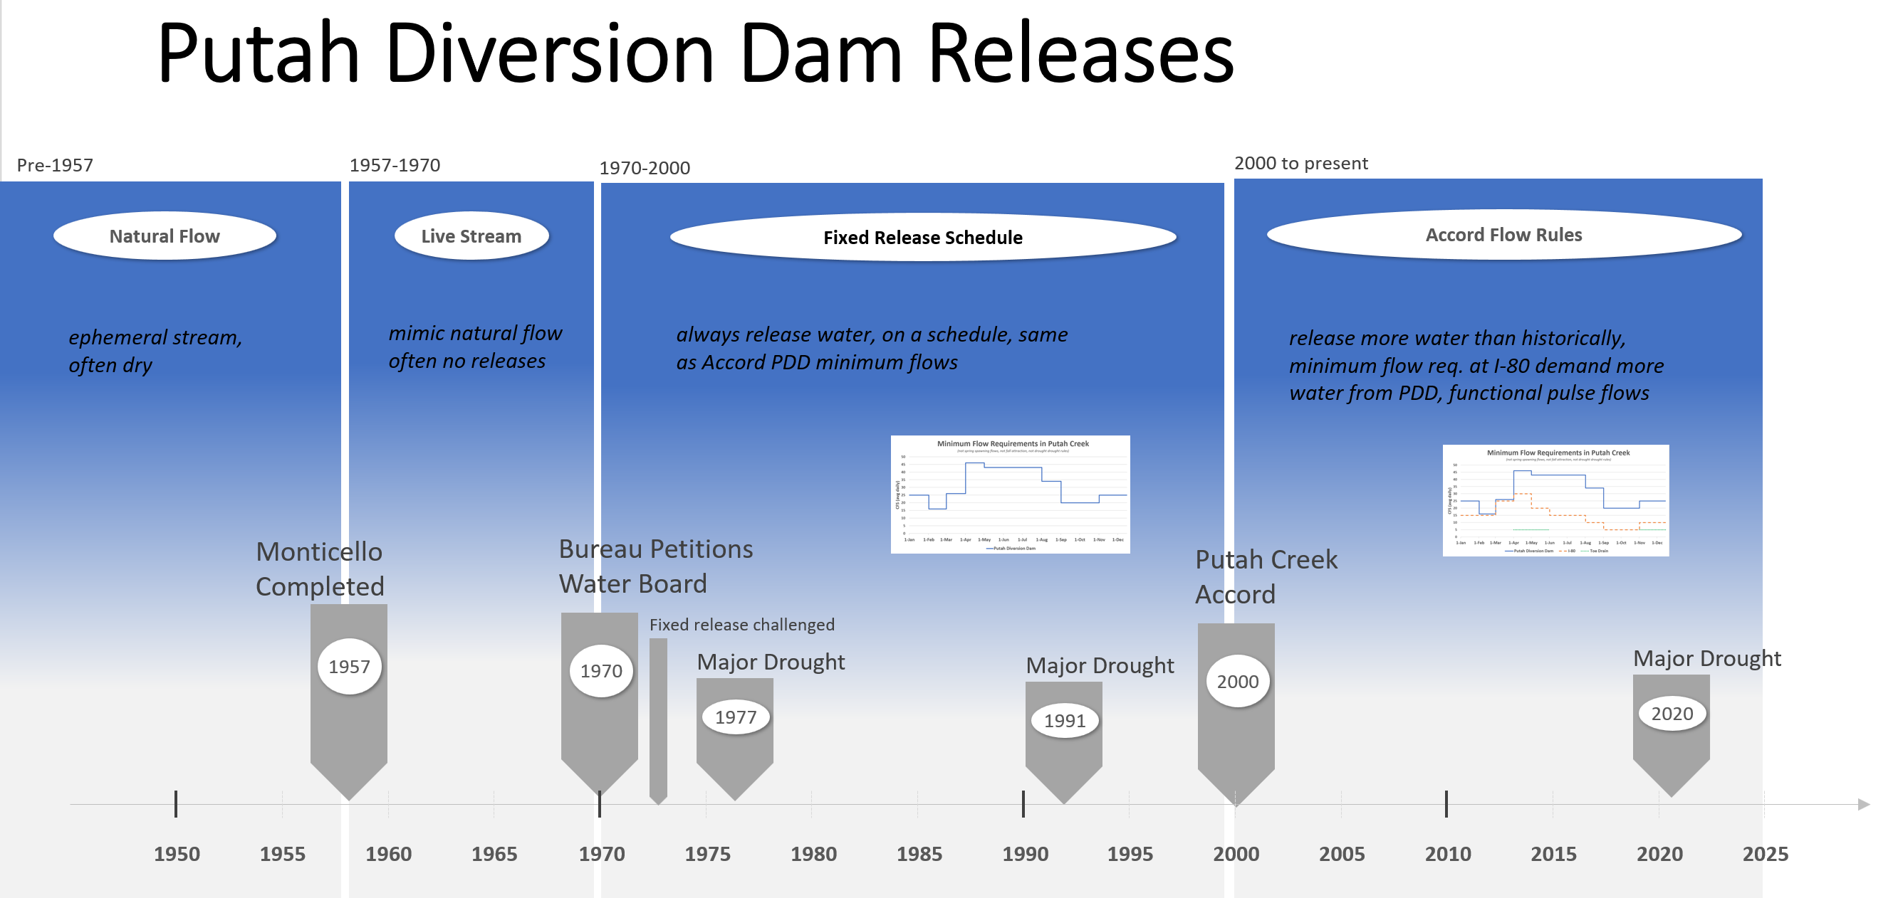
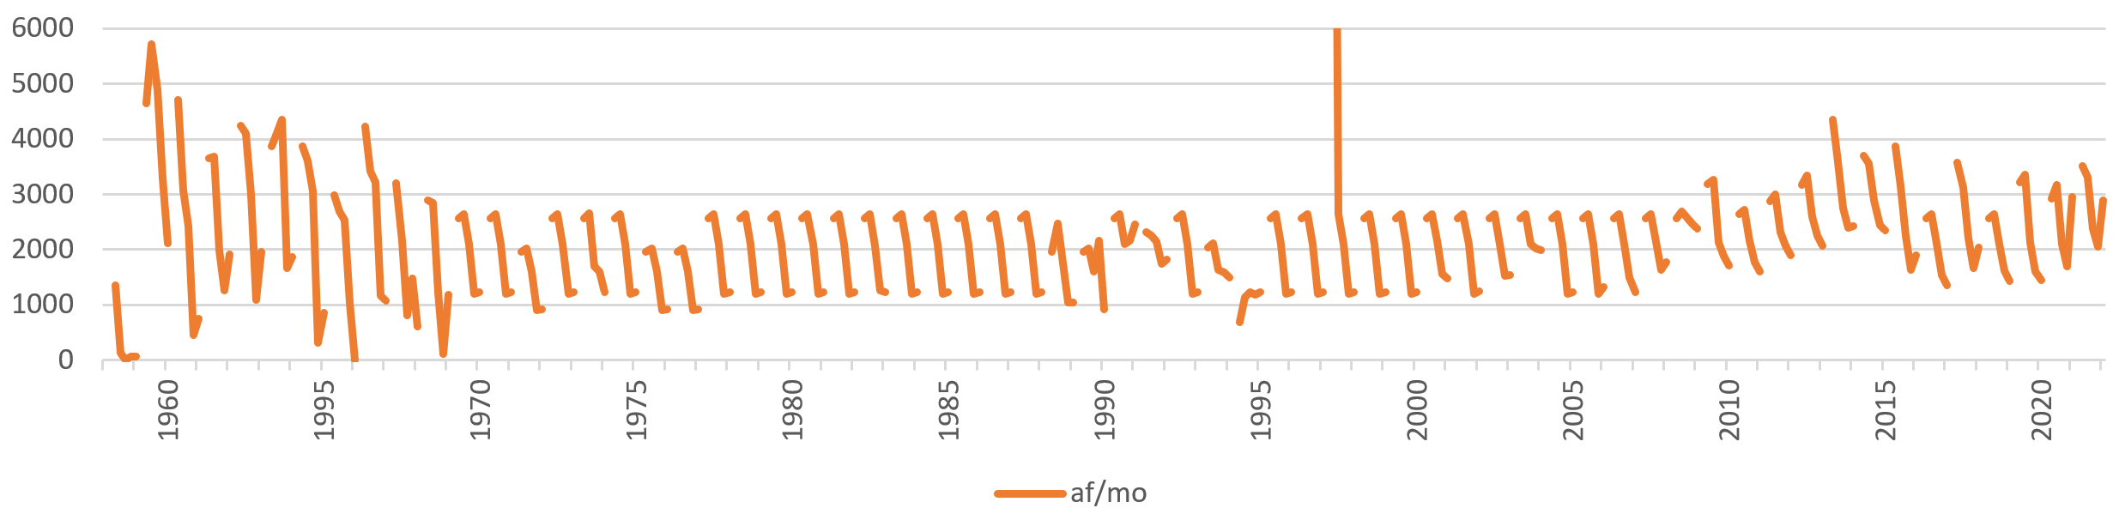
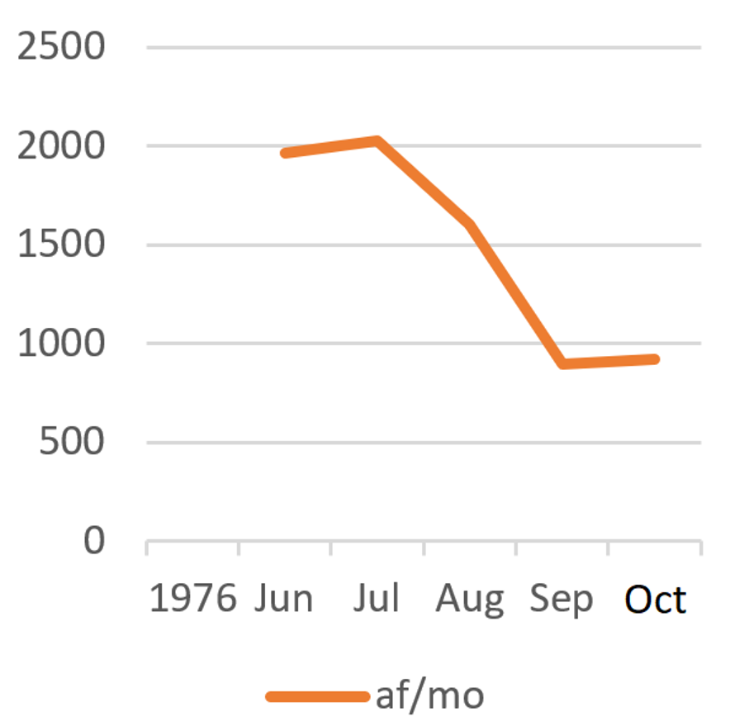
Add rain data
Groundwater levels?
Riparian forecast
Summer Releases
PDD to Putah Creek
(Jun-Oct)
Acrefeet/month

Slide 49
Colusa Basin Drain
Ridge Cut
Toe Drain
Davis
Winters
Putah Creek
Toe Drain
Fairfield
Rio Vista
SF Bay

Slide 50
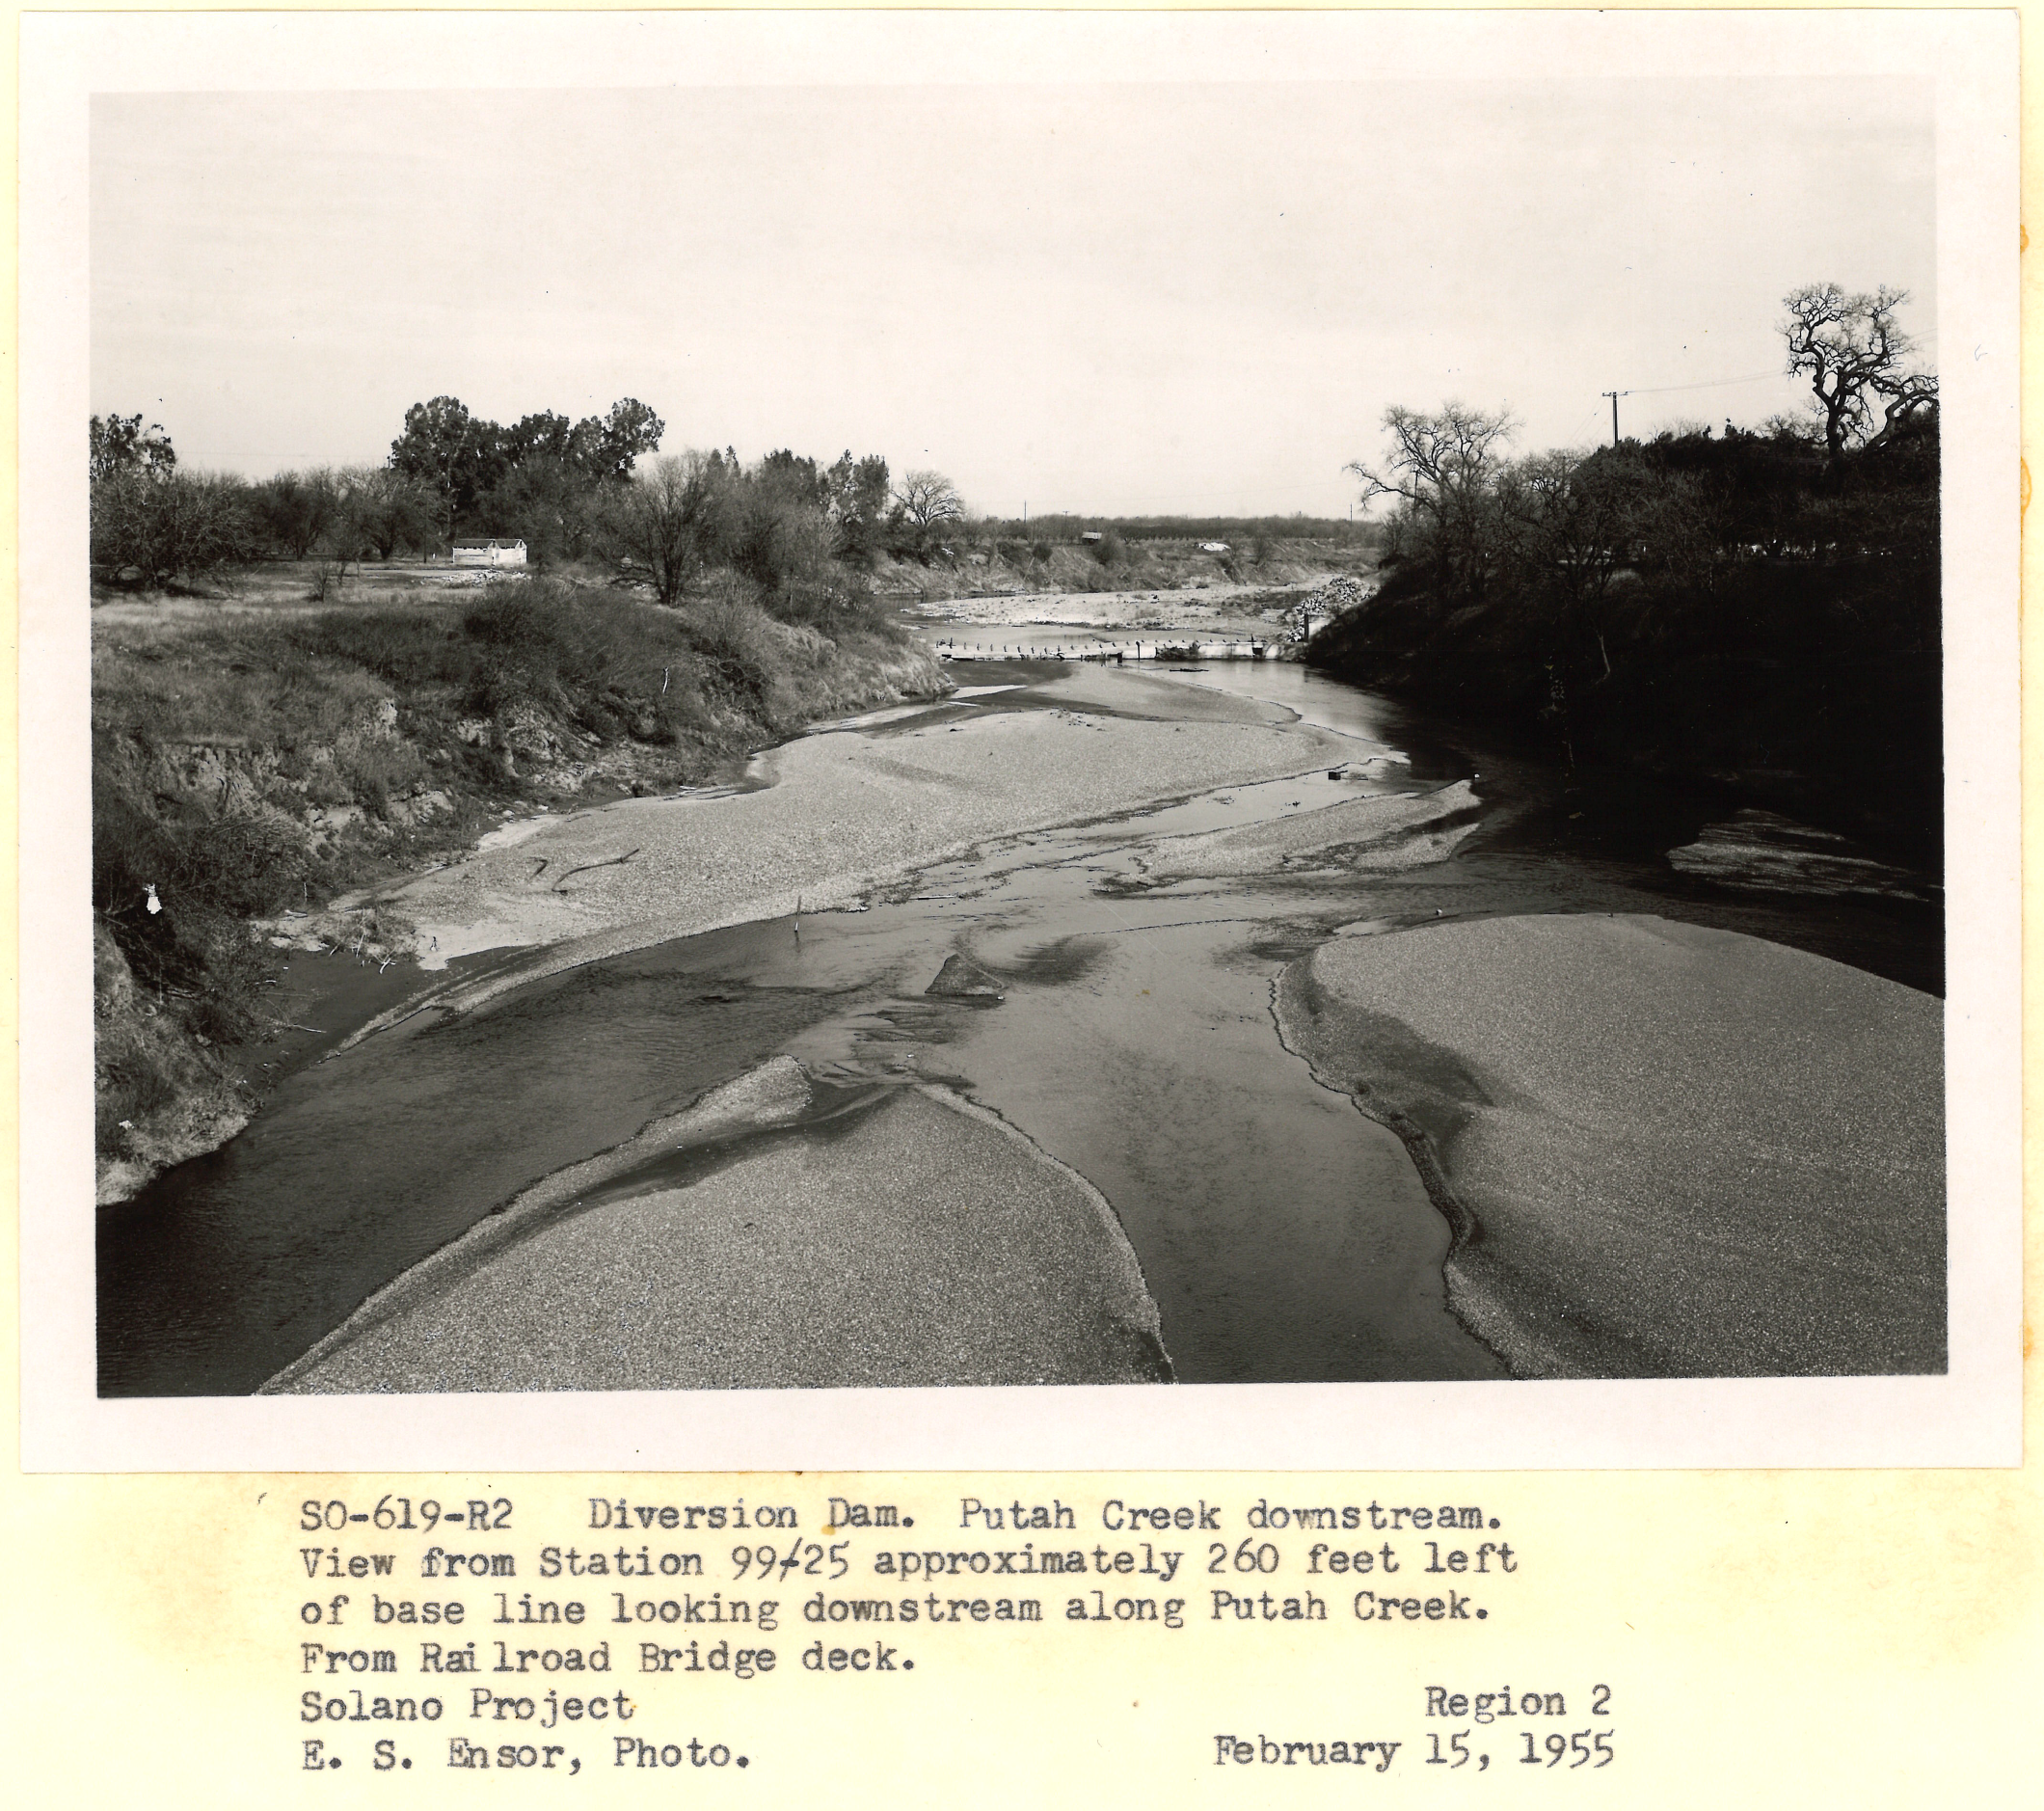

Slide 51
