Slide 1
SCWA Flow Management and Salmon Run Preparation
Solano County Water Agency
Senior Water Resource Specialist
Zach Hyer

Slide 2
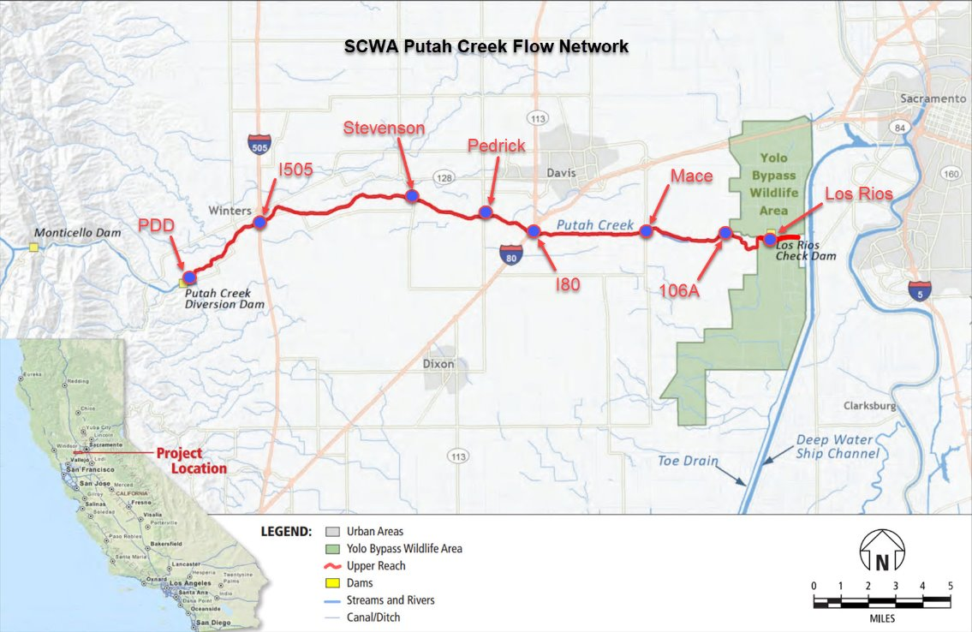
Putah Creek Flow Network
8 Locations PDD, I505, Stevenson, Pedrick, I80, Mace 106 A, and LRCD

Slide 3
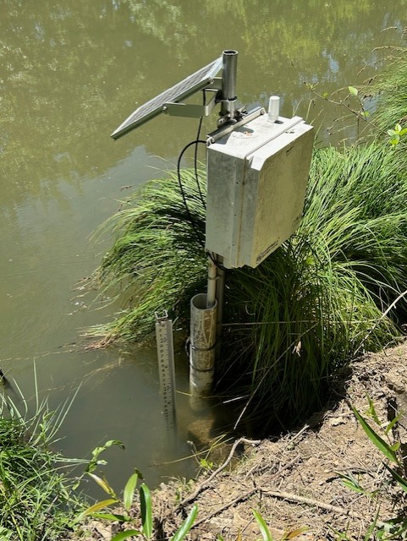
Permanent And Temporary Stations
Permanent Stations
  PDD
  I80
  I505
  Mace
  LRCD
Temporary Seasonal Stations
  Stevenson
  Pedrick
  106A
Notes:
Read slide then There are plans to make Pedrick more permanent once the Nishikawa project is complete

Slide 4
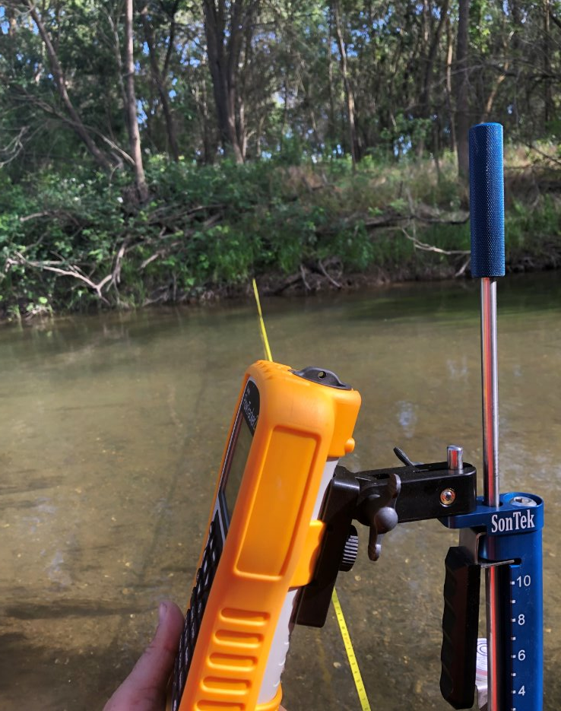
Manual Check Measurements
These measurements are used to check the accuracy of the flow data being collected.
Taken using a Sontek Flowtracker 2

Slide 5
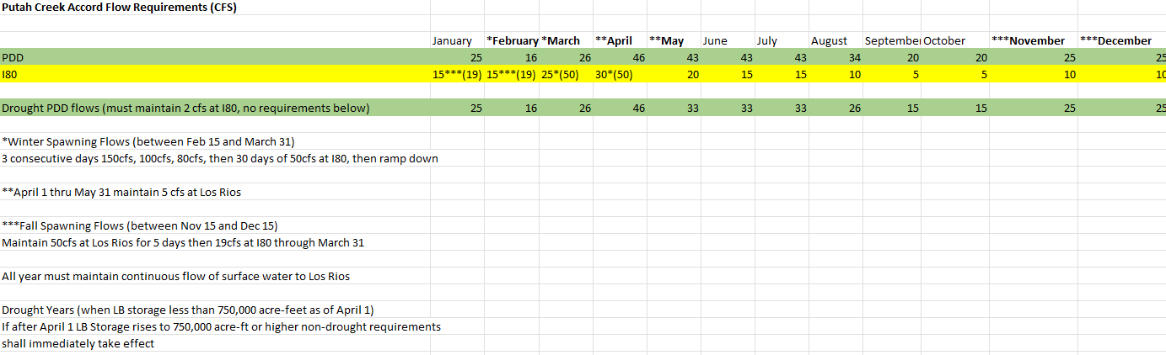
Accord Flows
Data Collected Helps SCWA Stay in compliance with the Putah Creek Accords.
Notes:
Read slide use example of April requirements.

Slide 6

Challenges In Maintaining Accord Compliance
Balancing agricultural diversions and environmental flows.
1
Maintaining flow through 106 A culverts.
2
Maintaining overspill at the Los Rios Check Dam
3
Managing travel time and pumping capacity to prevent Dewatering events.
4

Slide 7

Salmon Run Preparations
106 A Fish Culvert Clearance
Beaver Dam Breeching
Scarification and Gravel Augmentation
Fish Counting Weir Installation
LRCD Board Removal
Pulse Flow Coordination

Slide 8
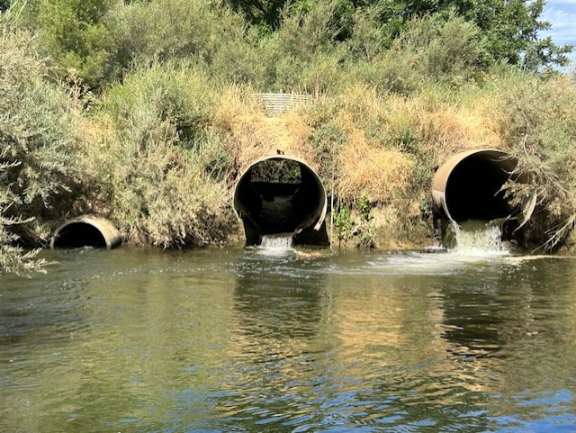
106 A Culvert Clearance
The 106 A Fish culvert allows salmon to pass upstream past the road 106A crossing
The culvert is blocked during diversion season and must be opened by either Los Rios Farms staff or SCWA Staff.

Slide 9
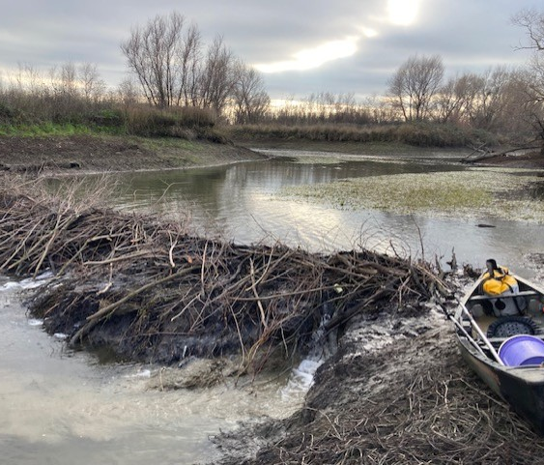
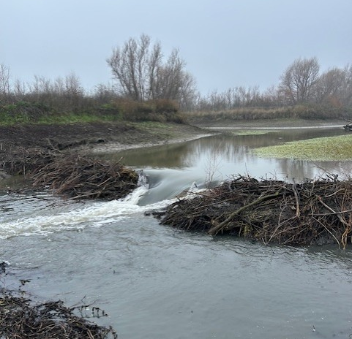
Beaver Dam Breaching
Beaver Dams can prevent Salmon from transiting the creek to spawning areas.
SCWA staff breaches the dams at the beginning of the salmon run and maintains the breaches throughout the run.

Slide 10
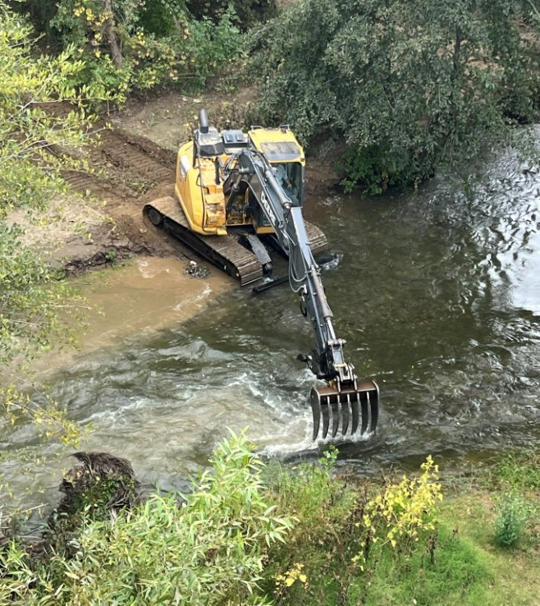
Scarification
Scarification is using an excavator with a rake to break through the sedimentation layer to expose the trapped gravel​
2013 – Rick Fowler Experimented with Scarification​
Rick Fowler scarified a small 30'section of creek by breaking through a sedimentation layer exposing clean gravel underneath​
During the salmon run that year this small area was the primary spawning location​
2014 – Received first permit to scarify 1000' of creek​
2015 – Rick Fowler designed and had a new rake fabricated​
Process now takes place every year.

Slide 11
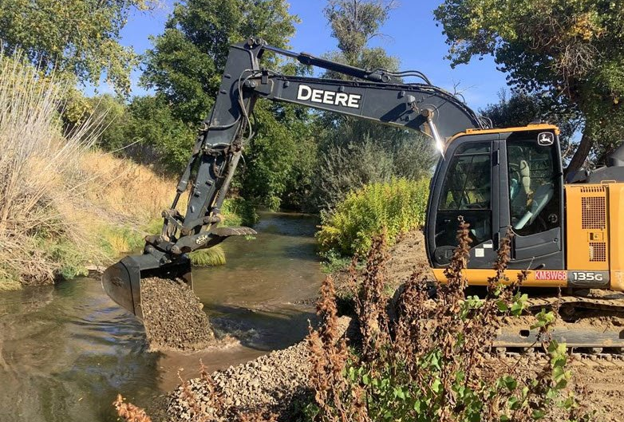
Gravel Augmentation
Gravel augmentation adds gravel to areas that are gravel deficient to increase the viable spawning areas​
2023 – First gravel augmentation under Winters Bridge​
Very specific mixture of rock is needed​
Salmon have spawned in this area that year and every year since​
80 cy of gravel applied​
2025 – Major gravel augmentation project implemented (1500 tons of gravel)​
Replenished the upstream scarification sites​
Added gravel to sections of the creek that previously did not have gravel​
800 cy of gravel installed in creek and another 800 cy staged along creek for future use​
All new augmentation sites already have spawning salmon​

Slide 12
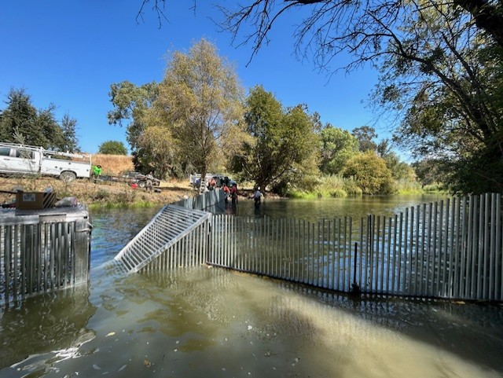
Counting Weir Installation
SCWA Staff install the fish counting weir and UCD staffs it.
Large numbers of fish are counted and sampled at this location.

Slide 13
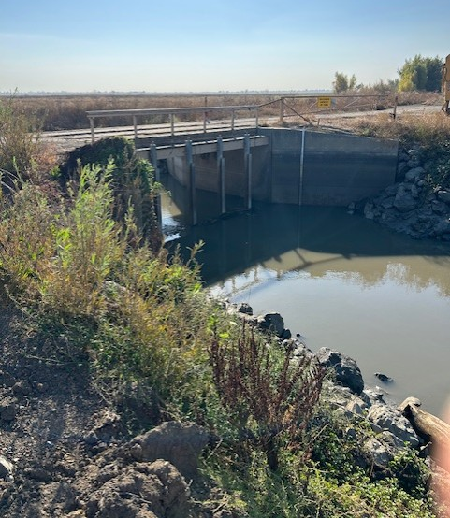
Los Rios Check Dam Removal
The last obstacle to be removed is the Los Rios Check dam.
The check structure in the Yolo Bypass Wildlife area is removed by Los Rios Farms Staff.
The path is clear and SCWA will begin coordination of the pulse flow

Slide 14
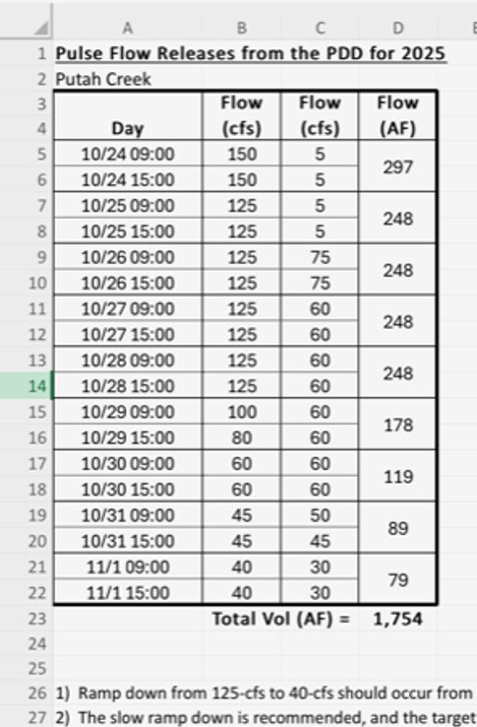
Pulse Flows
After Obstacles have been removed or breached the agency releases Pulse Flows to attract Salmon. ​
This simulates a rain event that elevates the flow in the creek and attracts fish upstream to prepared spawning areas. ​

Slide 15
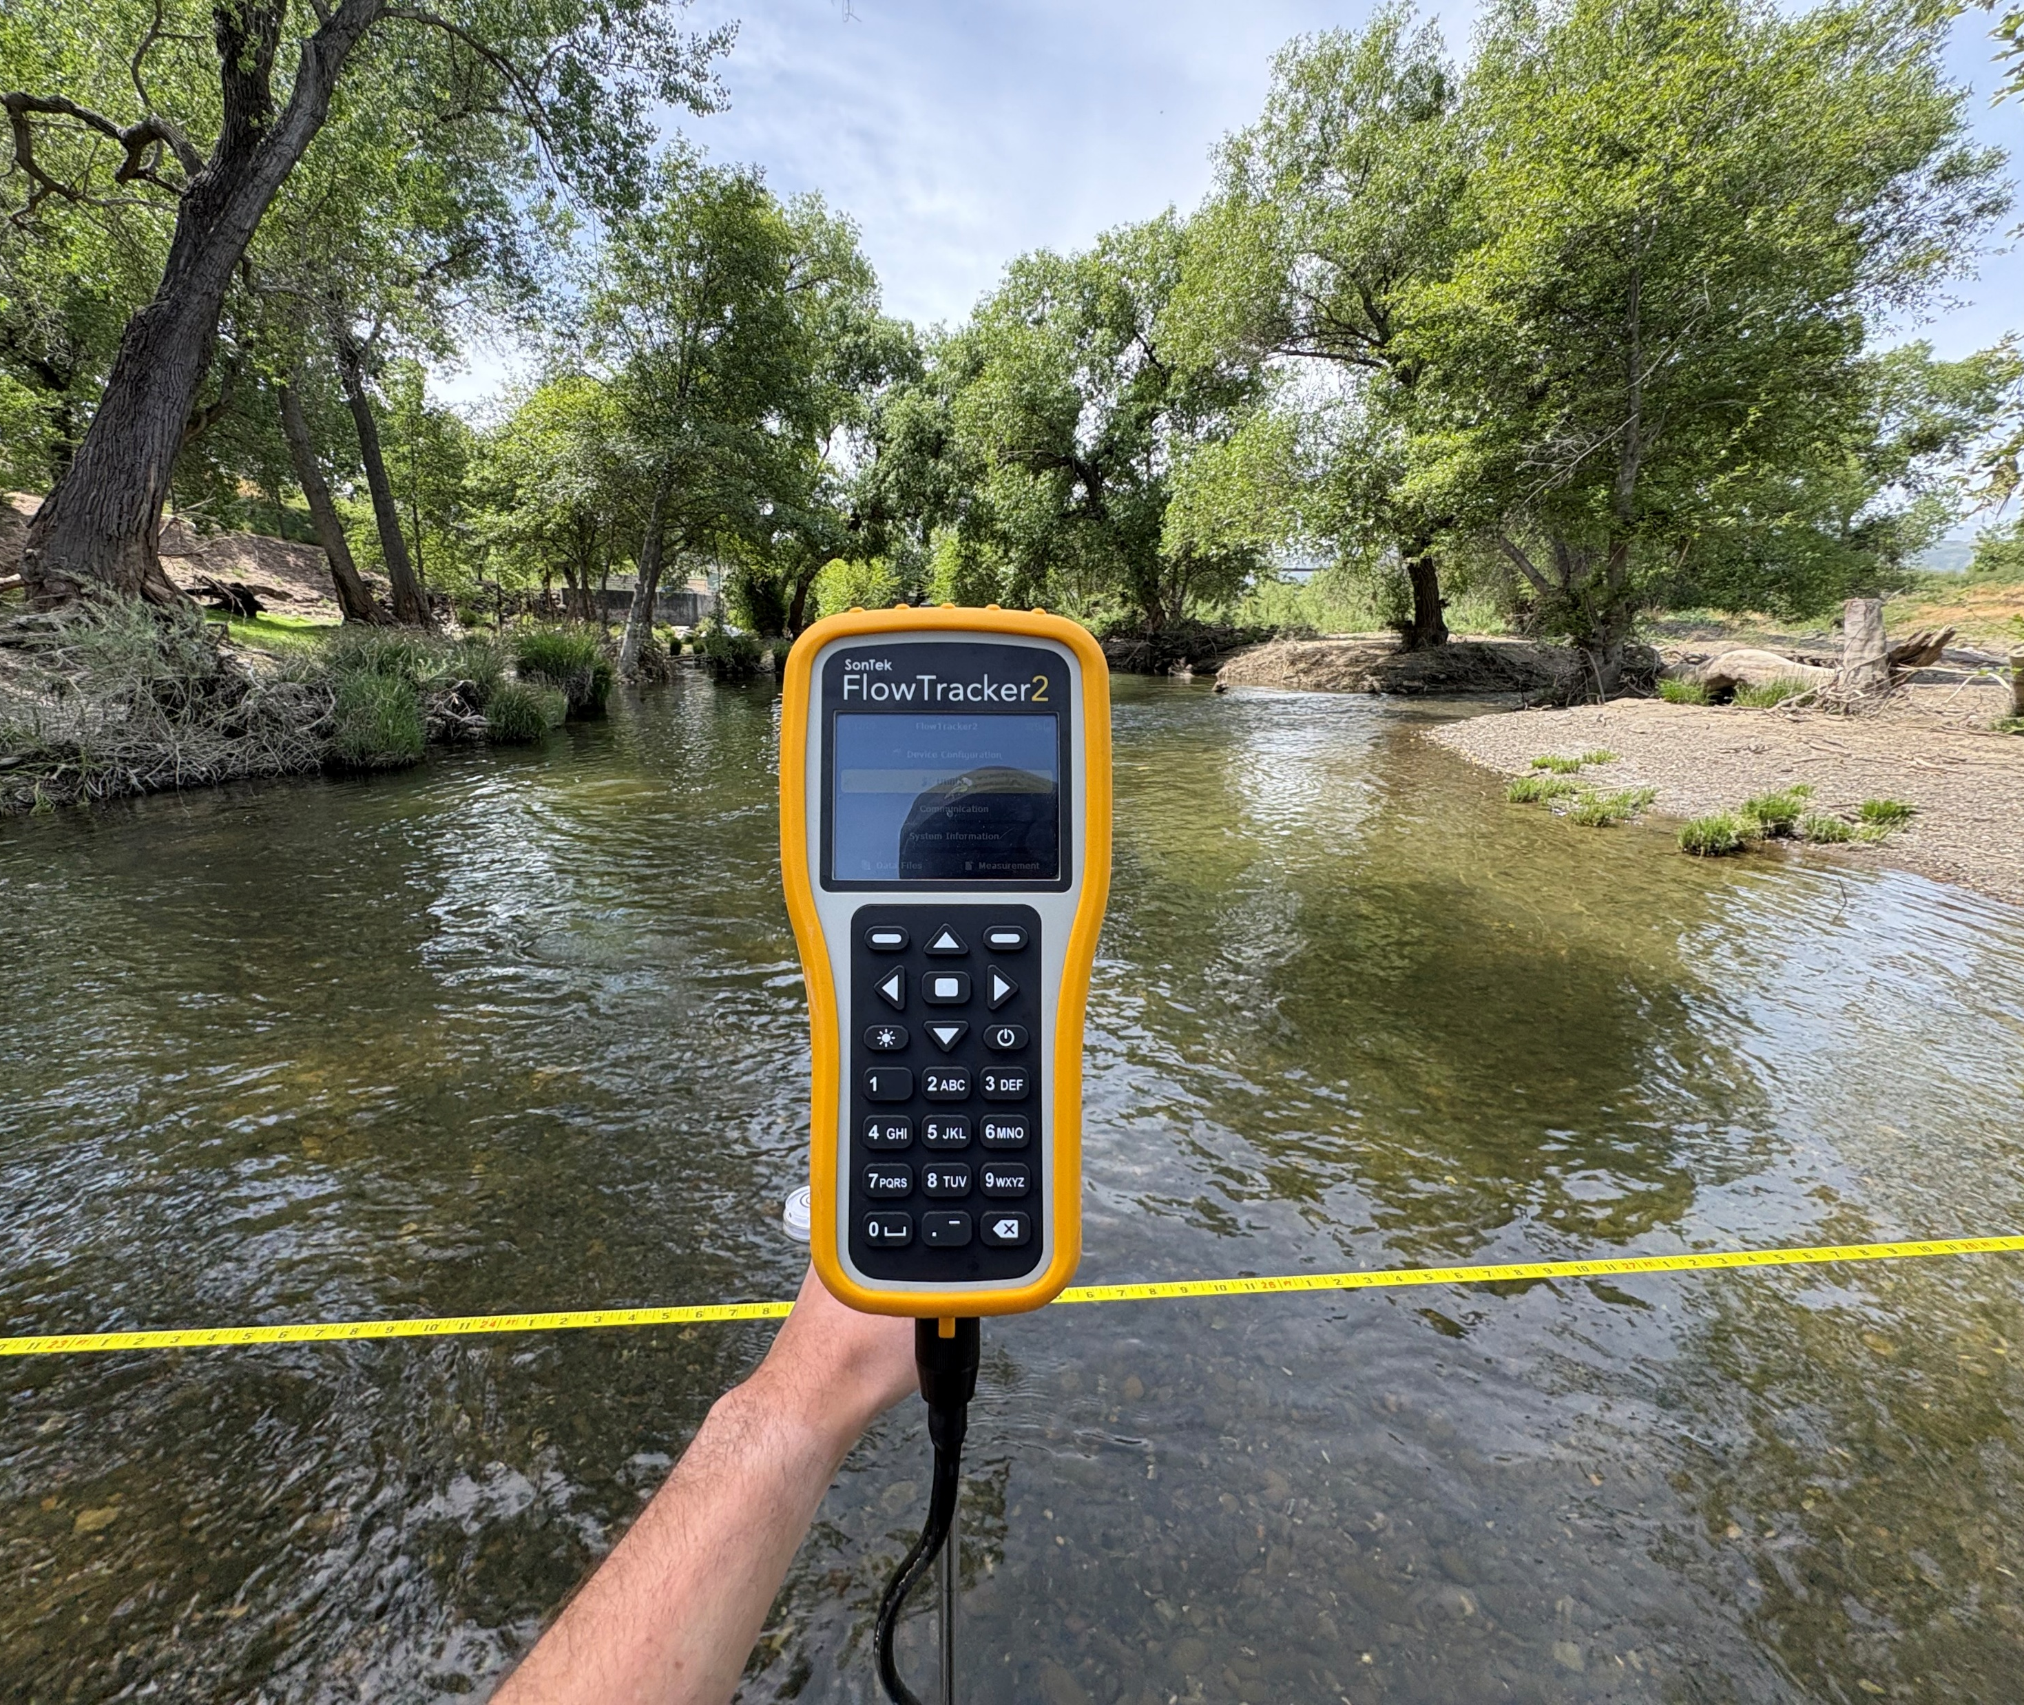
SCWA Data Collection on Putah Creek
Zach Turley
Assistant Water Resources Engineer
Solano County Water Agency

Slide 16
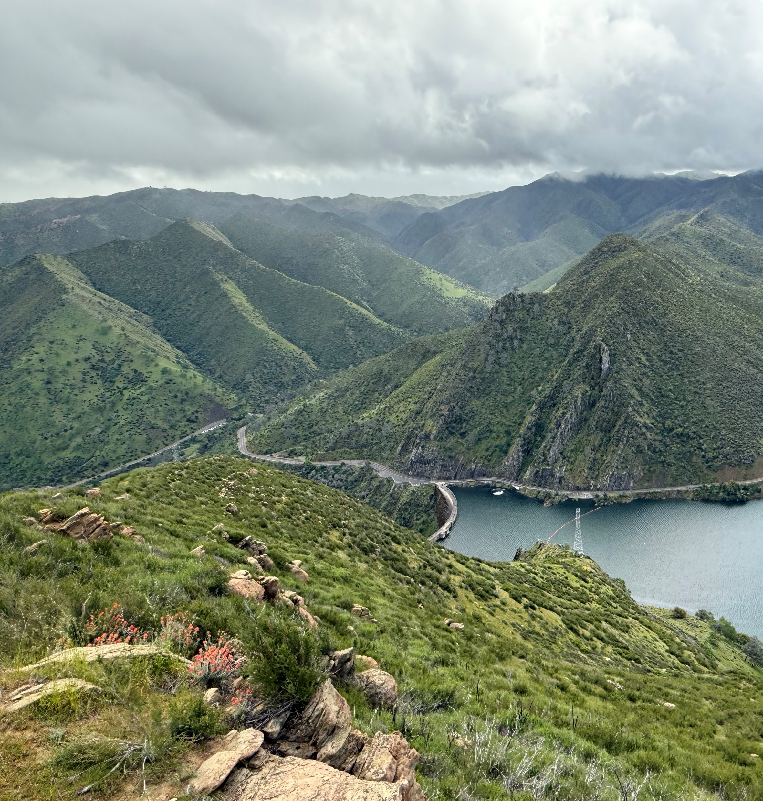
Overview
Lake Berryessa
InterDam Reach
Lower Putah Creek
Going Forward

Slide 17
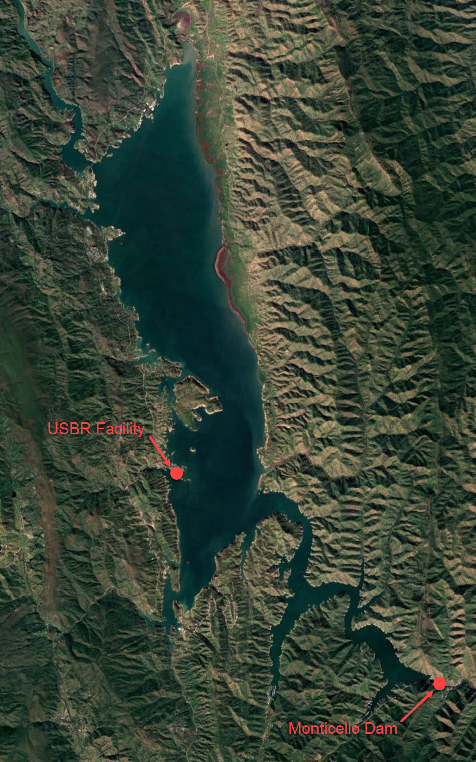
Lake Berryessa
Meteorological Station AT USBR Facility (2007-Current)
  Evaporation
  Relative humidity
  Solar radiation
  Dew point
  Wind speed/direction
  Precipitation
Monticello Dam (2007 – Current)
  Temperature string (1ft, 5ft, 10ft, 40ft, 70ft depths)
  Lake water surface elevation
  Lake storage

Slide 18
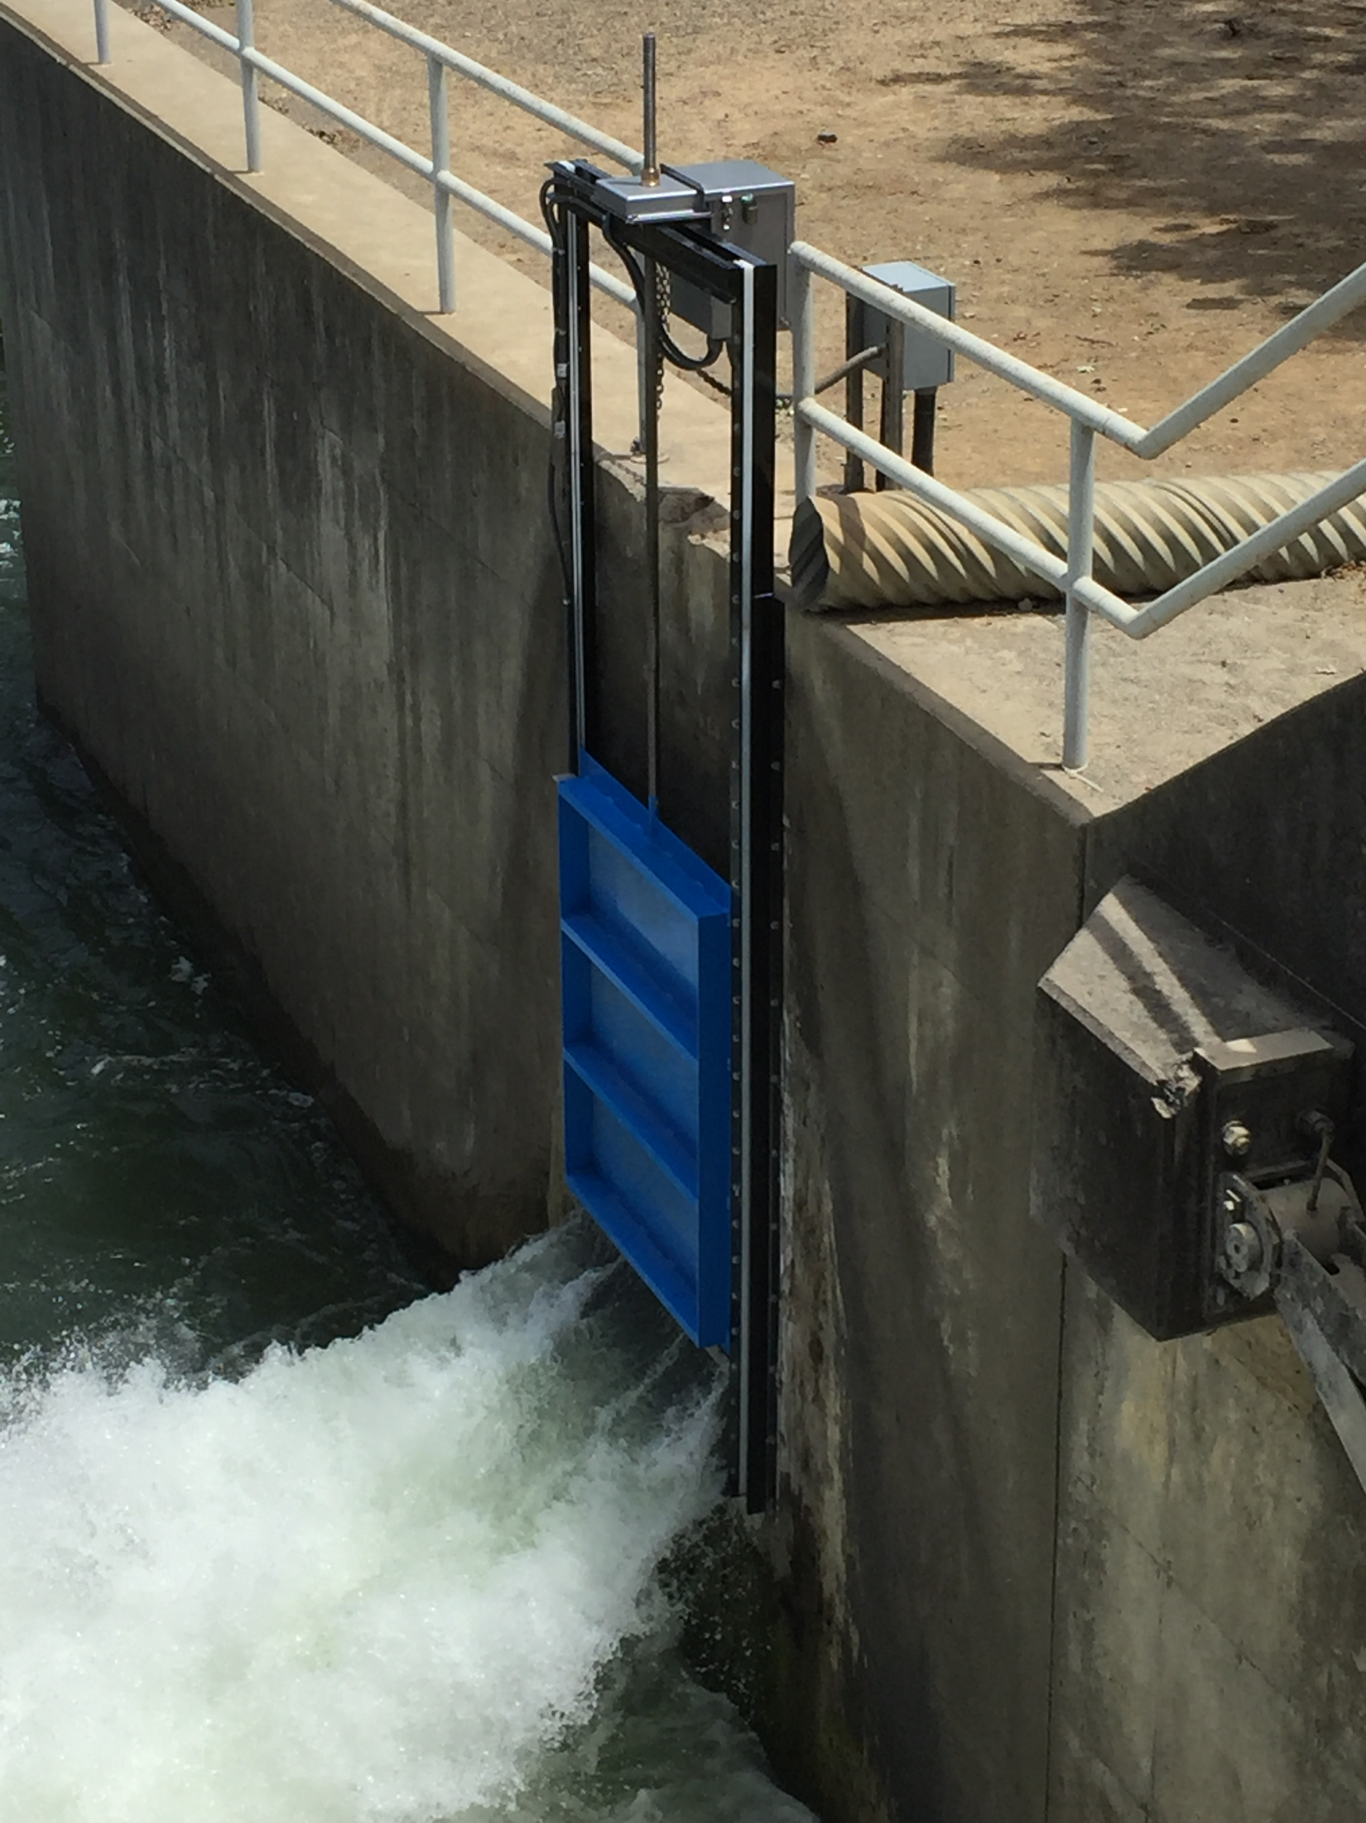
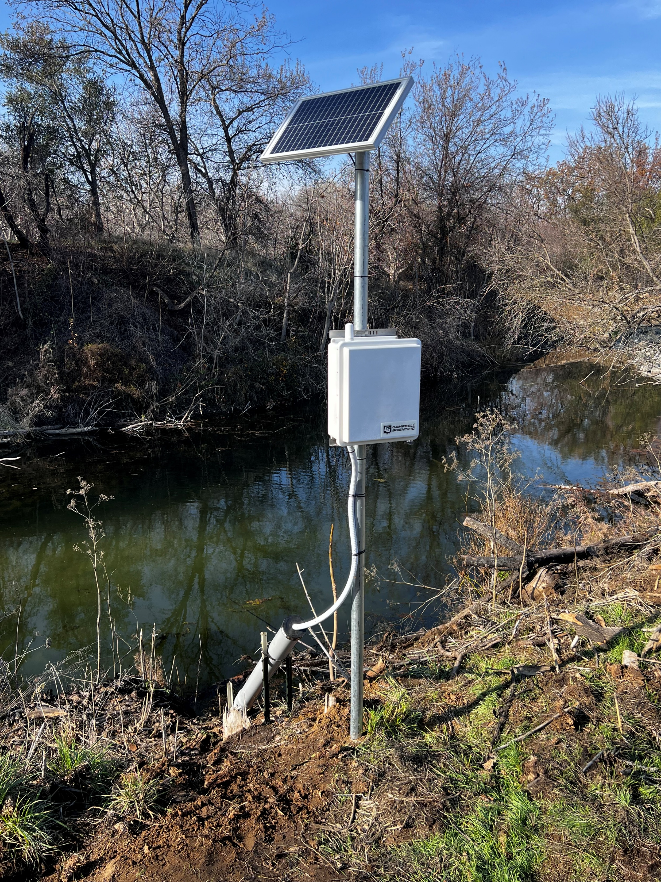
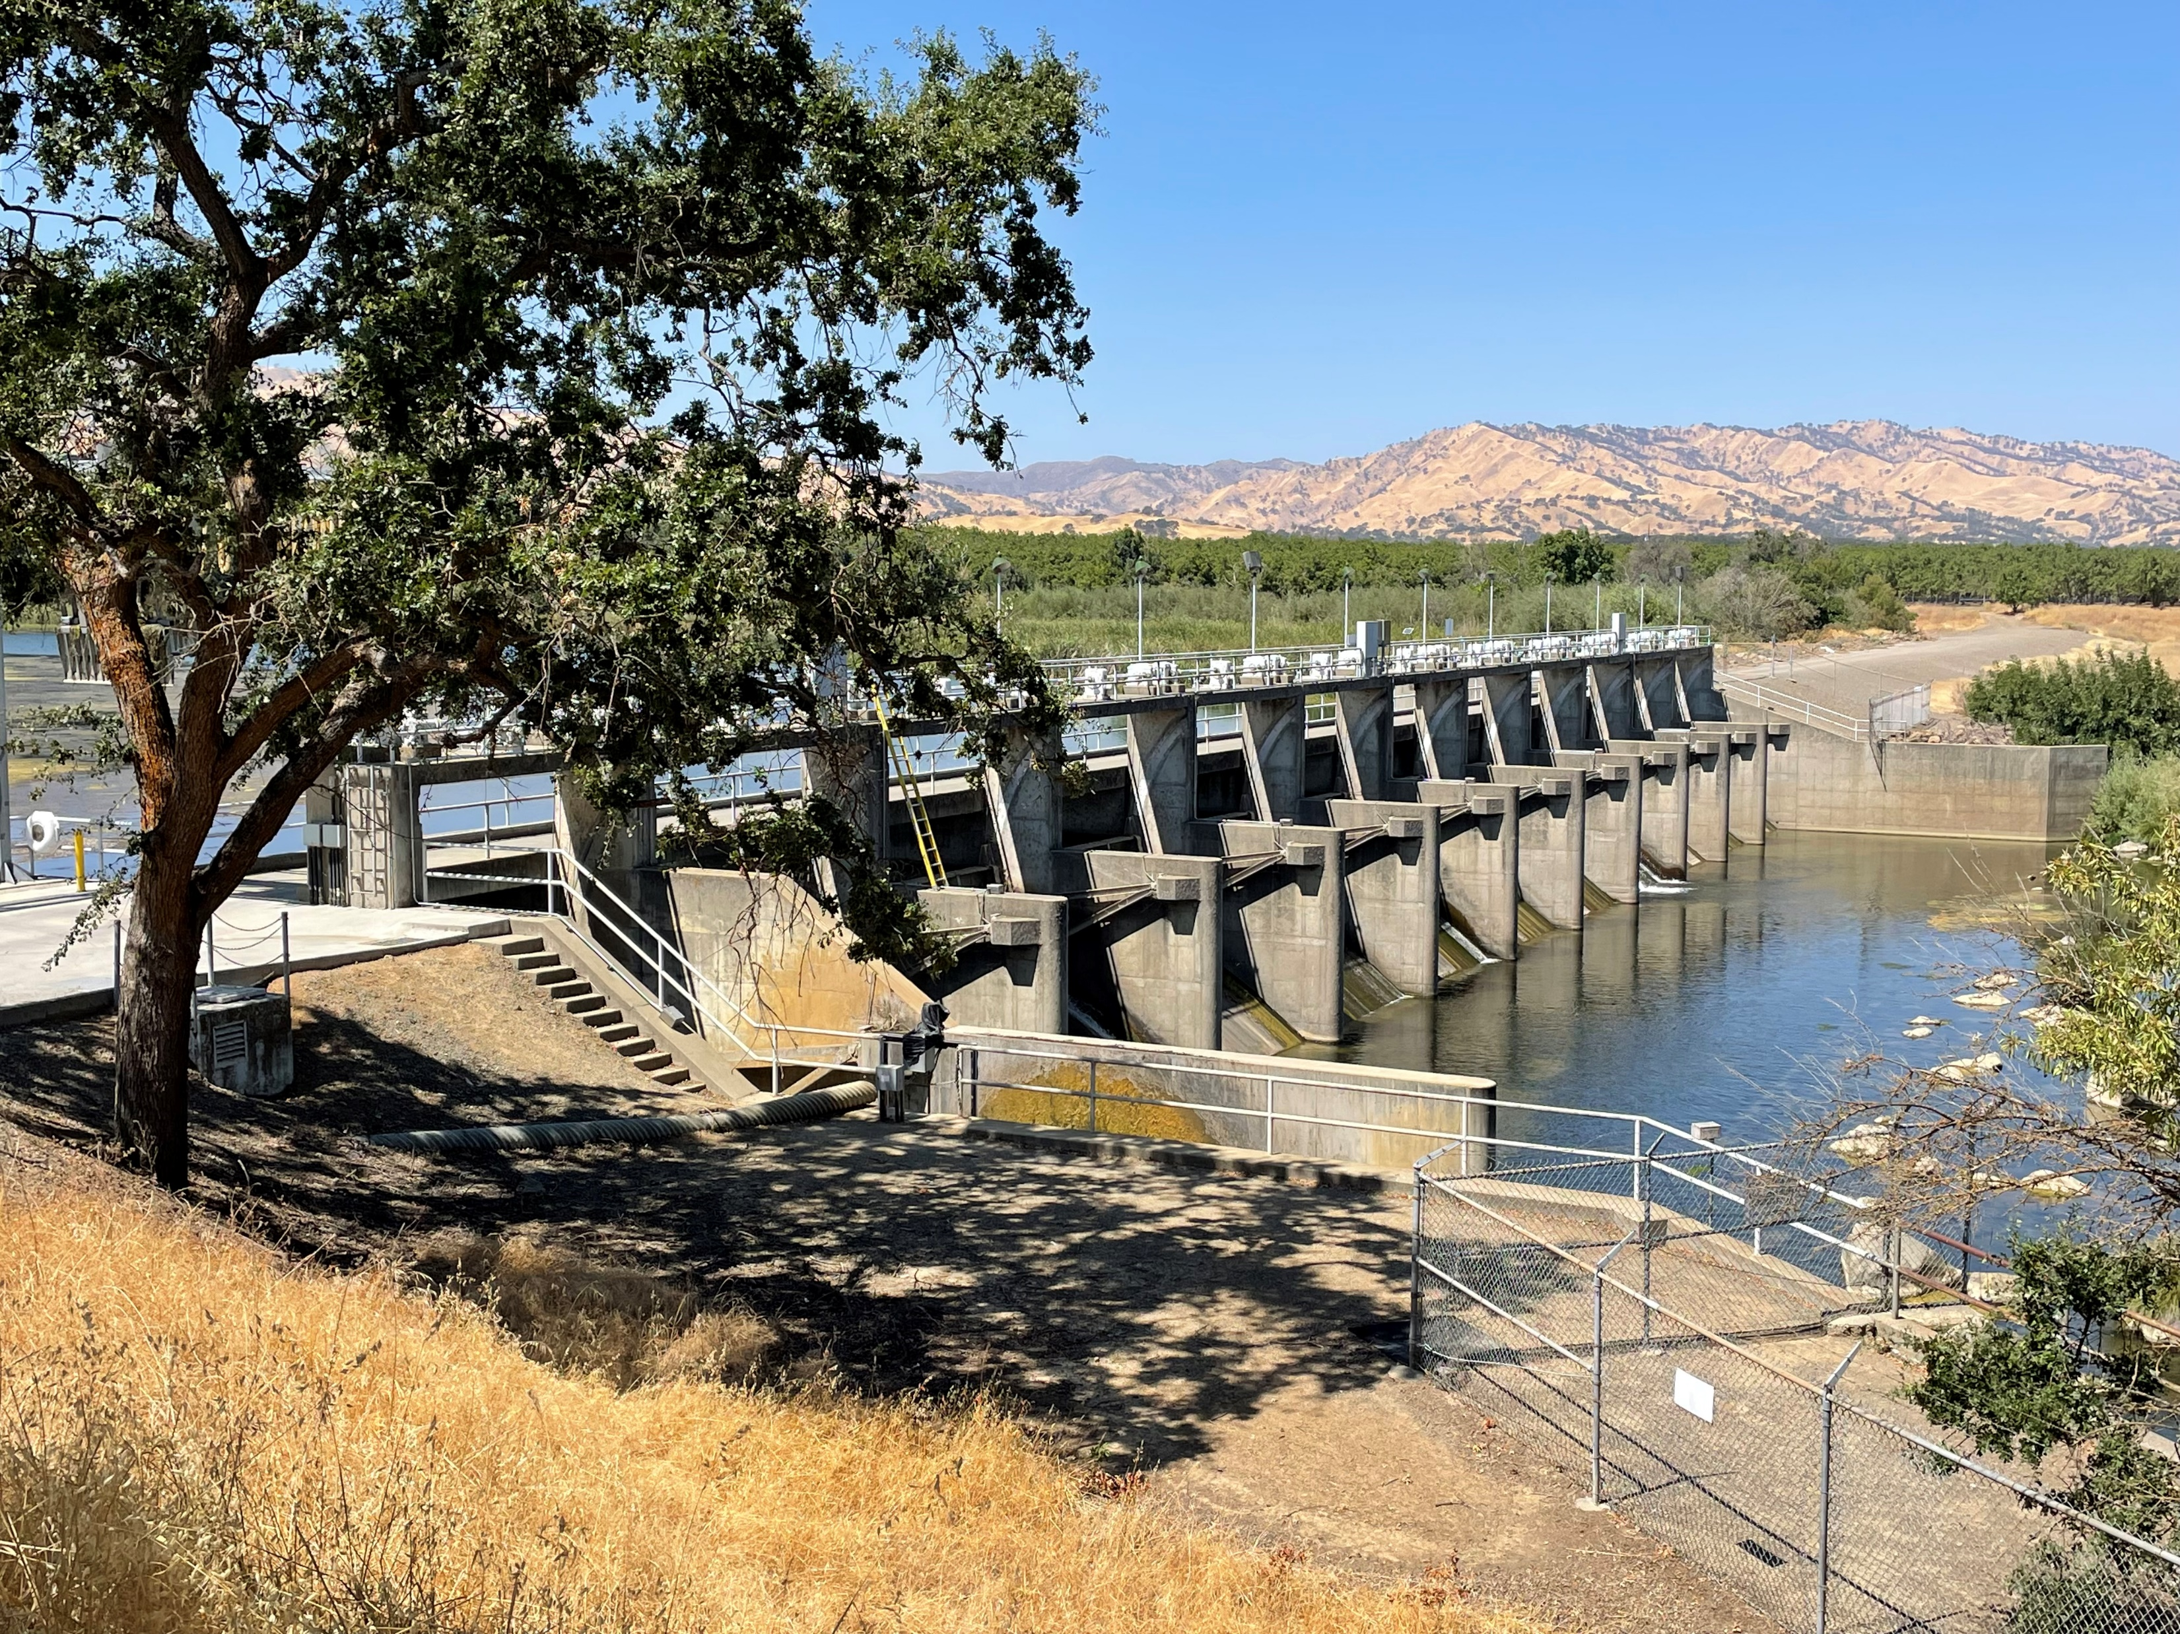
InterDam Reach
Turbidity at confluence of Pleasants Valley Creek and Lake Solano
USGS Flow Monitoring station
Putah Diversion Dam
  Automated flow to Putah Creek through Venturi
  WQ station: Turbidity, Conductivity, pH, and Precipitation
  Flood Gate Releases

Slide 19
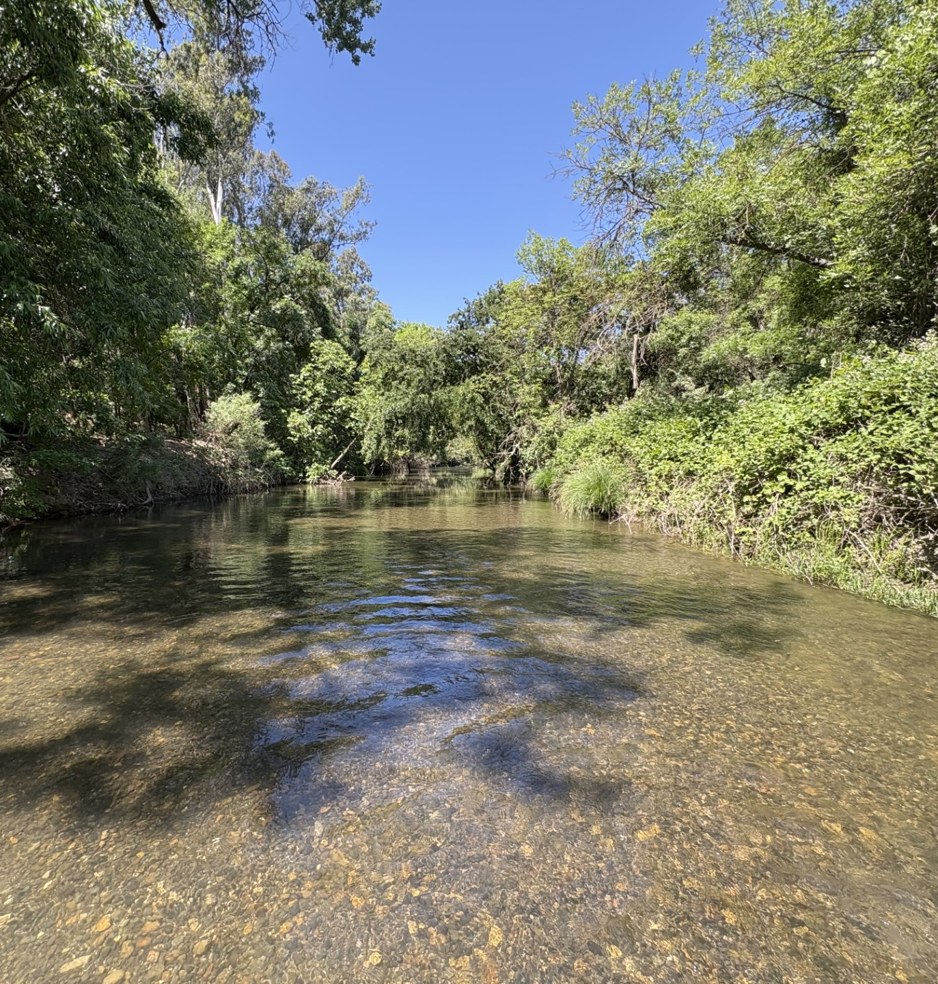
Lower Putah Creek
4 main Projects
  Flow Network
  Joint SCWA/DWR Groundwater Monitoring Network
  Water Temperature Network
  Putah Creek Diverter Network

Slide 20
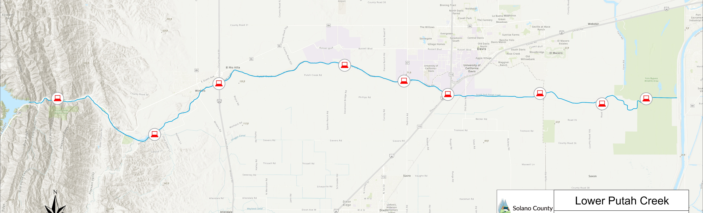
Putah Creek Flow
Network
Stevenson
Bridge
Pedrick
Los Rios
I505
Mace
USGS
I80
106A
PDD
9 Locations (USGS, PDD, I505, Stevenson, Pedrick, I80, Mace,106A, and Los Rios)

Slide 21
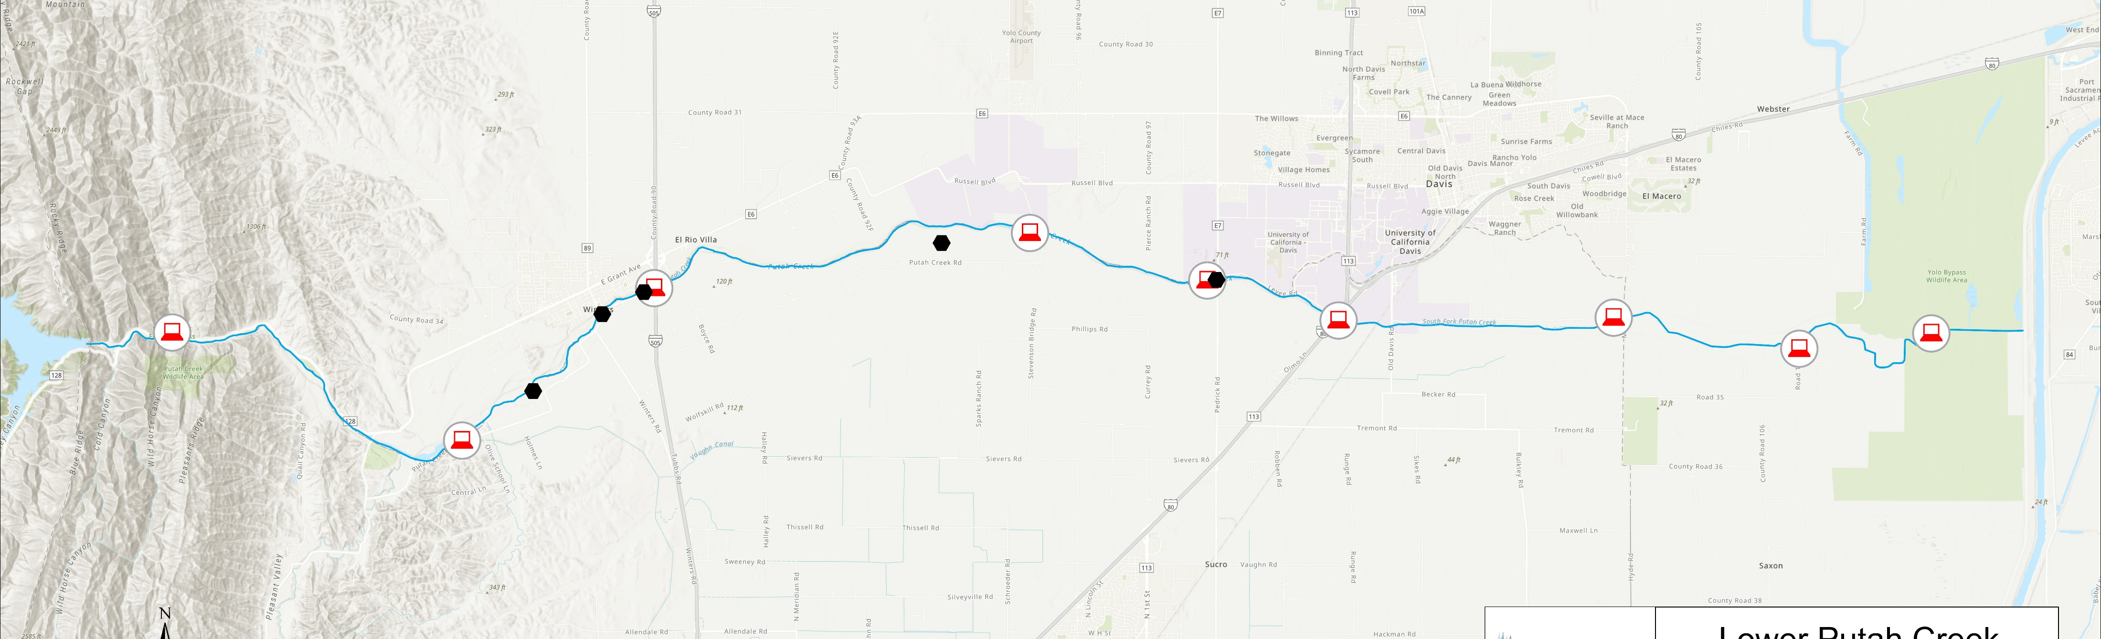
Putah Creek Well
Network
Winter’s Putah Creek Park
Herb Wimmer’s Property
Catholic Diocese
Winter’s Bridge
Nishikawa
5 Locations (Herb Wimmer’s property, Winter’s bridge, Winter’s Putah Creek Park, Catholic Diocese, and Nishikawa Creek Restoration Site
Nishikawa well installed Spring 2026

Slide 22

Putah Creek Temperature Network
McNamara
Property
Monticello
Dam
Pedrick
Mace
PDD
Stevenson
I505
Fish Access 3
Old Davis Rd.
Los Rios
10 Locations (Monticello Dam, Fish Access 3, PDD, I505, McNamera Property, Stevenson Bridge, Pedrick, Old Davis Rd, Mace, and Los Rios)

Slide 23
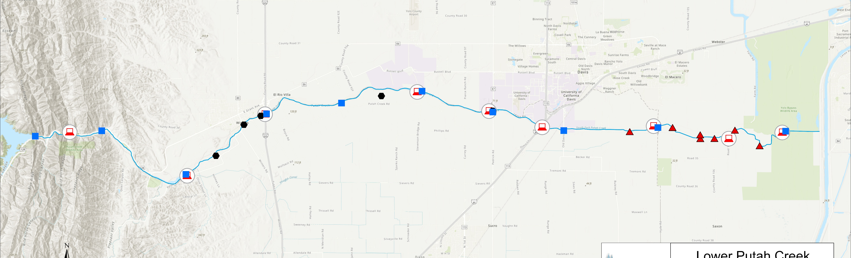
Putah Creek Diverter Network
Los Rios (2062LW)
Los Rios (2323R)
Bullseye Property (1784R)
Los Rios (2114R)
Paschoal Property (1950L)
Glide
(2199L)
Los Rios (2061R)
6 Diverter Locations:
  Bullseye Property (1784R)
  Paschoal Property (1950L)
  Los Rios (2061R, 2114R, 2323R)
  Glide Property (2199L)
1 wheeling site
  Los Rios (2062LW)
9 diverter pumps monitored

Slide 24
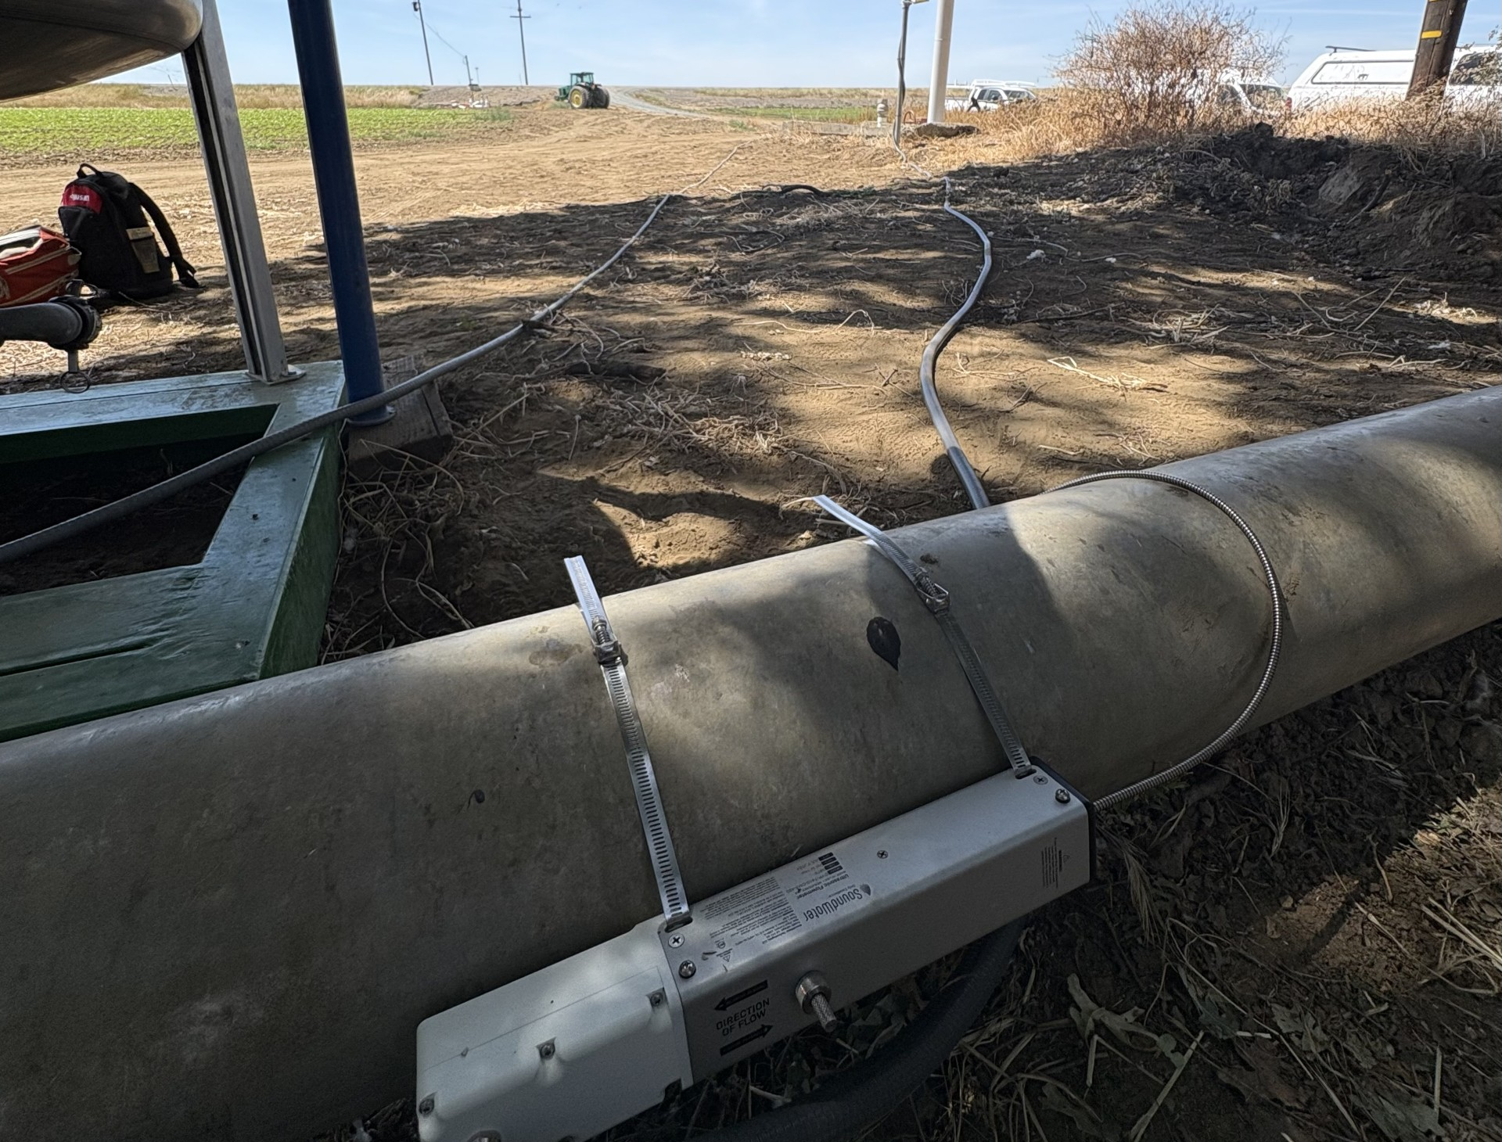
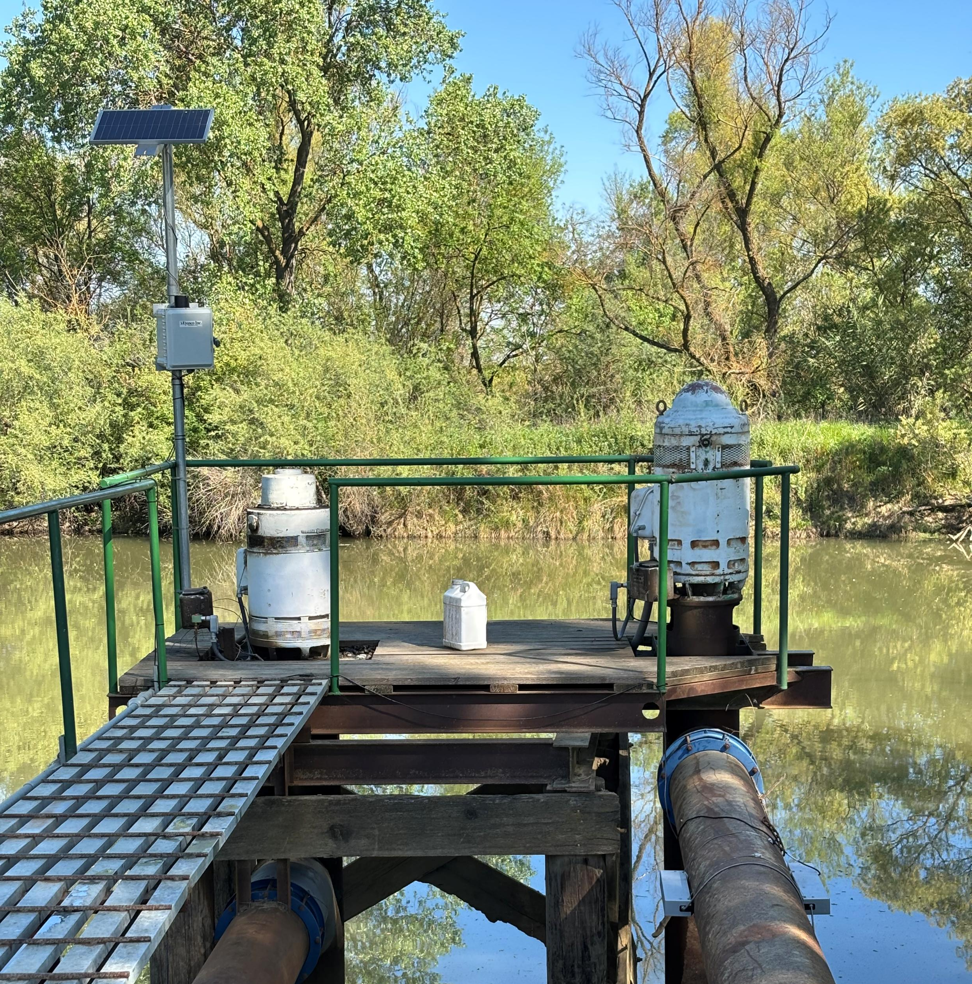
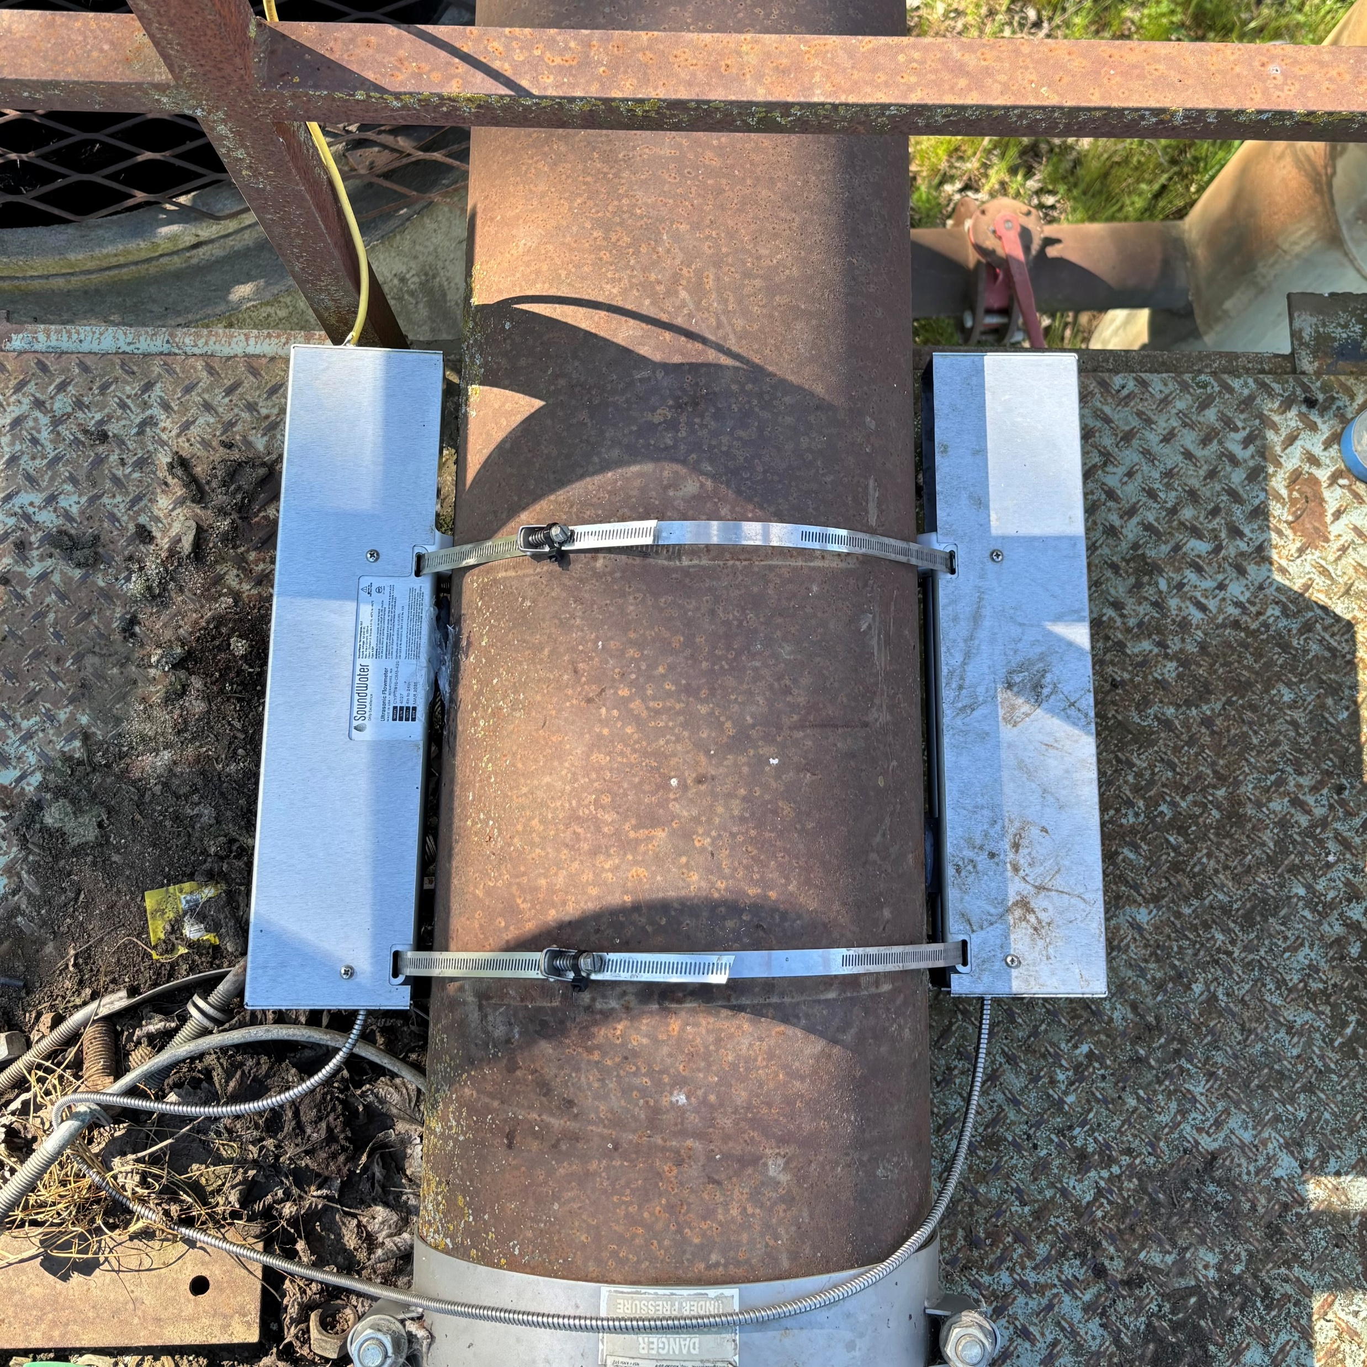
Putah Creek Diverter Network
Installed during 2025 agriculture season
Distinct naming convention
  1784 = Creek Mileage from Monticello Dam
  R or L = Right or Left Bank
  W = Wheeling Site
Two kinds of diversion sites in the network
  Diversion Sites – Water from Putah Creek
  Wheeling Sites – Water into Putah Creek to be diverted at a different point.
Flowmeters monitor discharge out of Putah creek.
Weir equation used for estimating discharge at wheeling site.
Helps close the mass balance on Putah Creek and meet Accord requirements

Slide 25
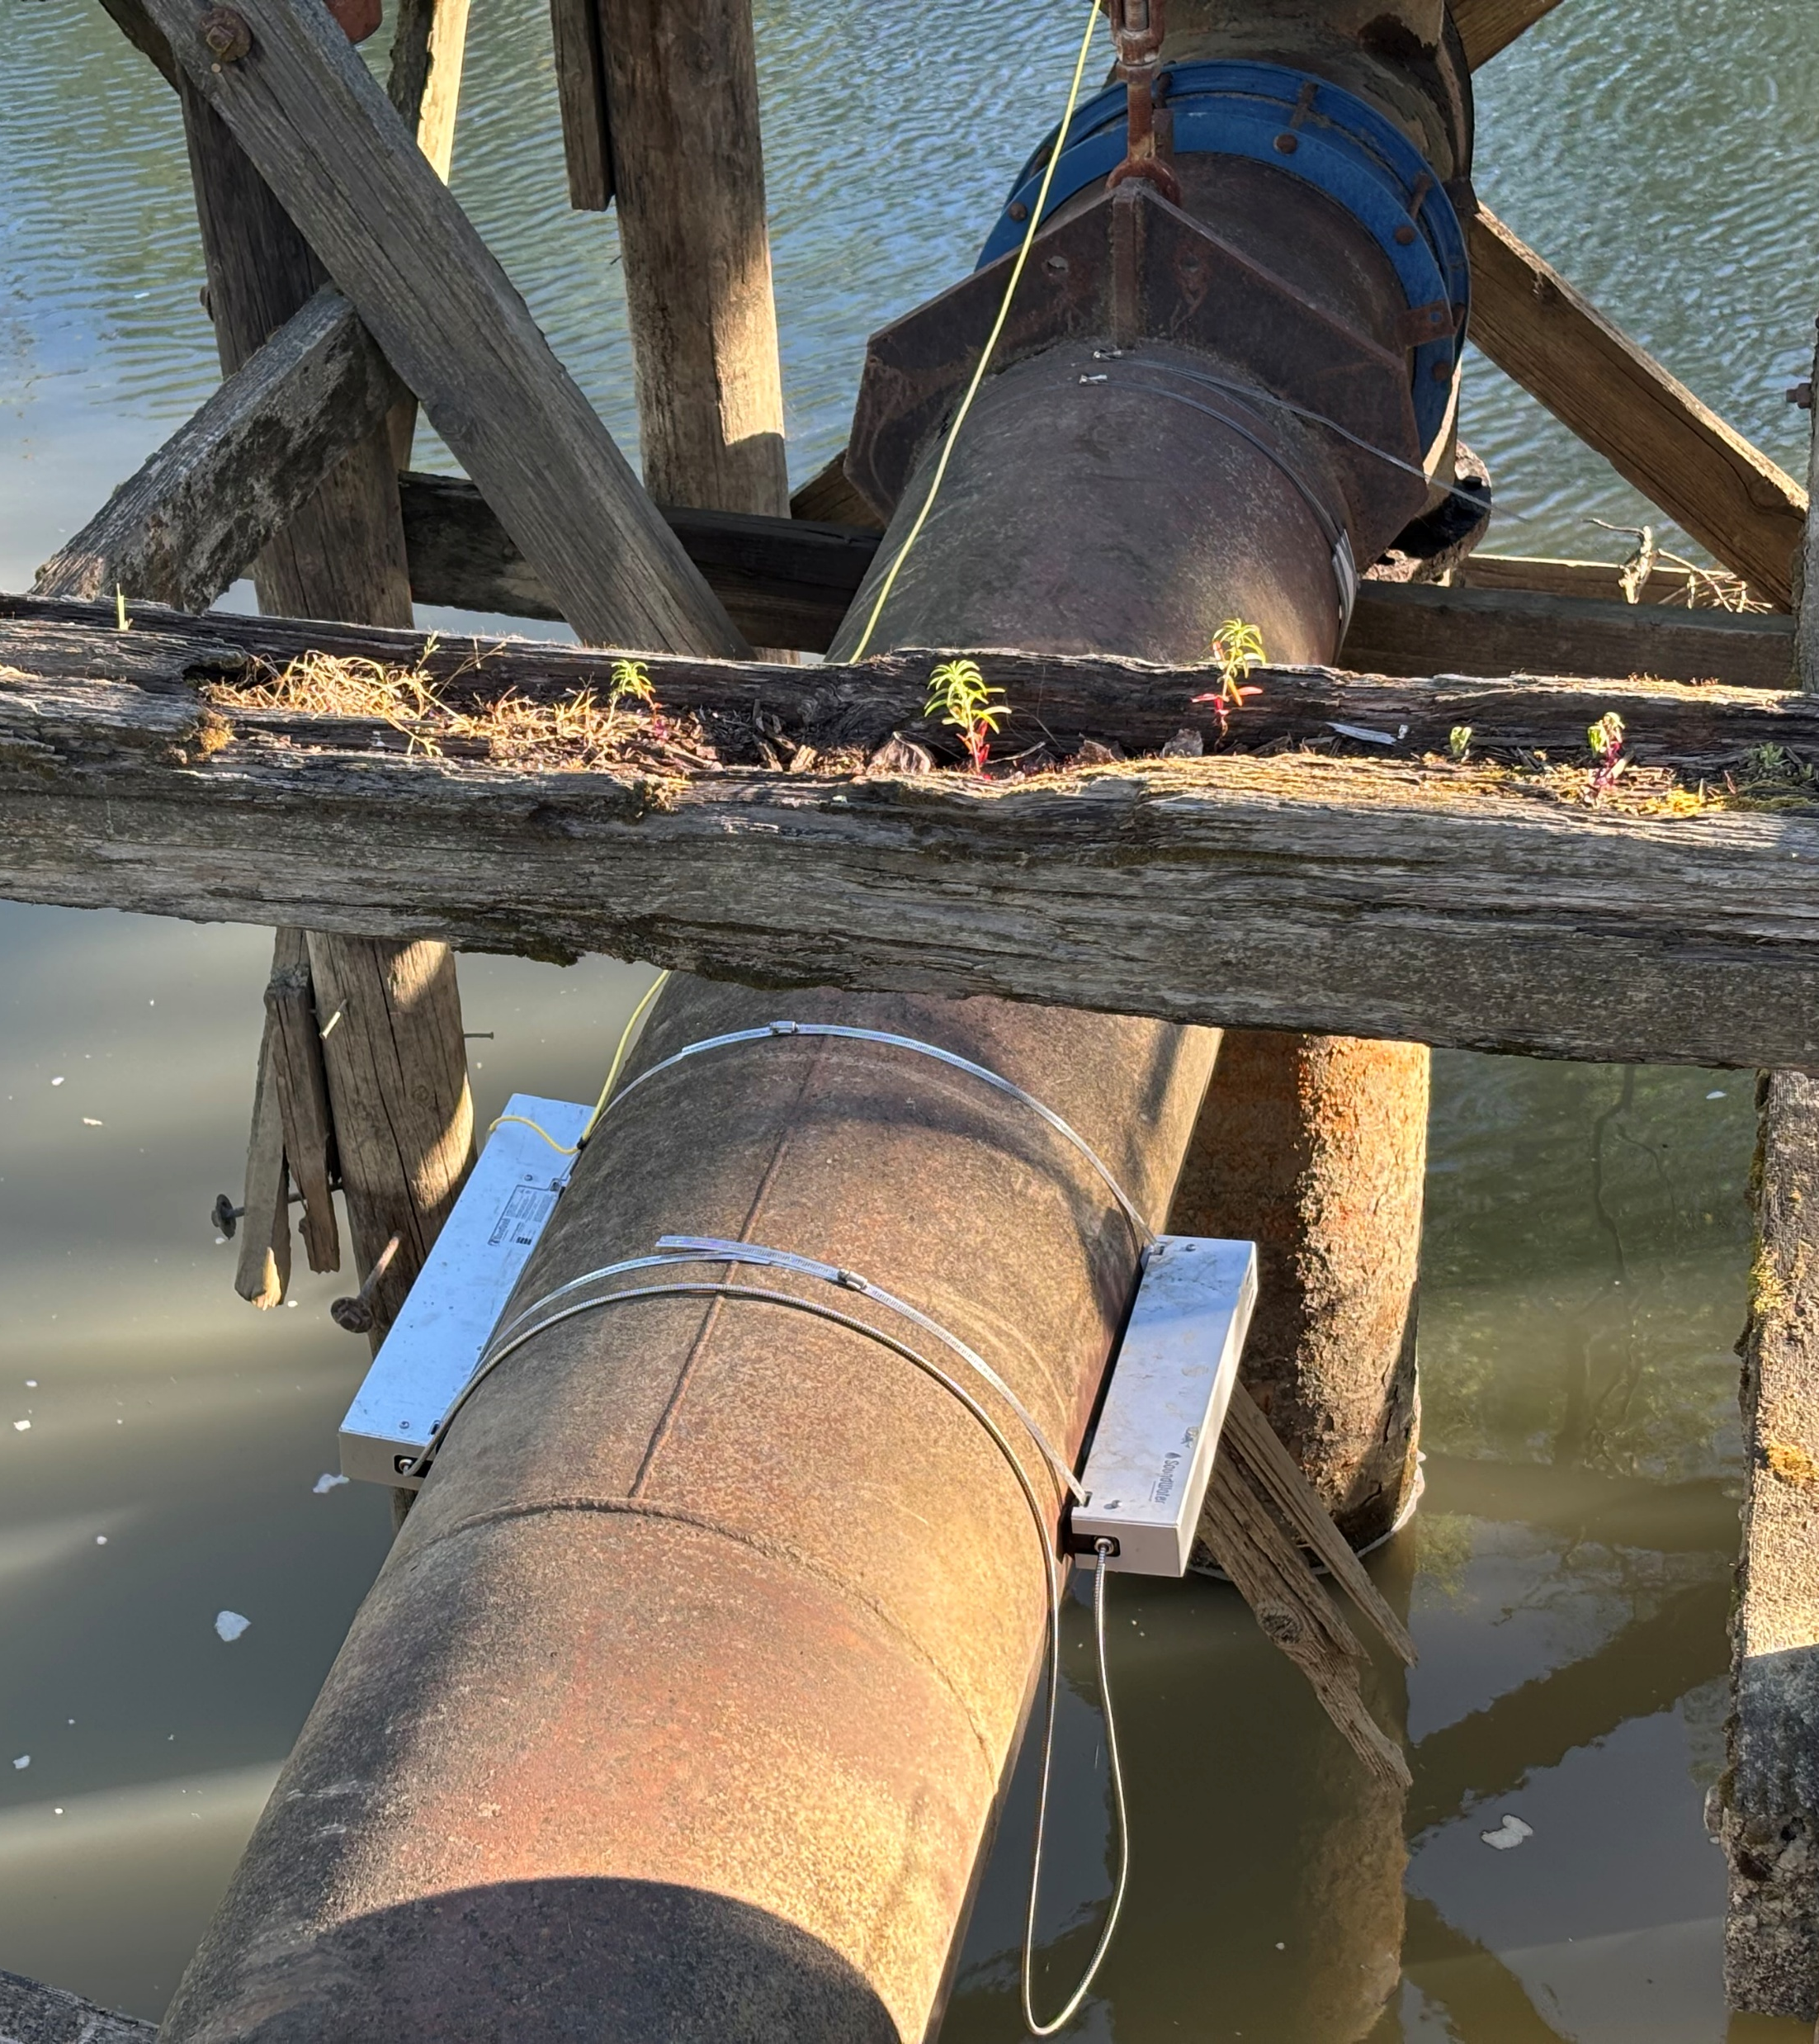
Going Forward
Add diverter meters and wheeling sites in 2026
Rebuild Mace flow monitoring site on Putah Creek
Install permanent Pedrick Rd flow station as part of the Nishikawa restoration project

Slide 26
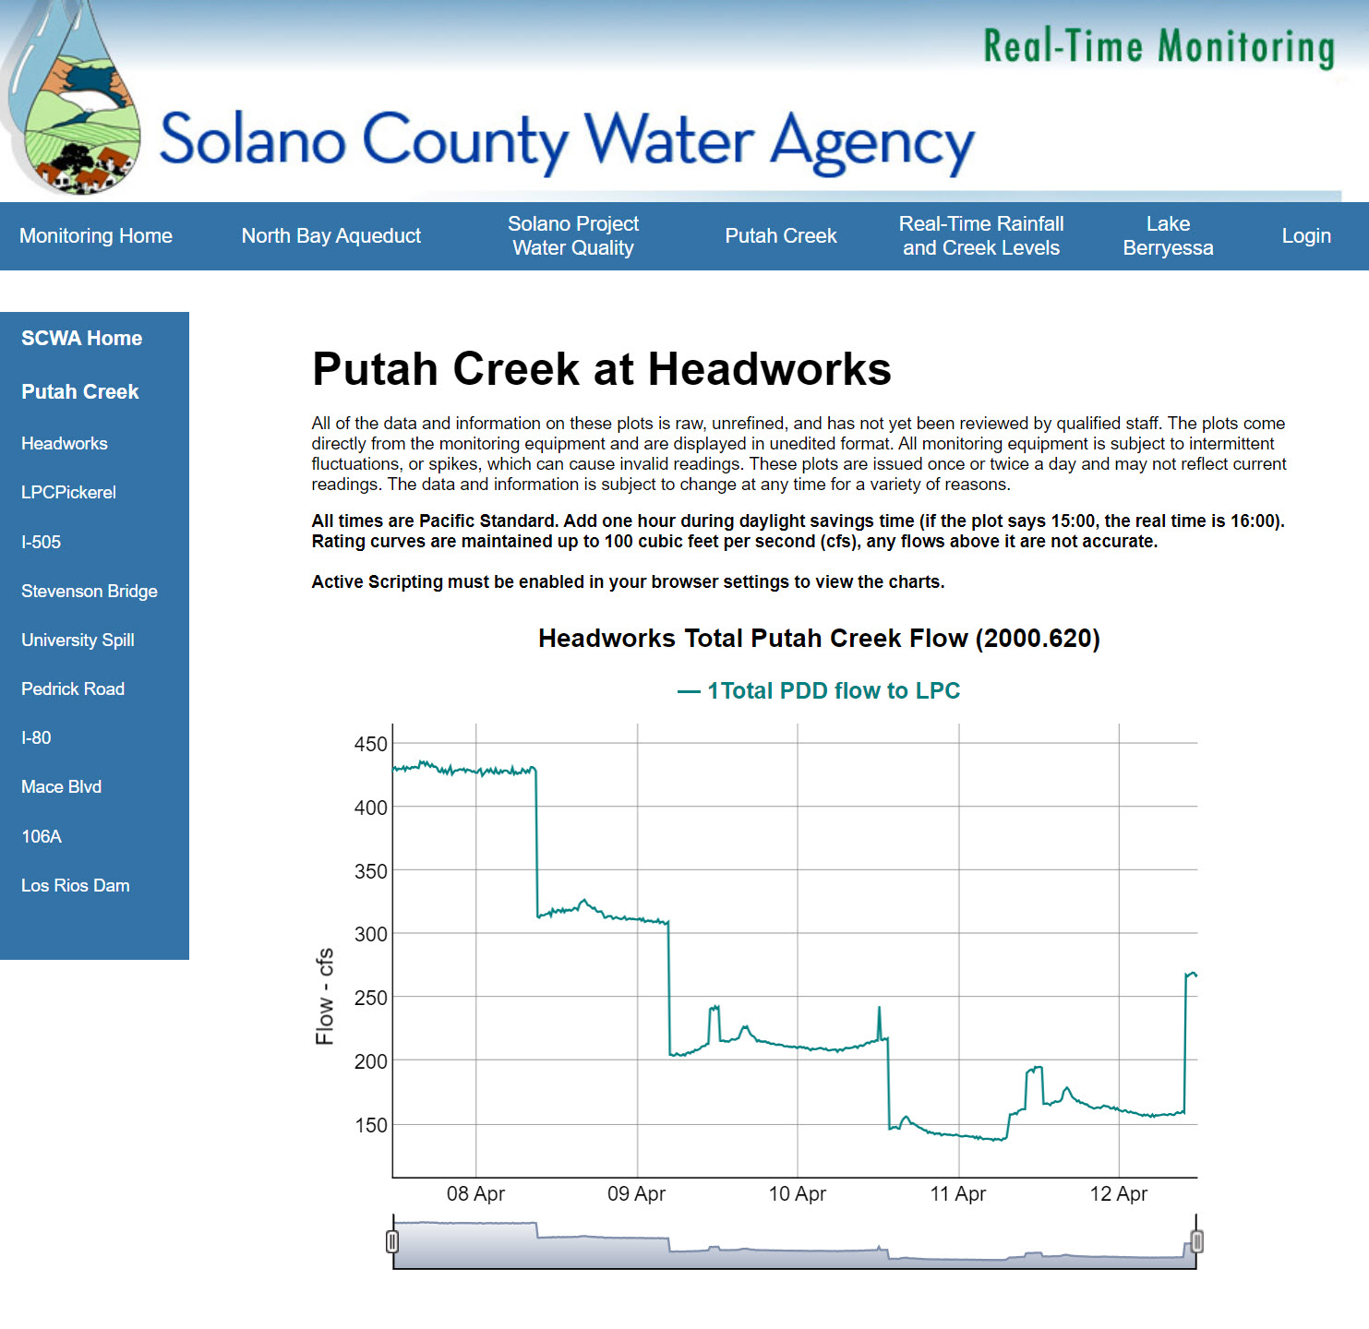
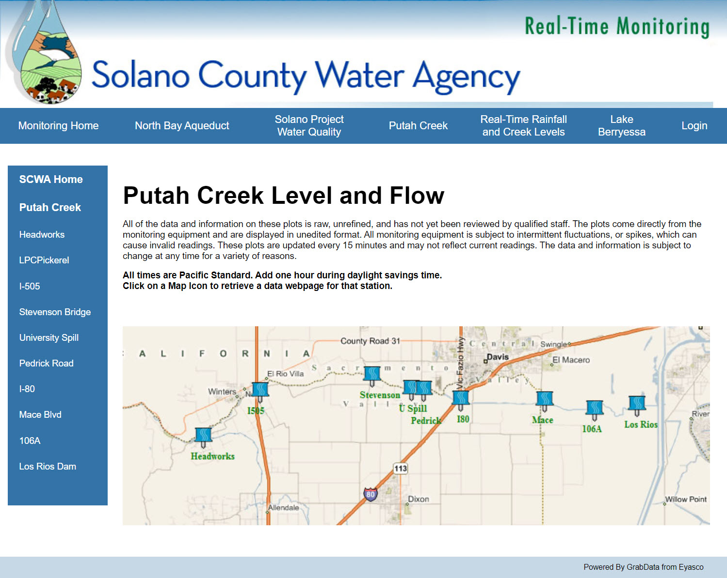
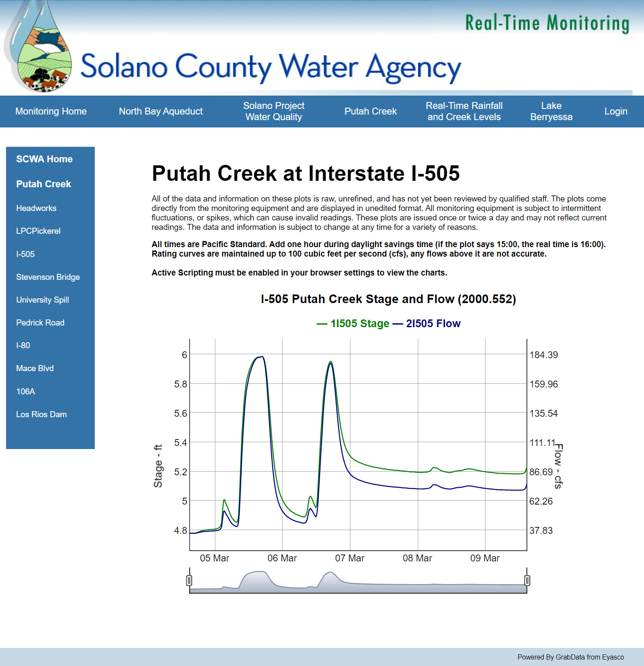
SCWA Data Available in Near Real-Time on our web page
https://www.scwamonitoring.com/solano_putahcreek/index.htm

