Slide 1
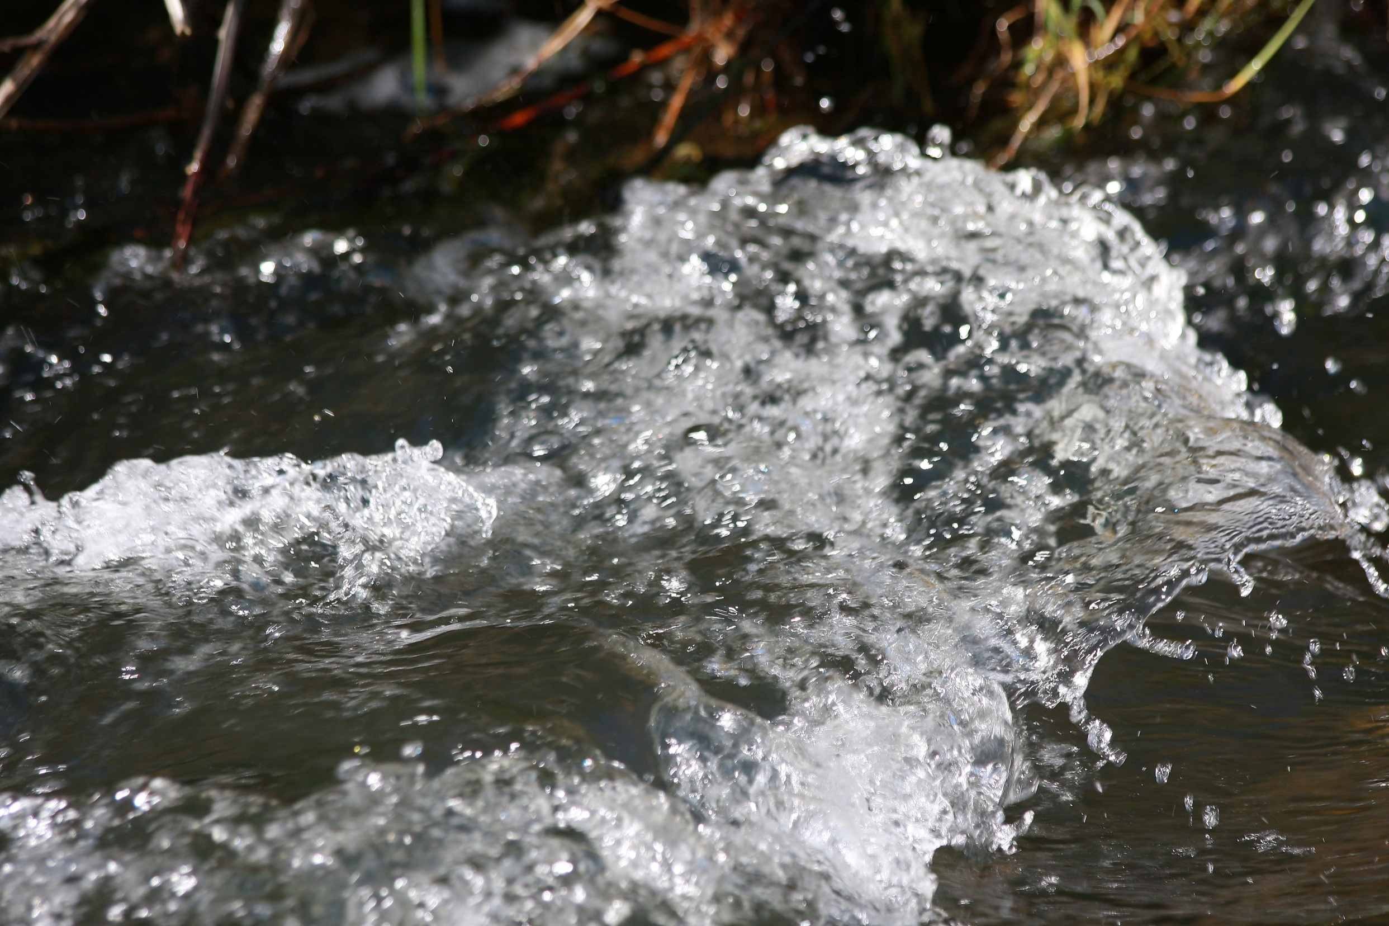
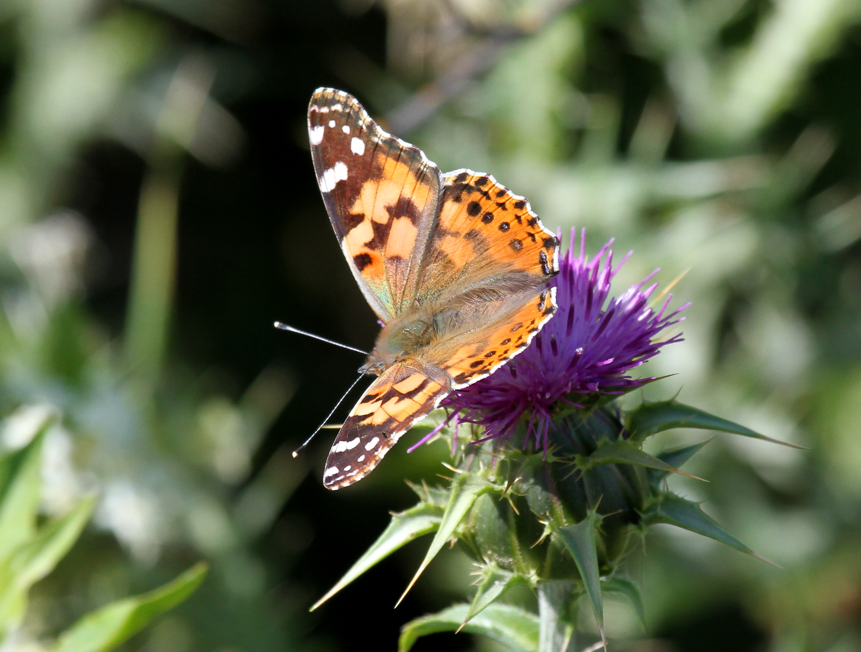
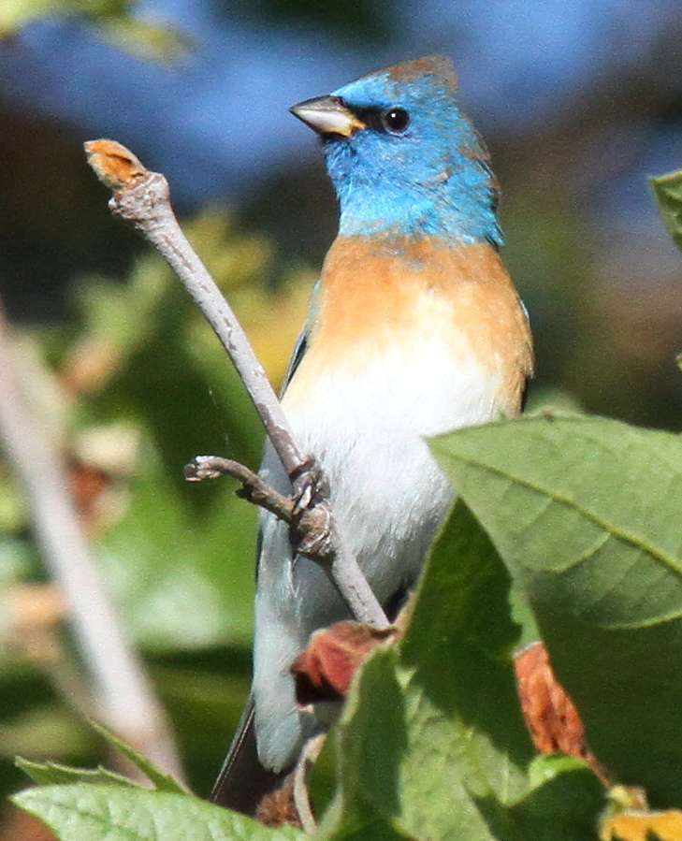
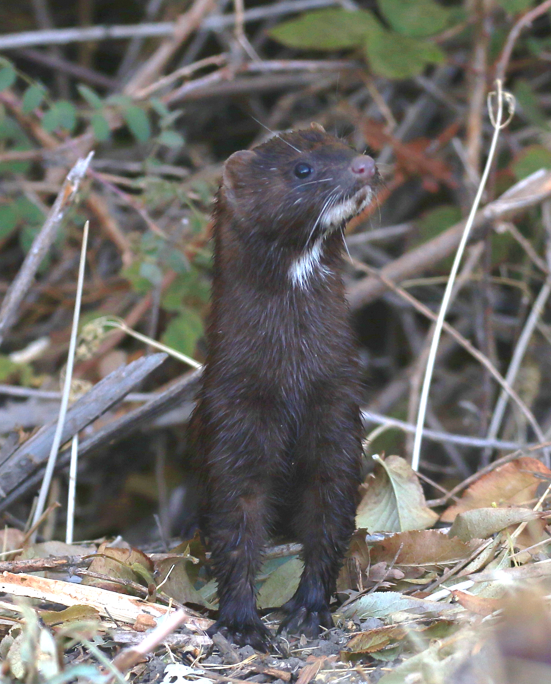
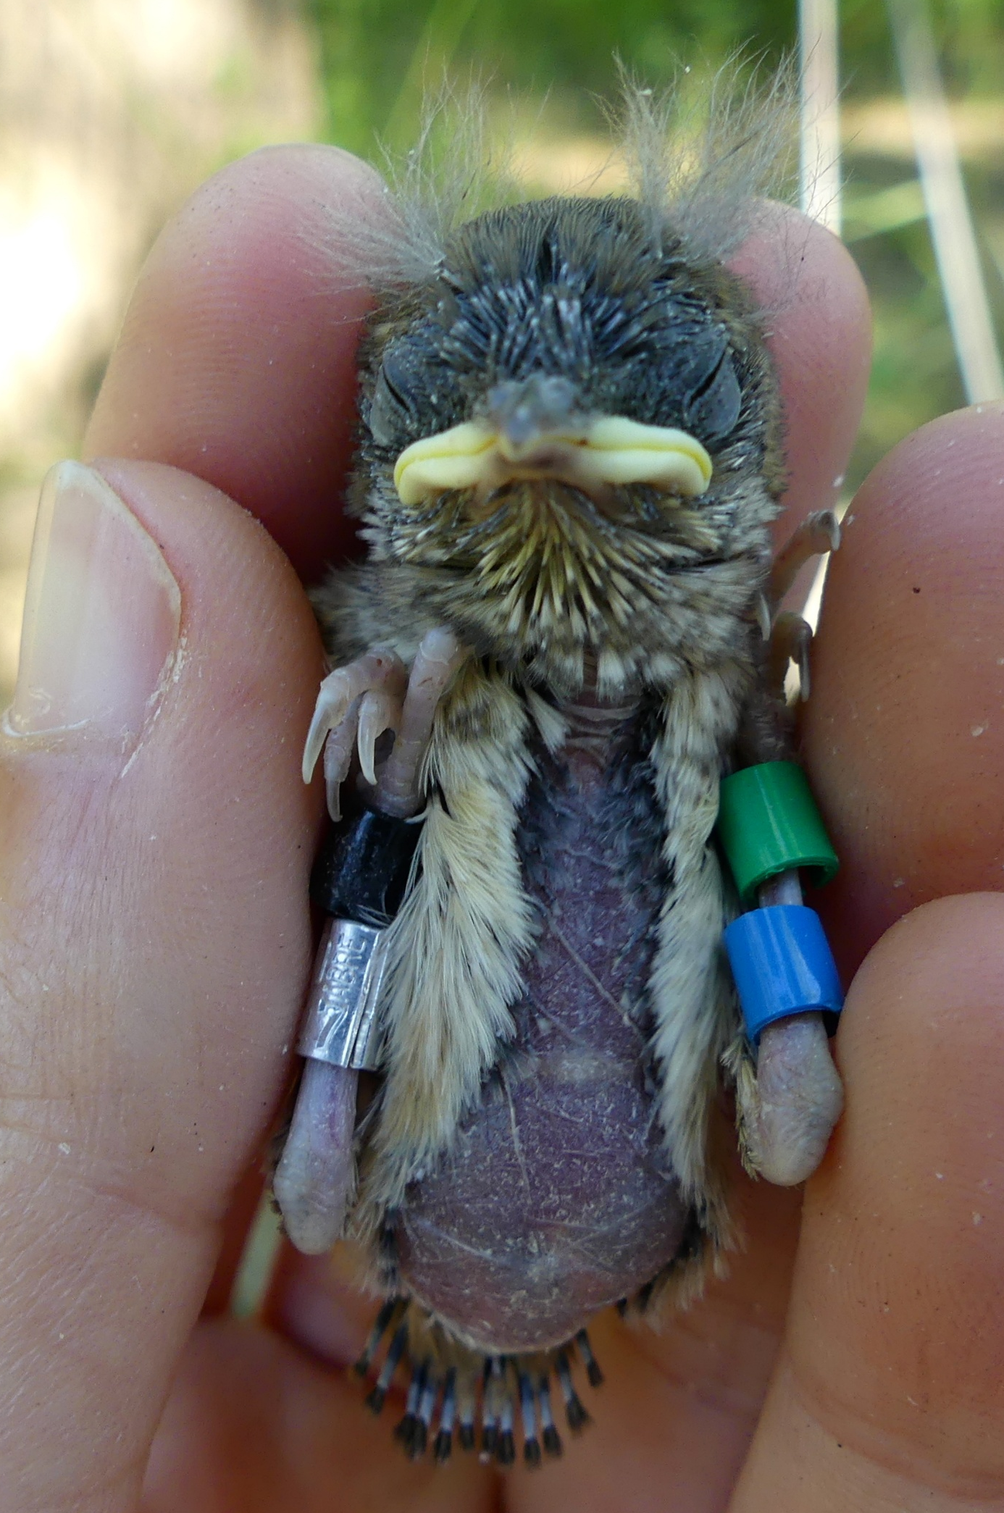
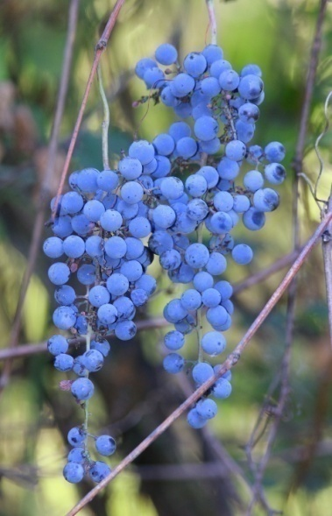
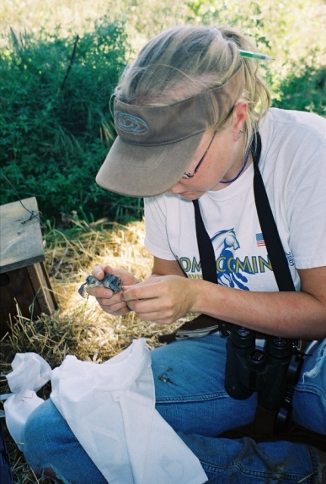
UC Davis Museum of Wildlife and Fish Biology
Putah Creek Terrestrial Wildlife Program 2000 - 2026

Slide 2
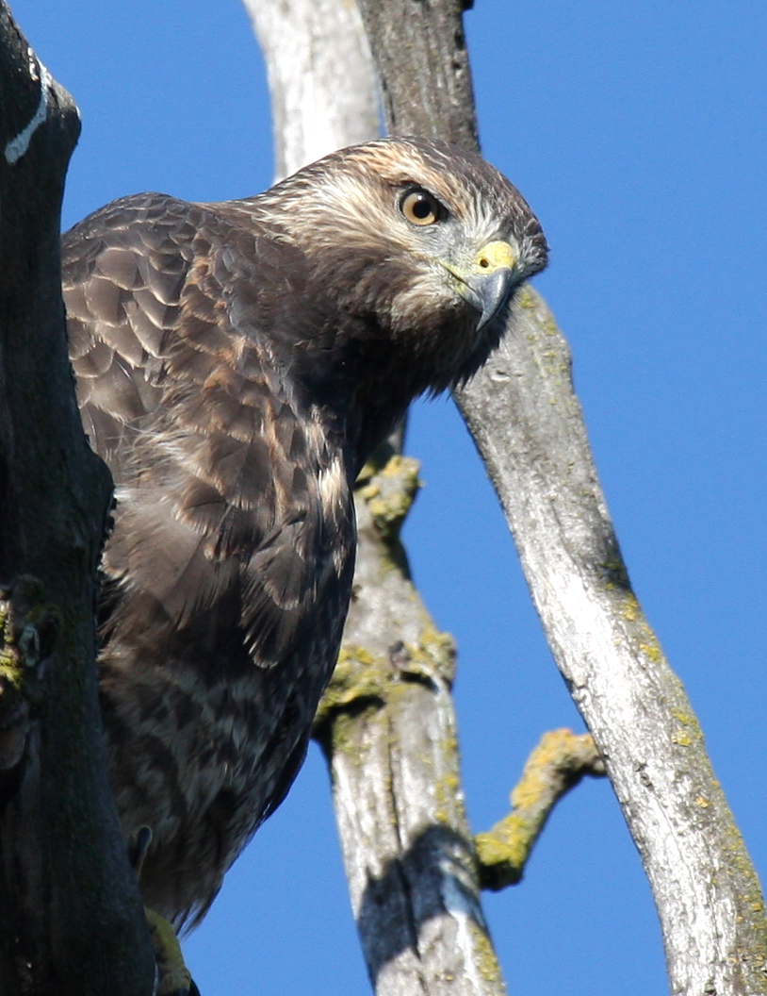
Putah Creek Terrestrial
Terrestrial Wildlife Monitoring Effort
Evaluate the quality and importance of Putah Creek’s riparian habitat and its contribution as a resource to the Central Valley landscape.
Measure wildlife response to restoration efforts and provide adaptive management recommendations to managers and landowners for habitat enhancement.
Improve scientific understanding of physical and biotic relationships for Central Valley riparian habitats.

Slide 3
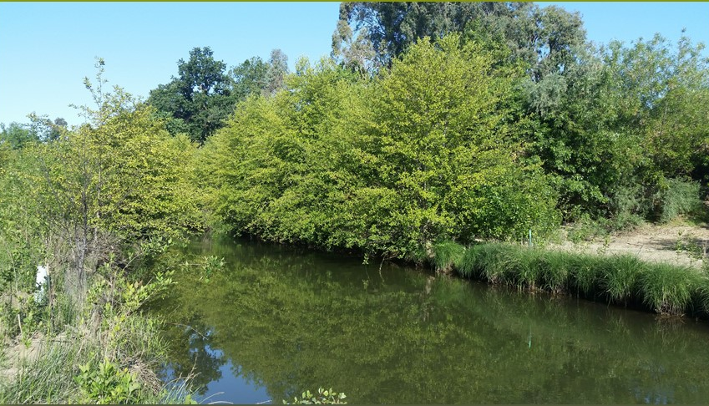
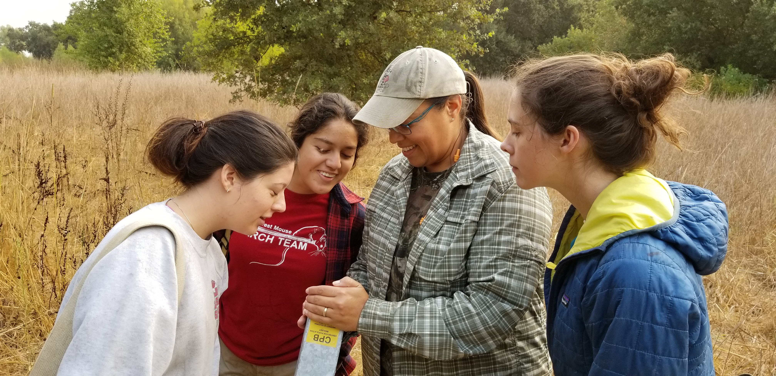
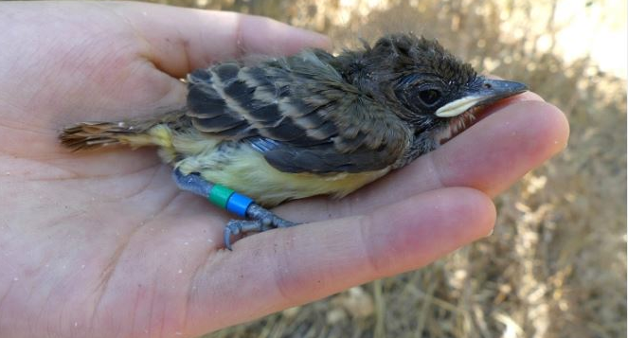
25 Years of Monitoring Support Habitat Goals for Putah Creek
Develop ecologically sound and economically viable projects for protecting and enhancing Putah Creek’s natural resources.
Advance the science and practice of restoration ecology through a partnership of community-based projects along the creek.
Advance training opportunities for undergraduate students

Slide 4
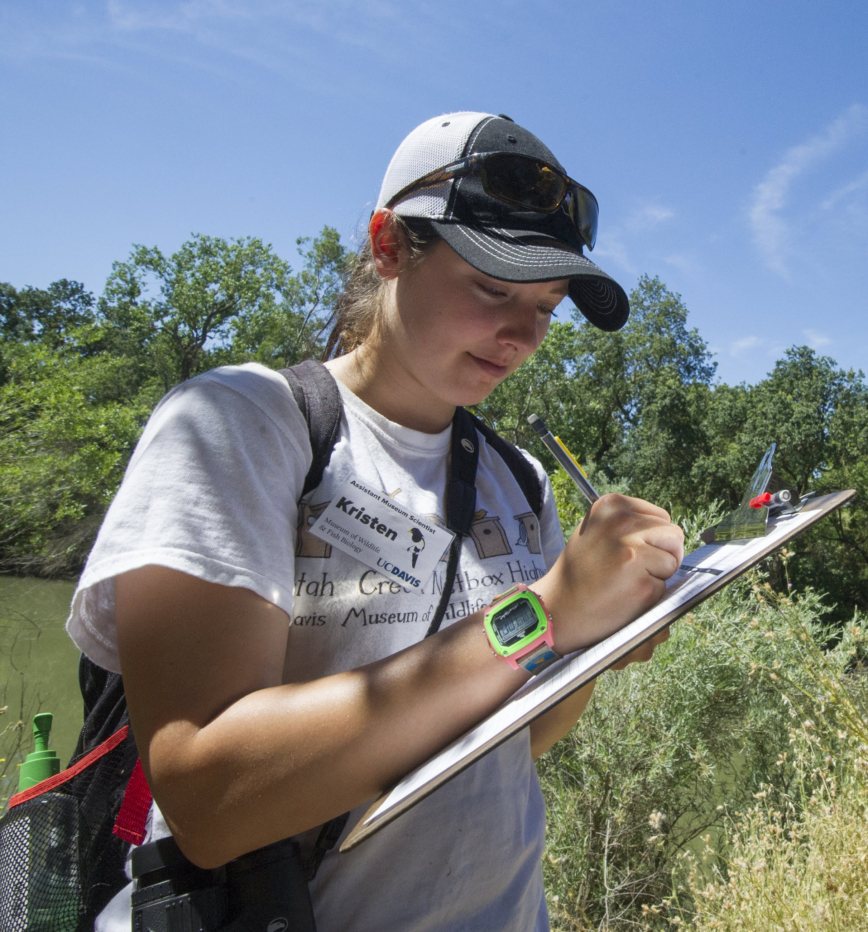
Monitoring a Novel Ecosystem:
Understand:
Study:
Inform:
Goal:
Define Existing Biodiversity
Ecological and Temporal Patterns
Inform Restoration and Management
Sustaining Biodiversity -- even if it is different from what it was originally

Slide 5
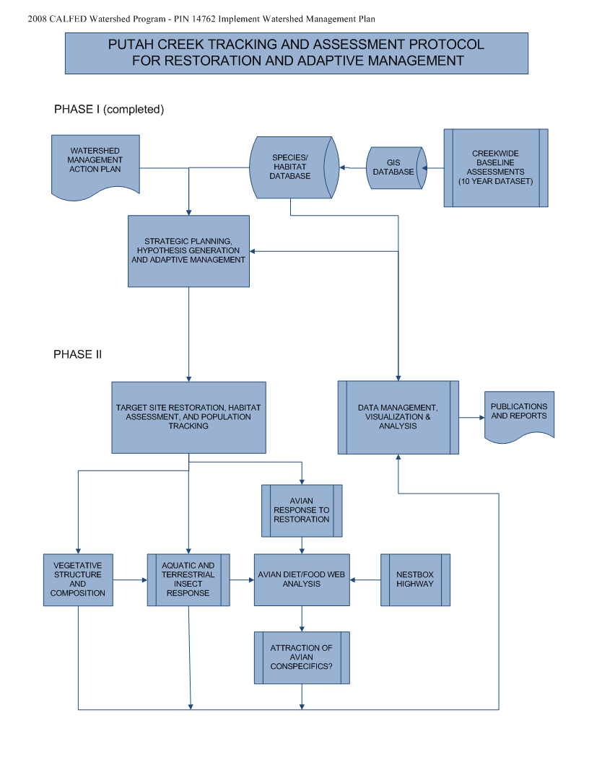
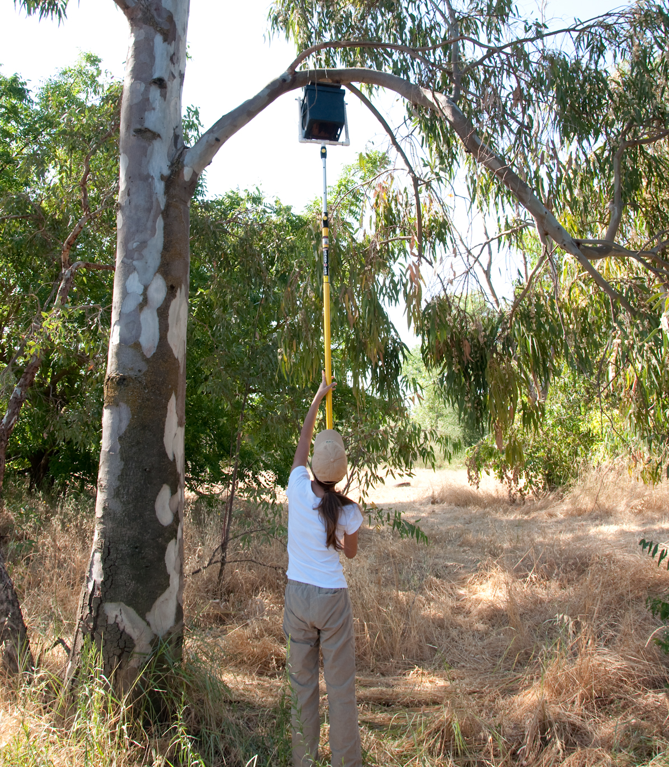
Flowchart for Putah Creek Wildlife Tracking Effort

Slide 6
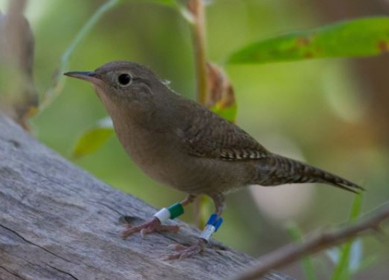
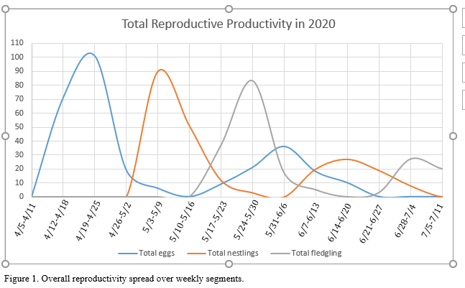
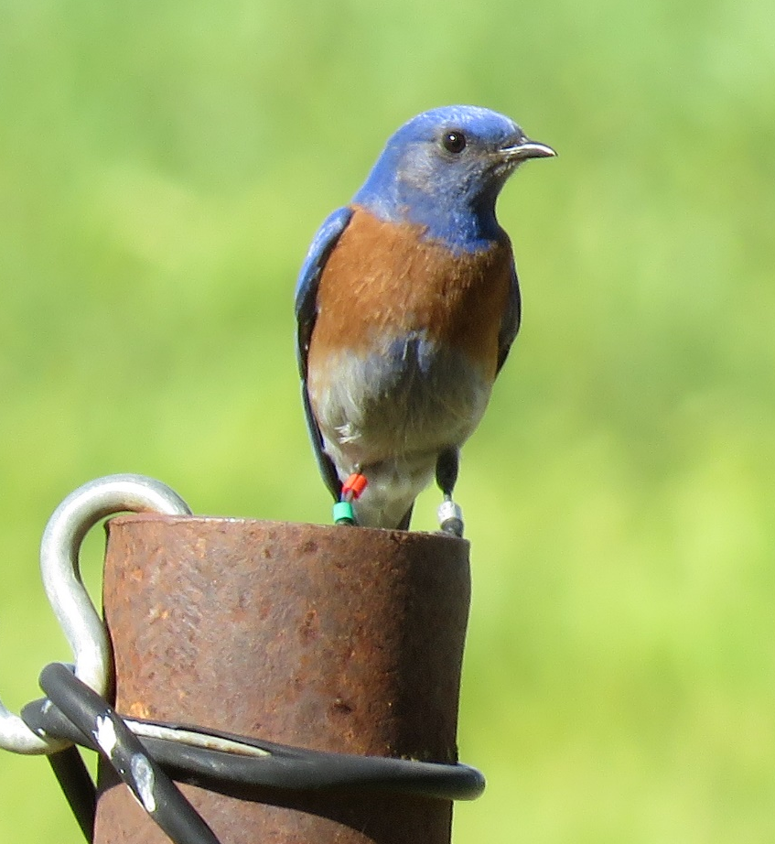
DESCRIPTIVE PHASE
COMPLETED by 2010

Slide 7
Descriptive phase documented diversity found on Putah Creek
PLANTS
ANIMALS
  New combinations of species, native and non-native
Notes:
Explain graph and walk students through the overall trends.

Slide 8
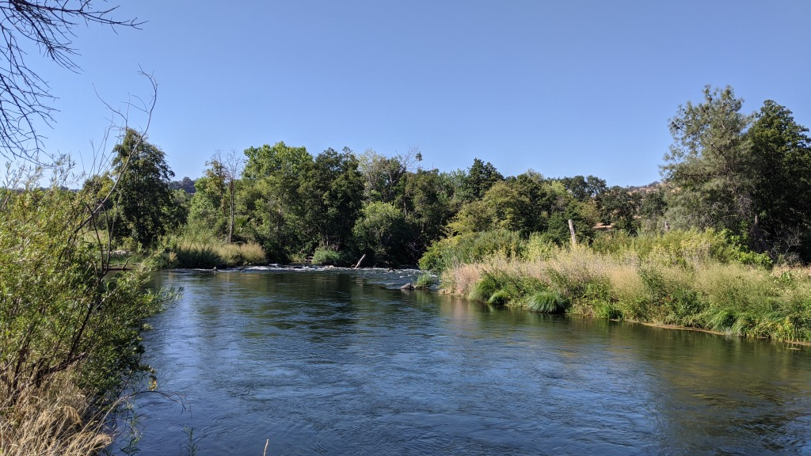
In new Phase of Understanding
Diversity and Response to Restoration
Influence of habitat and climate on the fitness of
cavity-nesting songbirds in California’s Central Valley
Jason Riggio, Andrew Engilis, Jr., Hanika Cook, Evelien De Greef, Daniel Karp, and Melanie L. Truan

Slide 9
Putah Creek BIOMONITORING “TOOLBOX”:
Biomonitoring designed specifically to integrate with and measure success of habitat restoration and management goals
Established 14 transects for long-term evaluation of creek wide AND site- specific patterns of diversity, abundance and distribution
Established wildlife distribution maps on 22 one-mile-long increments
Species list for all vertebrates along the creek, including Special Status
Birds: abundance, diversity and distribution data for sentinel species
Bird Nest Box Program: productivity data as bioindicators.

Slide 10
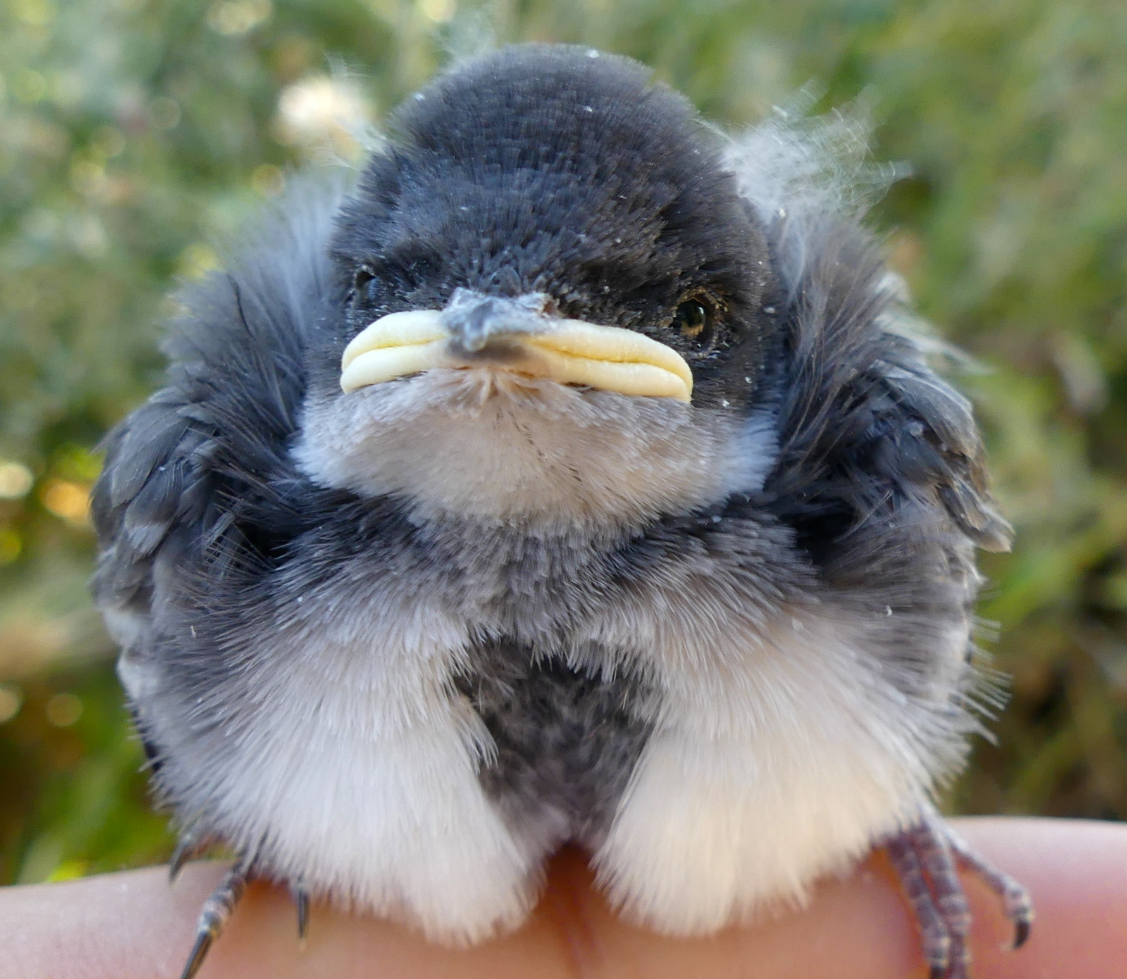
Survey Plots
Camera Stations
Bat Acoustic Surveillance
Bird point counts
Bird Transects
Bid Nest Box Program
Herp surveys
Butterfly Surveys
Native Bee surveys
Vegetation surveys
Small Mammal Trapping

Slide 11
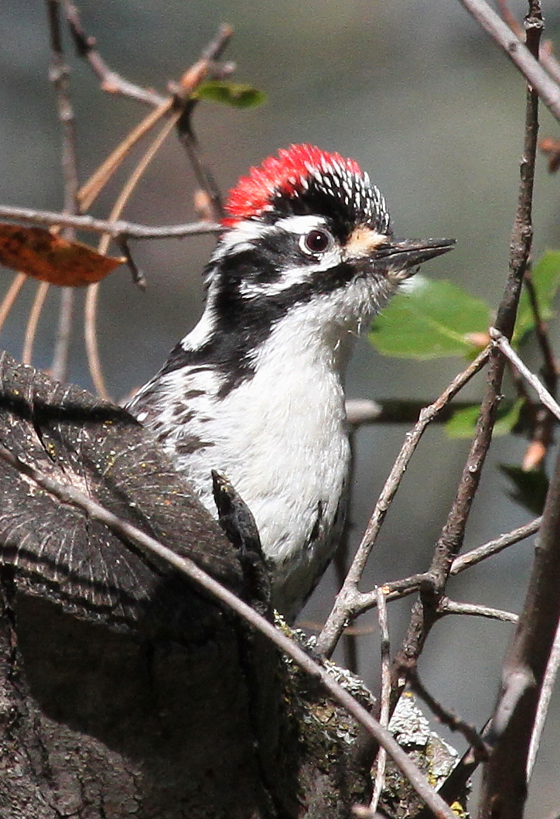
Annual Terrestrial Wildlife Workflow
on Putah Creek
January - February
Mid-winter Avian Surveys
March
Preplanning surveys and crews recruit undergrads for Nest Box Program
September - October
Complete data entries and management for the field season. Conduct Fall bird transect surveys
November - December
Draft reports, manuscripts, and disseminate to partners and landowners
July - August
Wrap up field surveys for breeding season, begin data management
April - June
Nest Box Monitoring, Avian Point counts and transects on Putah Creek, other incidental surveys

Slide 12
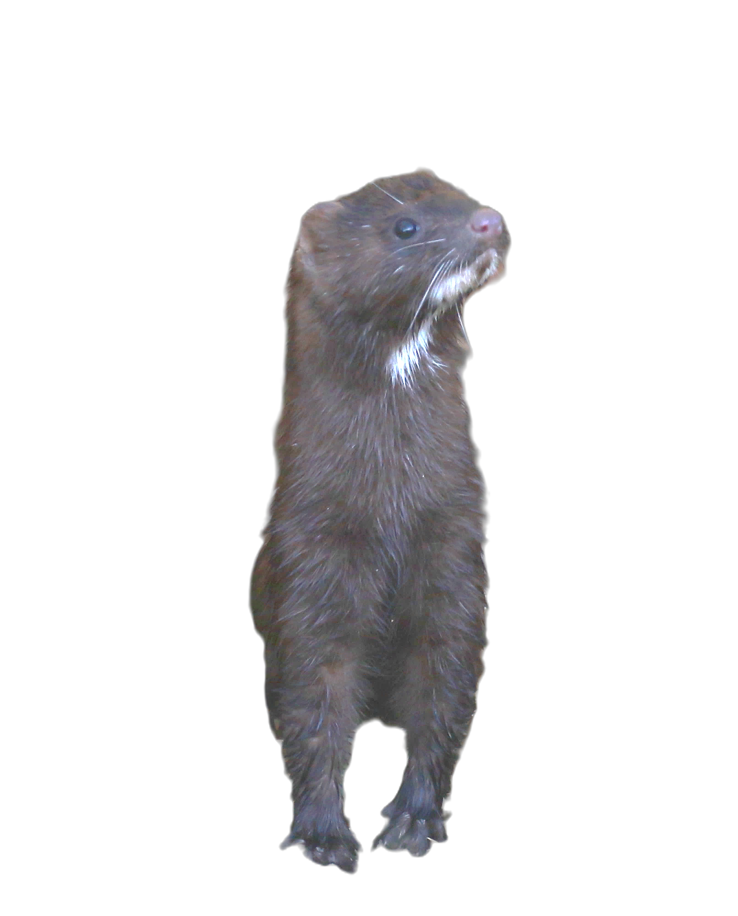
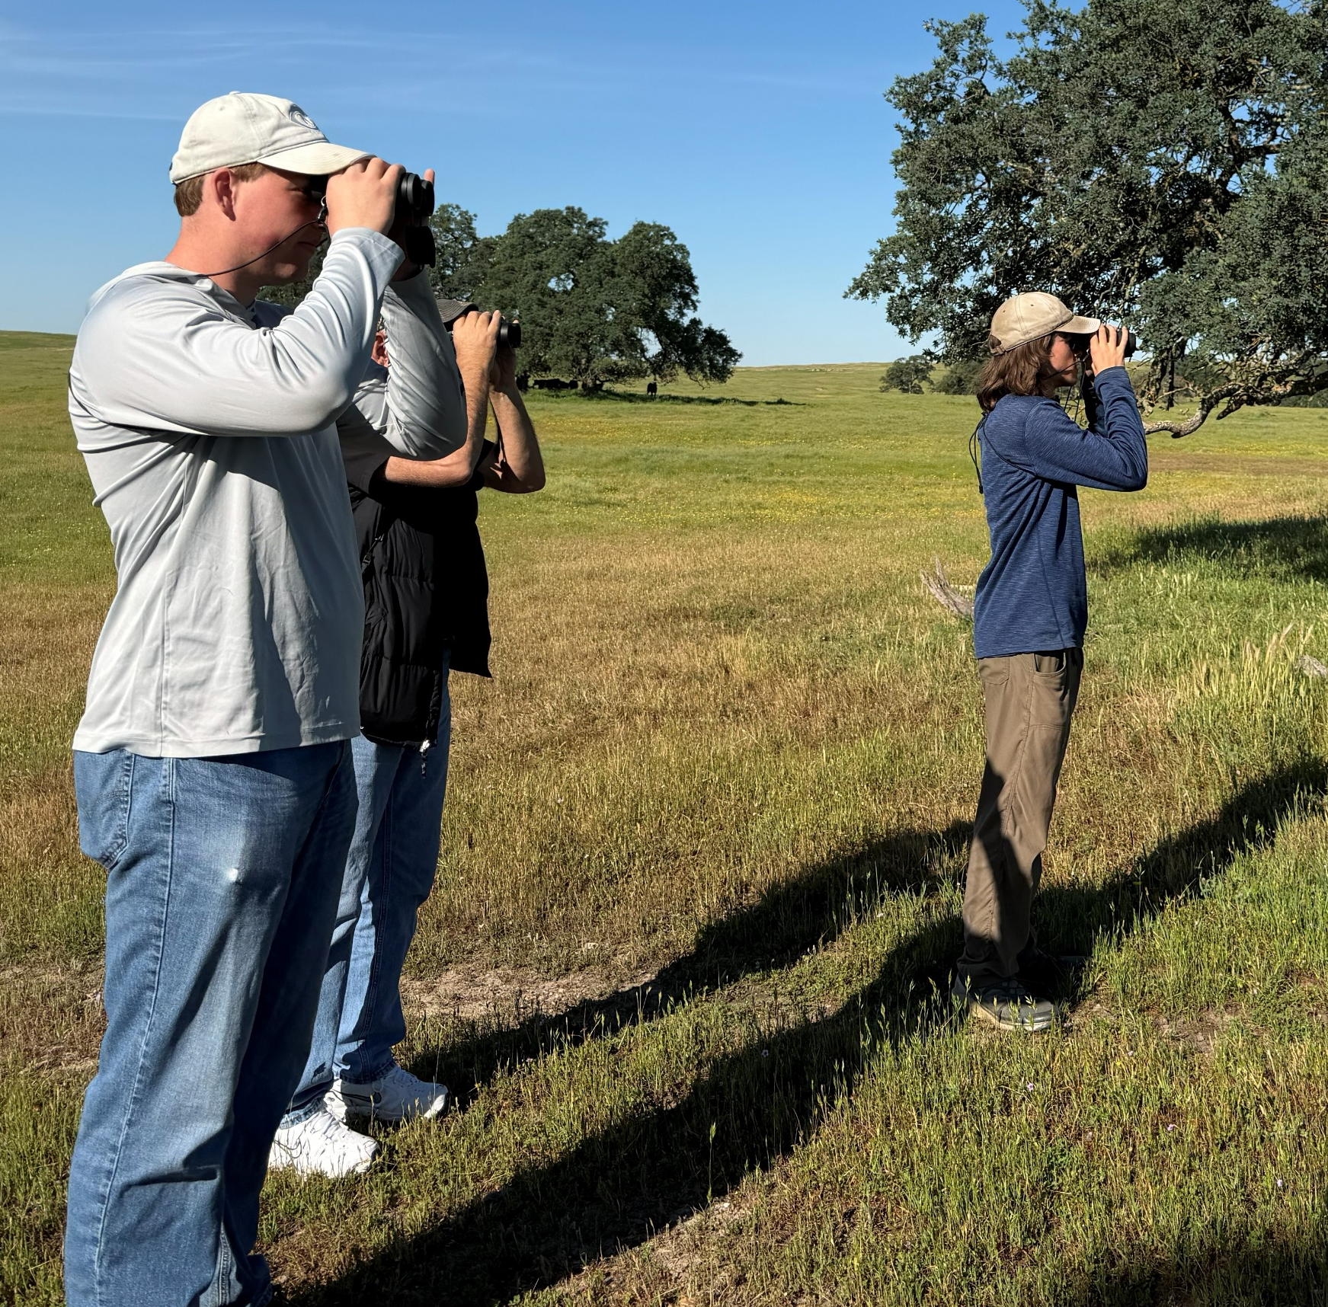
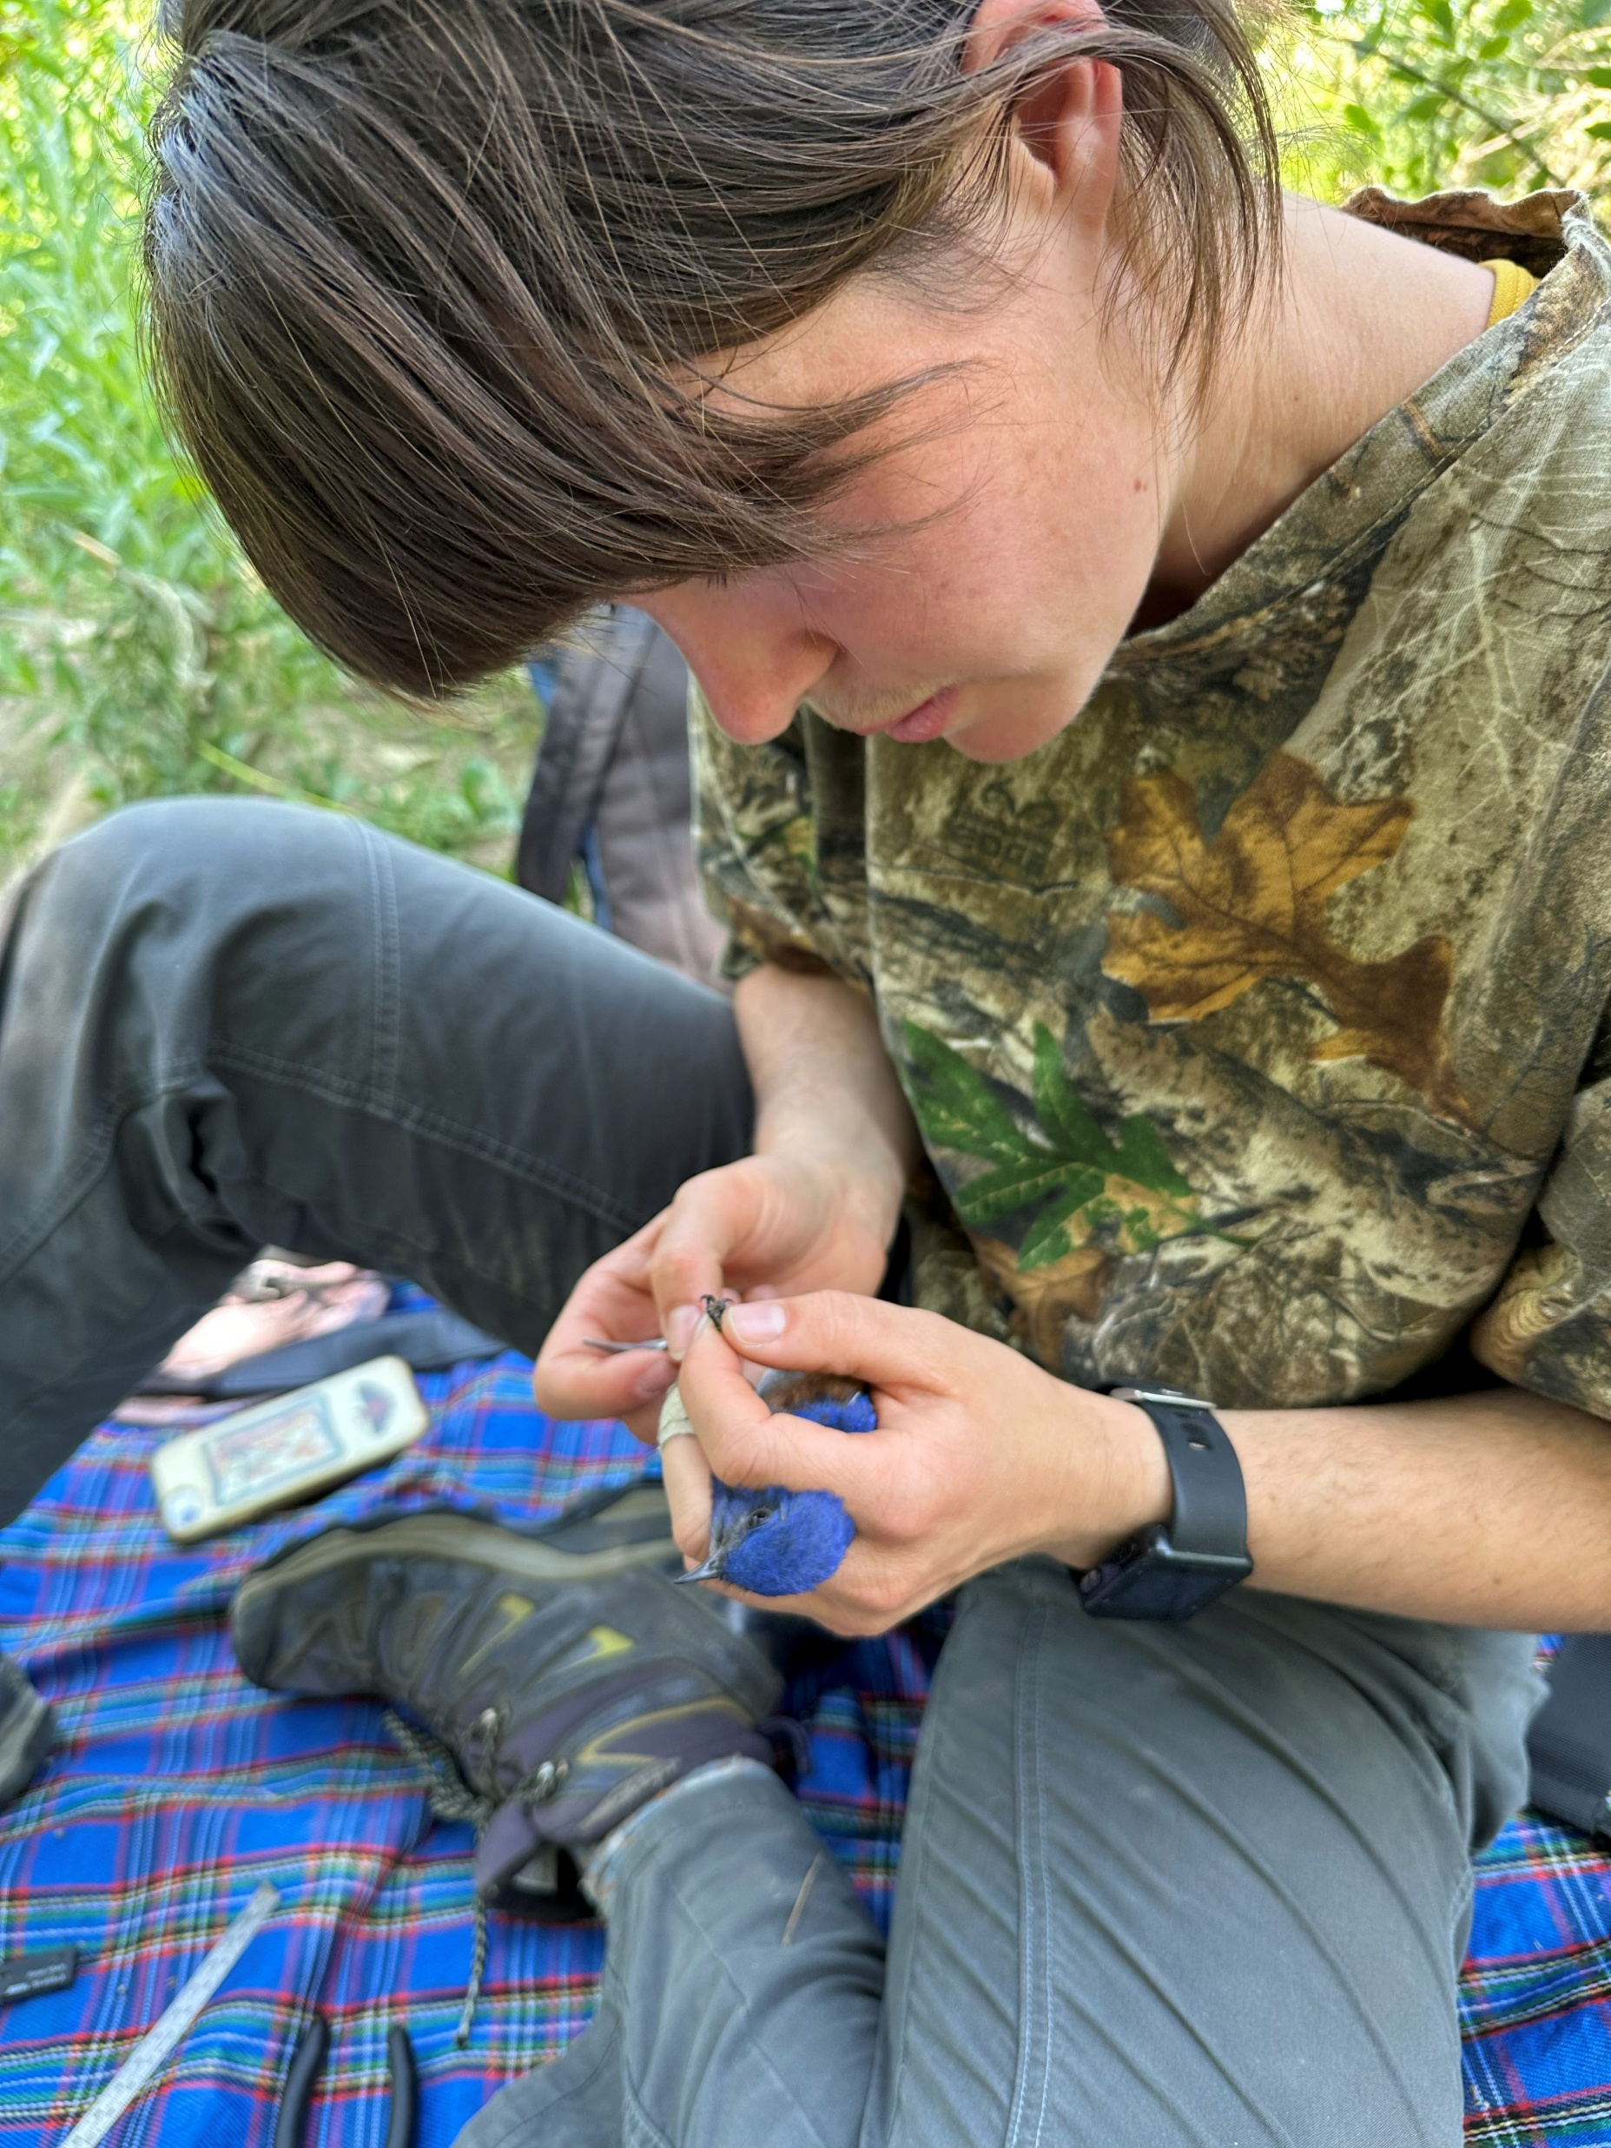

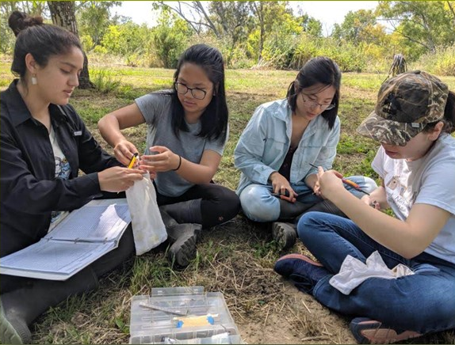
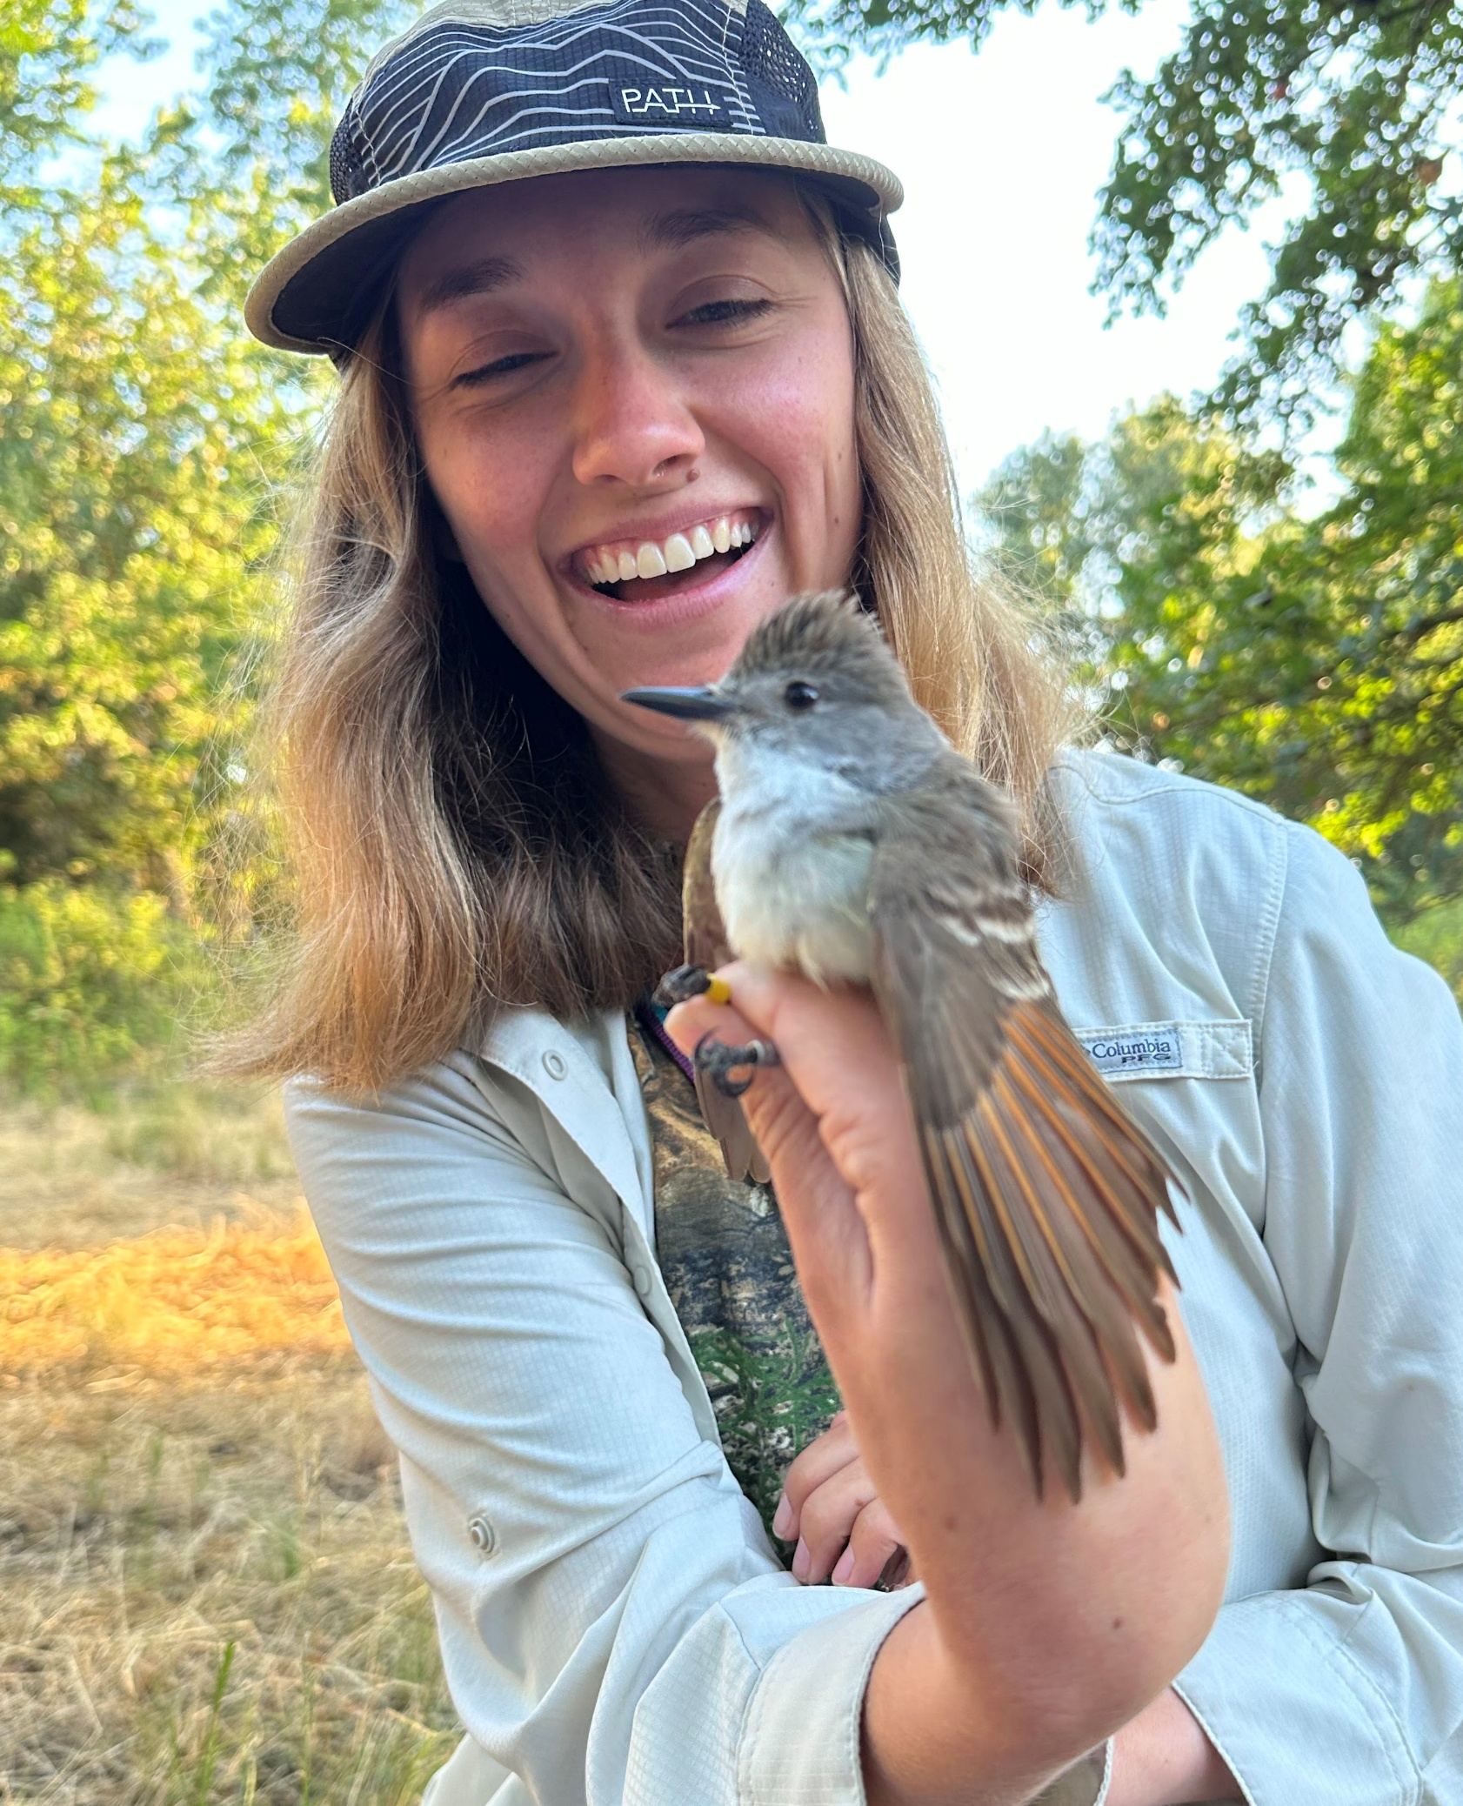
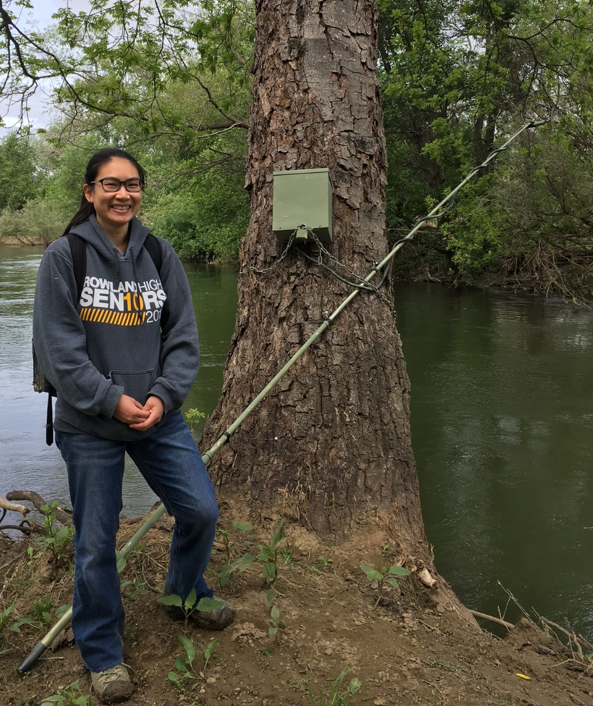
Staffing
2025 →
Avian Survey Team
Amanda Kindel
Research Biologist
Nest Box Teams
Andy Engilis
PI
Maggie Borda
PC Biologist
Misc Survey Teams

Slide 13
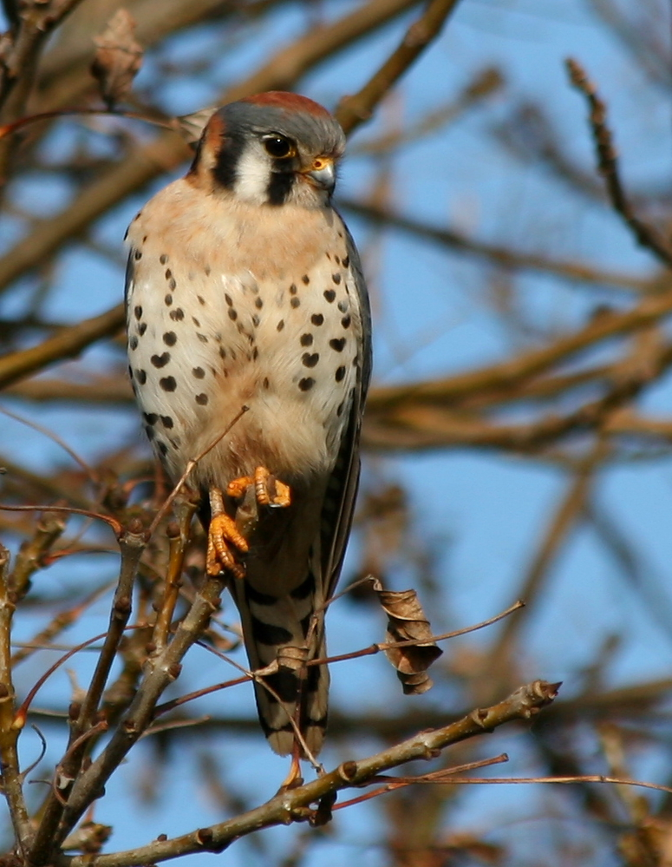
Workflow for Data Capture and Management
on Putah Creek – Terrestrial Wildlife Surveys
Data Entry into Excel Spreadsheet files (stored on main computers, backed up to cloud storage)
Surveys Assigned
Conduct avian and other surveys as scheduled. Use of Data Sheets
Truth Data Entry different team members than those who entered data
Data Sheets (hard copies) turned-in to central Museum Folders
Archive data as hard copies, digital files in multiple hard drives and cloud-based storage
Scan Data Sheets for digital copies, archive

Slide 14
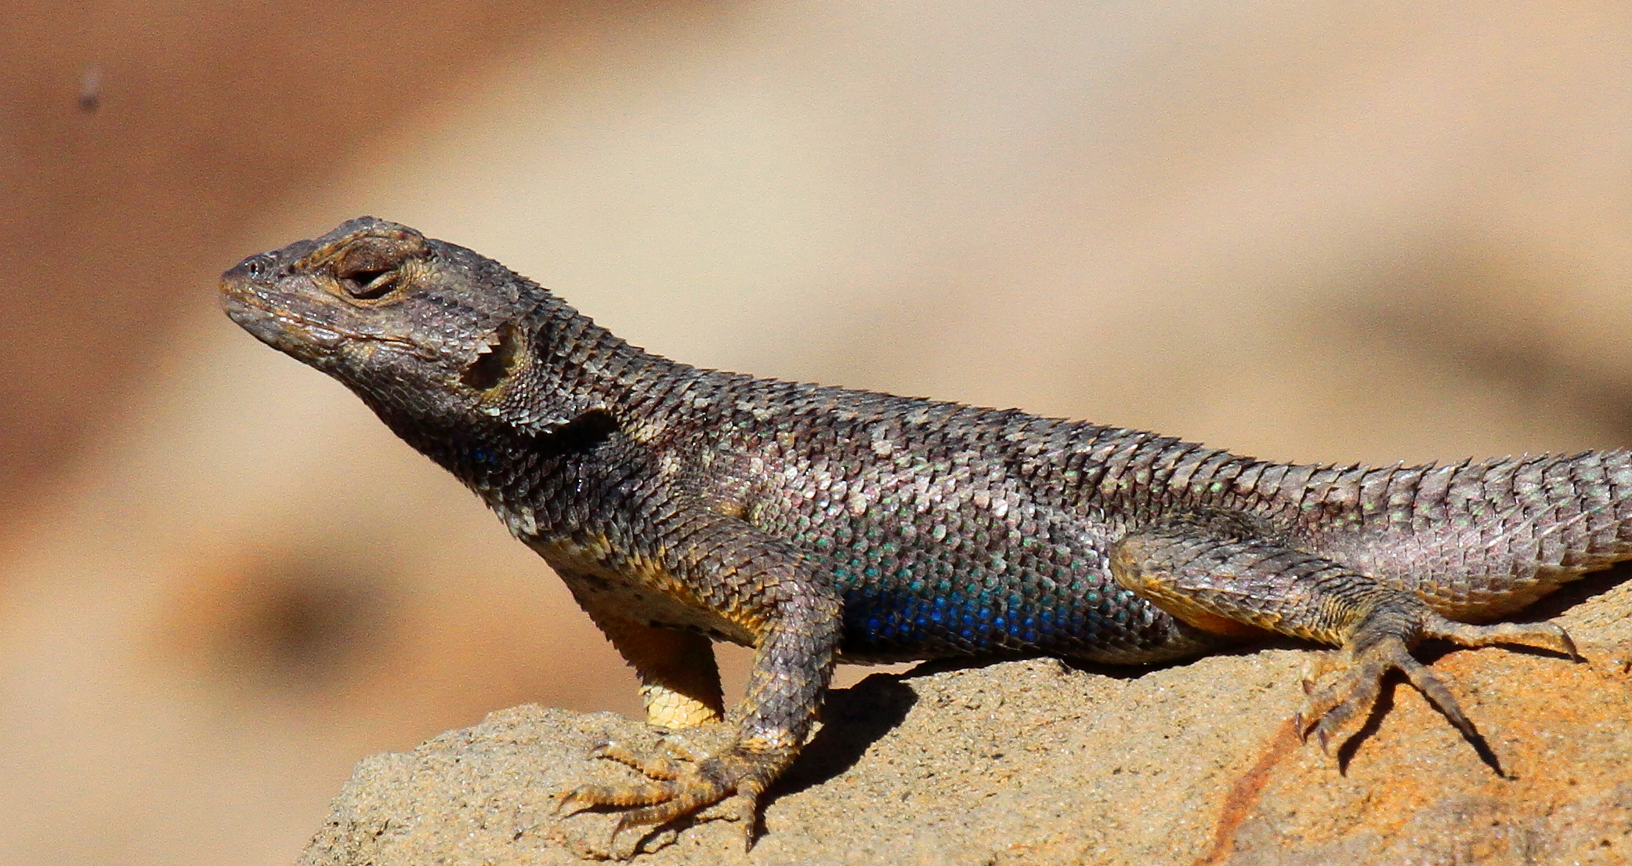
Workflow for Data Capture and Management
on Putah Creek Nest Boxes
Nest Box Monitoring
Teams Assembled
Develop comprehensive logs for each nest when eggs hatch (entered and Maintained on One Drive in an excel format (Proofed weekly)
Monitor Nest Boxes
Weekly logs, develop data sheets for each nest box (approx. 200).
Bird Banding (May-July)
Banding Records to USGS Banding Office. Archived
Data and Banding sheets turned in and scanned
Data Entry into Excel Spreadsheet files (stored on main computers, backed up to cloud storage, and external hard drive.
Truth Data Entry different team members than those who entered data Archive in multiple sites

Slide 15
Archived Data Sets include
Seasonal Bird Surveys – 20 years
Bird Nest Box Productivity – 25 years
Breeding Bird Atlas – 10 years
Mammal Camera Trap Data – 2 years
Bat Diversity Data – 2 years
Yolo Bypass Avian Productivity – 3 years
Diversity of Native Bees – 1 year
Diversity of Butterflies – 3 years
Isotope data on birds – 3 years
Herpetological Surveys – 2 years
Incidental Observation Datasets – 25 years

Slide 16
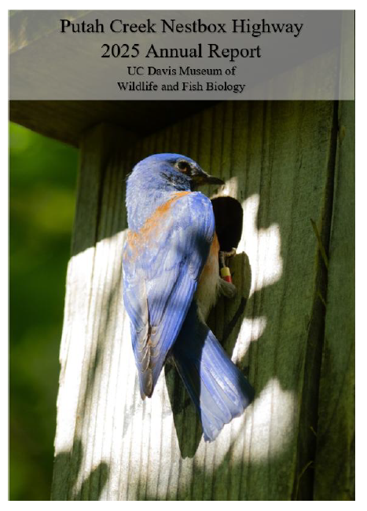

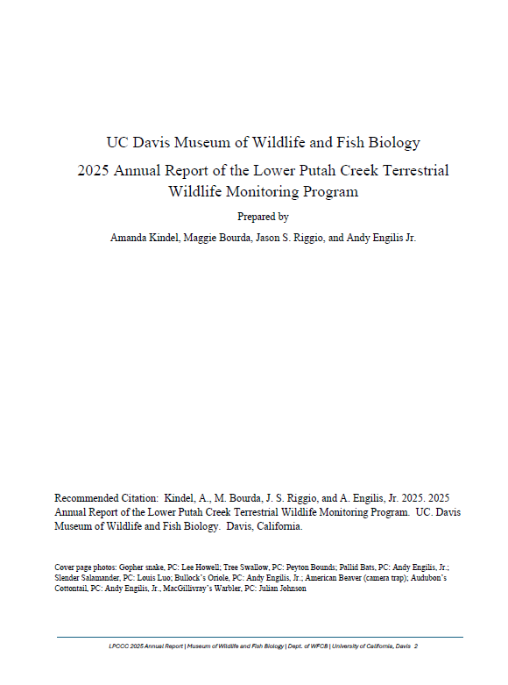
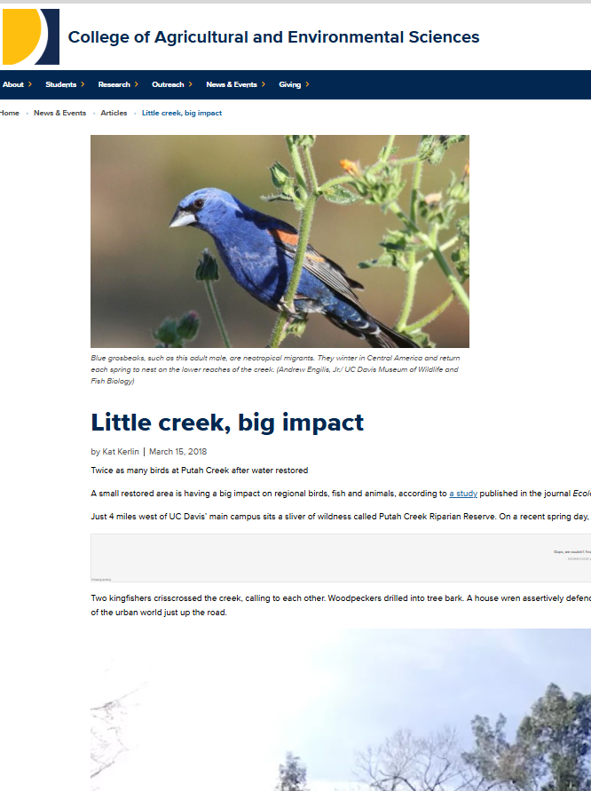
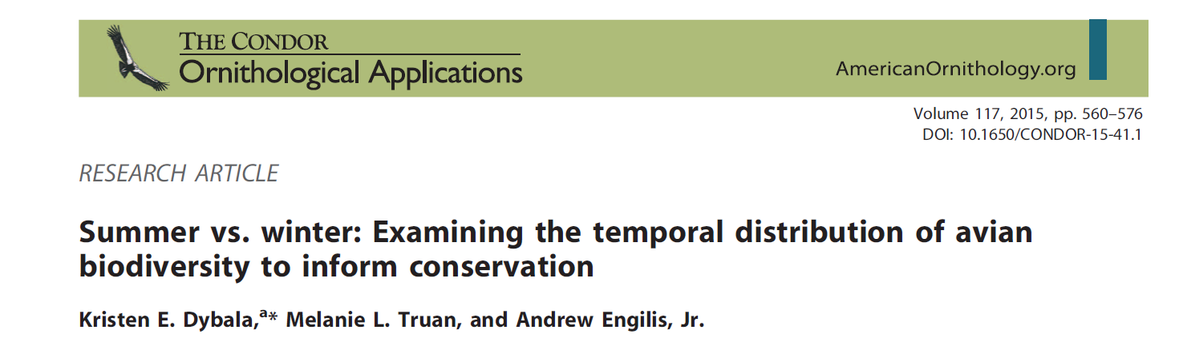
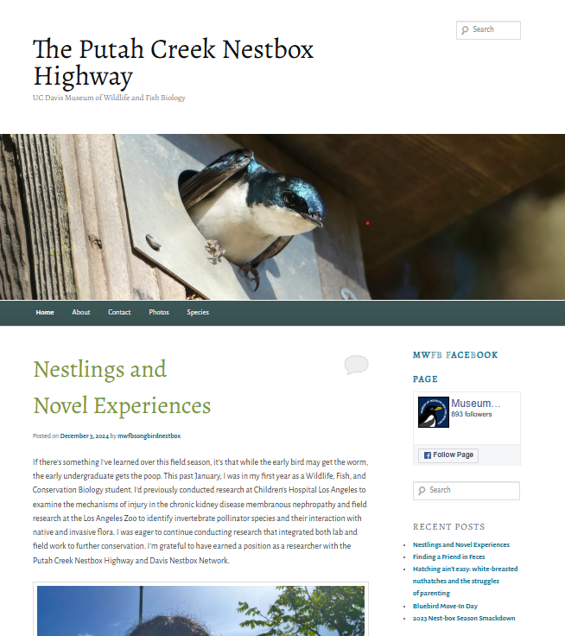
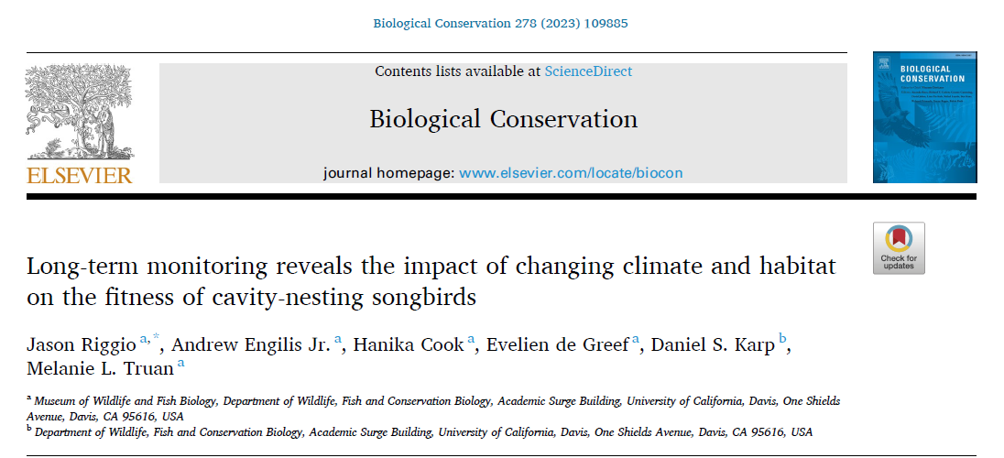
Data Management
Visualization &
Analysis
Annual Reports
Publications
Outreach Blog, Social Media, Media

Slide 17
Longevity is the key to
Understanding and Documentation
25+ Years of data
Informs spatial and temporal patterns
Provides meaningful data to mangers and landowners
Expands scientific inquiry to explore other limiting factors for wildlife along the creek
Expands role of monitoring team in restoration planning
Examines impacts of water and climate on wildlife

Slide 18
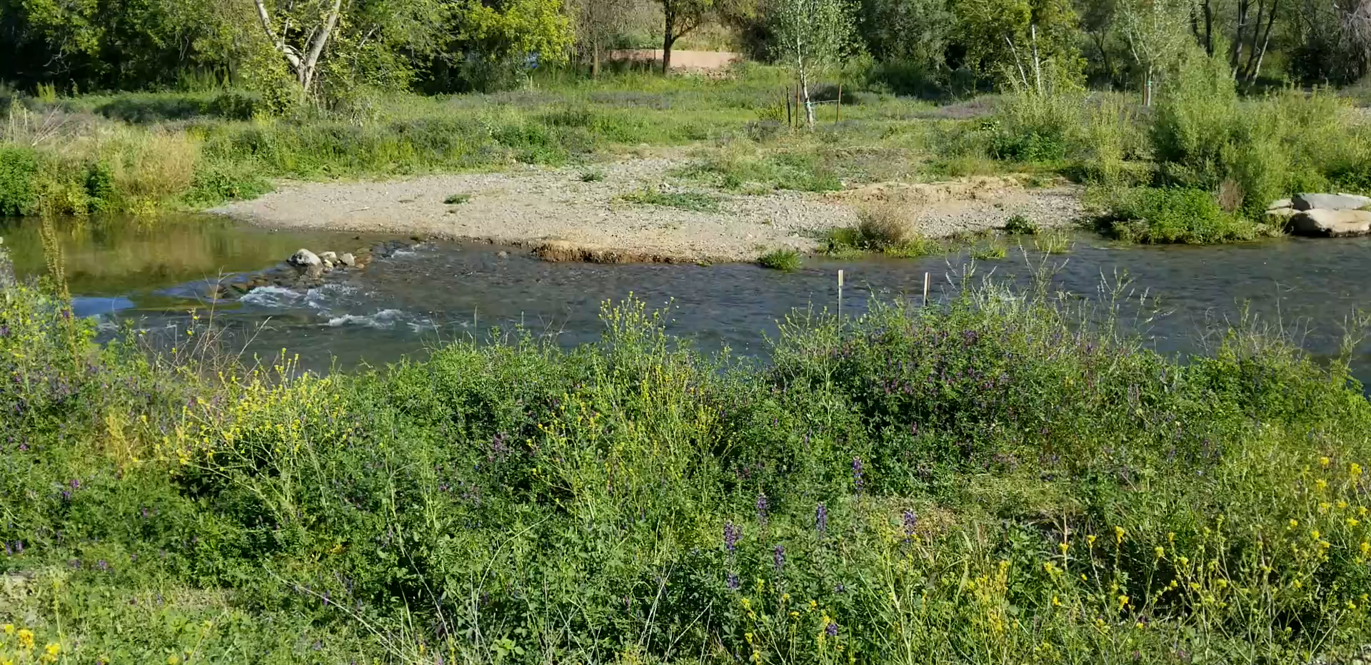
Biomonitoring and Restoration Programs on Putah Creek serves as a model program for linking wildlife evaluation and science with landscape restoration and watershed planning

