Slide 1
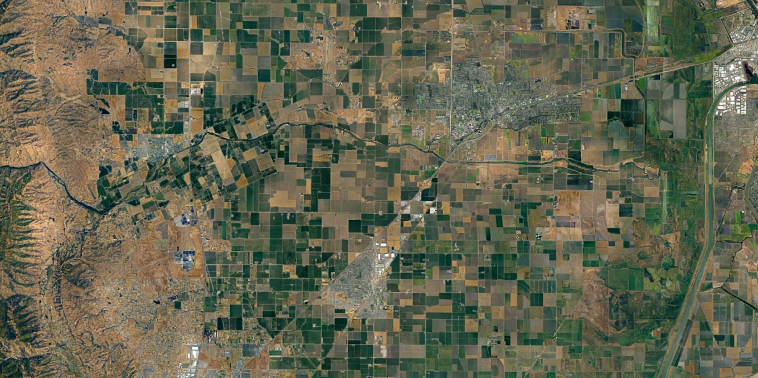
RR
Kilkenny*
Pedrick*
Mace
LRCD
Pickerel
Notes:
Pickerel since 2019
Kilkenny (when RST is in since 2021)
Russell Ranch (x2) since 2019 added one in 2020
Pedrick (since 2024)
Mace (since 2019)

Slide 2
Kilkenny
PG
ODR
106A
WP
IDR
TD

