Slide 1
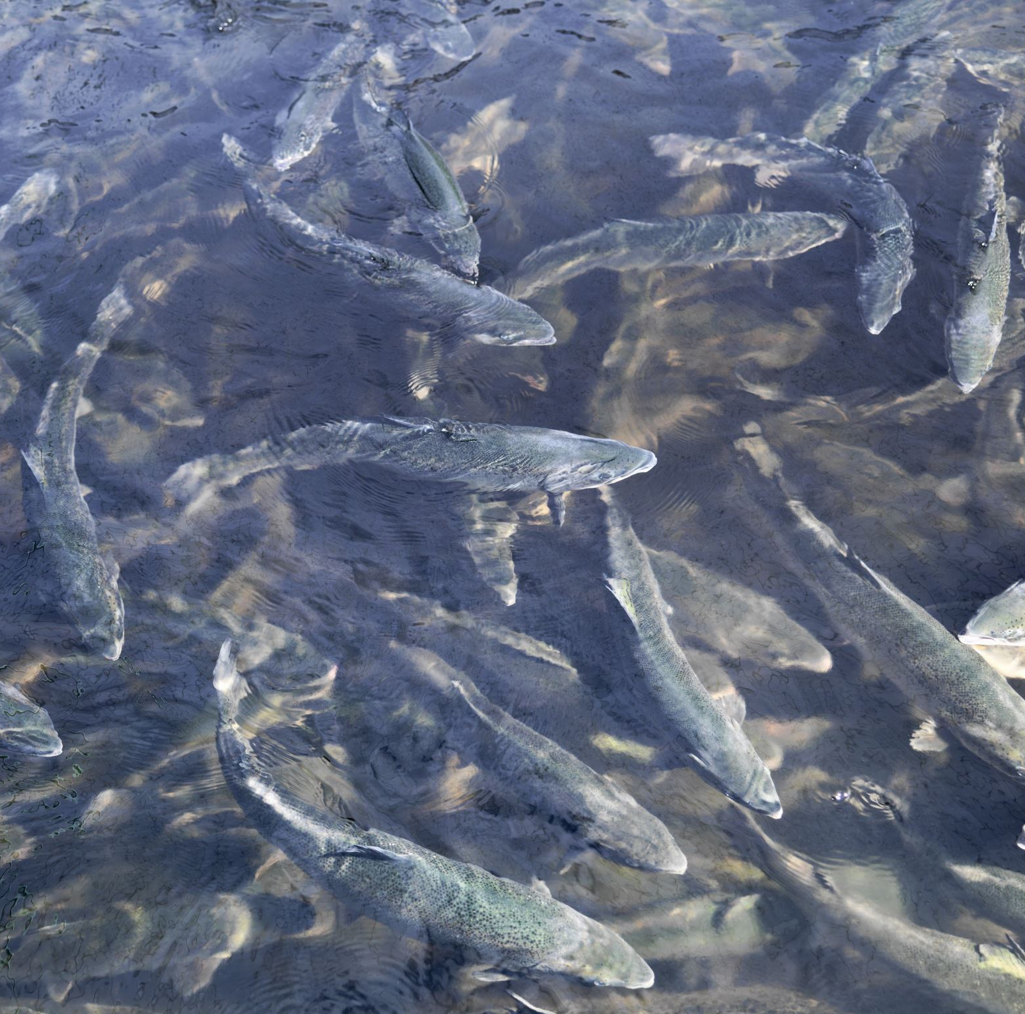

Using parentage-based tagging to identify natal origins of Chinook salmon returning to a restored creek
By: Alana Luzzio
PhD Candidate, Graduate Group in Ecology
Major Advisor: Dr. Andrea Schreier
Genomic Variation Lab, Animal science department, UC Davis

Slide 2
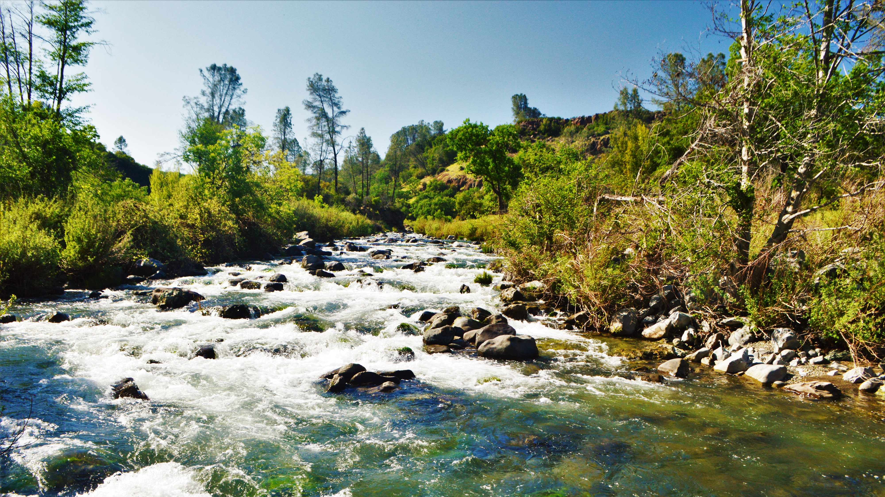
Roadmap
Background
Objectives
Methods
Preliminary results
Future directions

Slide 3
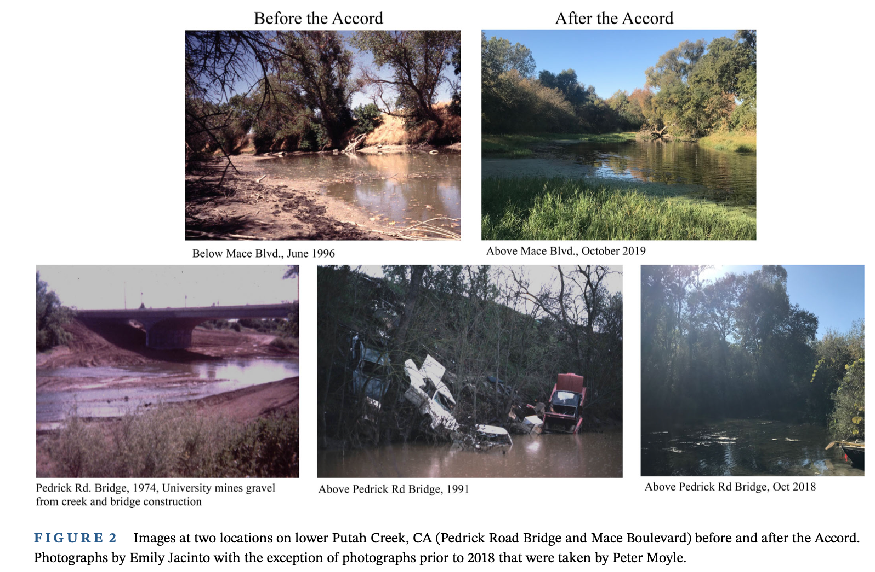
Background
Jacinto et al., 2023
Notes:
The active restoration of Putah Creek with their reestablishment of perennial flows to support native fishes has resulted in many native fish assemblages increasing with the cold water flow establishment (cite)
with this Chinook salmon began reappearing in the Creek
Cold flows favor native species over invasives
It's been shown through otolith chemistry that most of the fish are hatchery strays, however a portion are pPC origin

Slide 4
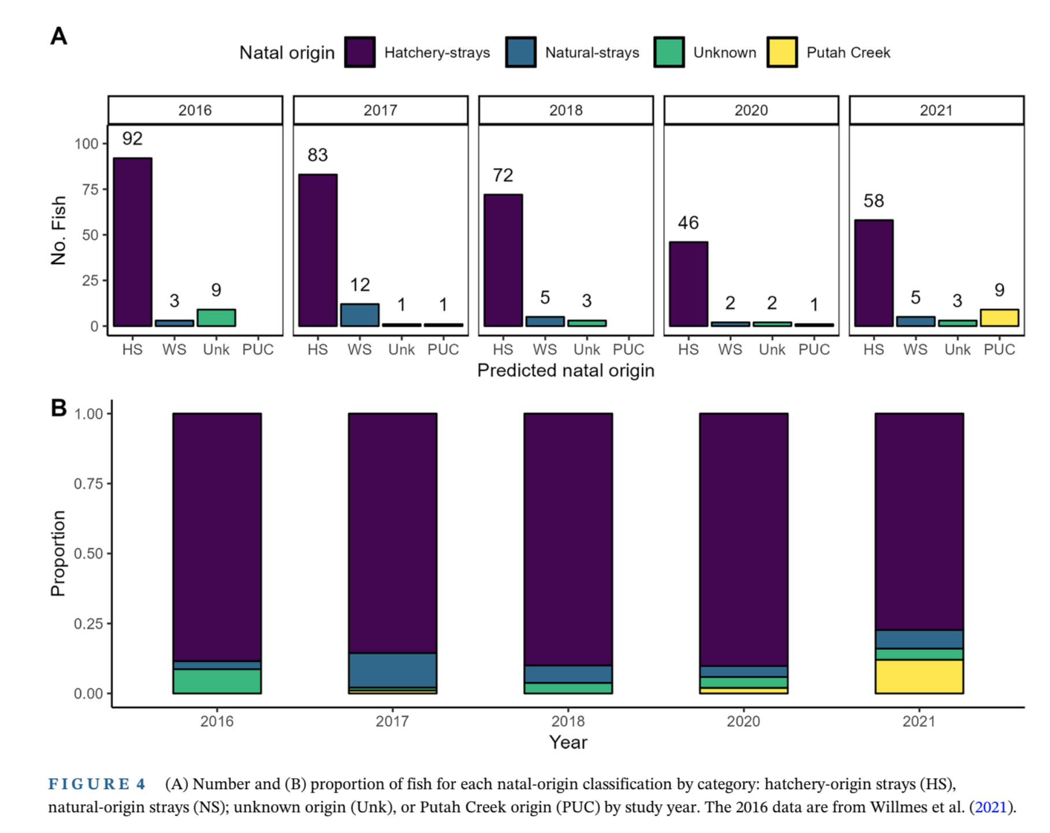
Otolith analysis
Hitt et al., 2025
Notes:
Building off wilmes et all, Lauren Hitt showed XYZ
Methods
Sampled x #fish with isotopic analysis
Results
11/13 PC origin
Able to complete life history within PC

Slide 5
Otolith analysis
11/13 individuals as Putah Creek origin
Hitt et al., 2025
Notes:
Building off wilmes et all, Lauren Hitt showed XYZ
Methods
Sampled x #fish with isotopic analysis
Results
11/13 PC origin
Able to complete life history within PC

Slide 6
Parentage-based tagging (PBT)
Further resolution of natal origin using genetics
PBT is a molecular based approach to genetically “tag” fish to conduct large scale parentage assignments instead of physically tagging individuals
  Uses single nucleotide polymorphisms (SNPs) unique to individuals
  SNPs = “genetic GPS coordinates”
  SNP panel higher efficacy on carcass tissue vs sequencing
PBT create families where further questions can be explored such as:
  ID stock/origin: genetically identify natural origin vs hatchery salmonids
  Population health/demographics: breeding patterns and reproductive success

Slide 7
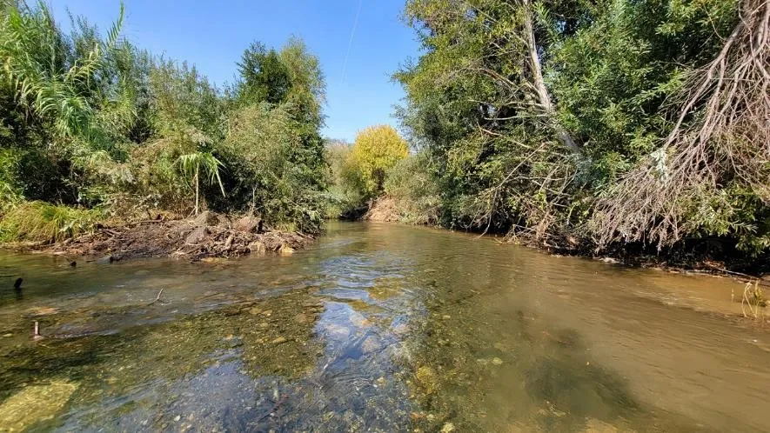
Objectives
I will use the genetic method of parentage-based tagging (PBT) via a validated SNP panel to:
  Use the parentage assignments to elucidate how many Chinook salmon spawning in Putah Creek are the progeny of those that spawned in previous years
  Explore factors influencing individual reproductive success of the Chinook salmon in Putah Creek

Slide 8
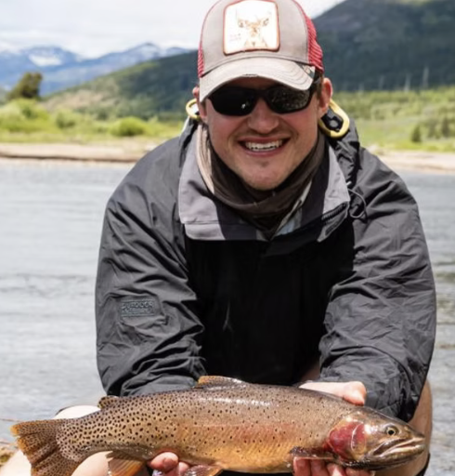
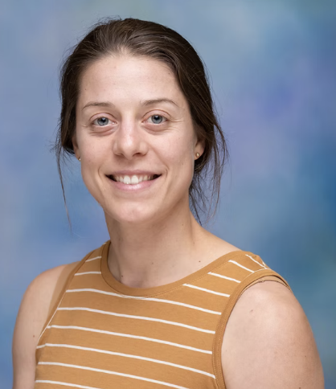
Methods: PBT panel creation
Sequencing and SNP discovery:
Extracted and sequenced out-migrating juveniles from Putah Creek and combined sequencing data with available sequenced data from the Mokelumne Hatchery
Filtered based on minor allele frequency 0.2<MAF<0.45 and matching major and minor allele between the two data sets to ensure concordance
  Higher heterozygosity = more power in parentage analysis
Filtered to SNPs found in more than half of the 42 individuals (SNPs = 226) and further prioritized SNPs with a difference in MAF score between the two data sets of ~0.1 (SNPs = 104)
Dr. Mac Campbell
Dr. Emily Funk
Sequencing & SNP Discovery
Parentage simulation with candidate SNPs
In lab validation
Preliminary results
Pedigree construction
Future directions
Feather River family test

Slide 9
Methods: PBT panel creation
Parentage simulation with candidate SNPs:
Simulated families using allele frequencies from Putah Chinook and performed parentage analysis in CERVUS to assess how well the candidate SNPs perform for parentage analysis
104 candidate loci
50-90% simulated parents sampled
Output: single parent assignment (out of 2000 parents), parent pair assignment (out of 1000 parent pairs), a confidence score in these assignments (LOD score)
  Single parent: 99.2-99.8% assigned with high confidence
  Parent pair: 51-89% assigned with high confidence
Sequencing & SNP Discovery
Parentage simulation with candidate SNPs
In lab validation
Preliminary results
Pedigree construction
Future directions
Feather River family test

Slide 10
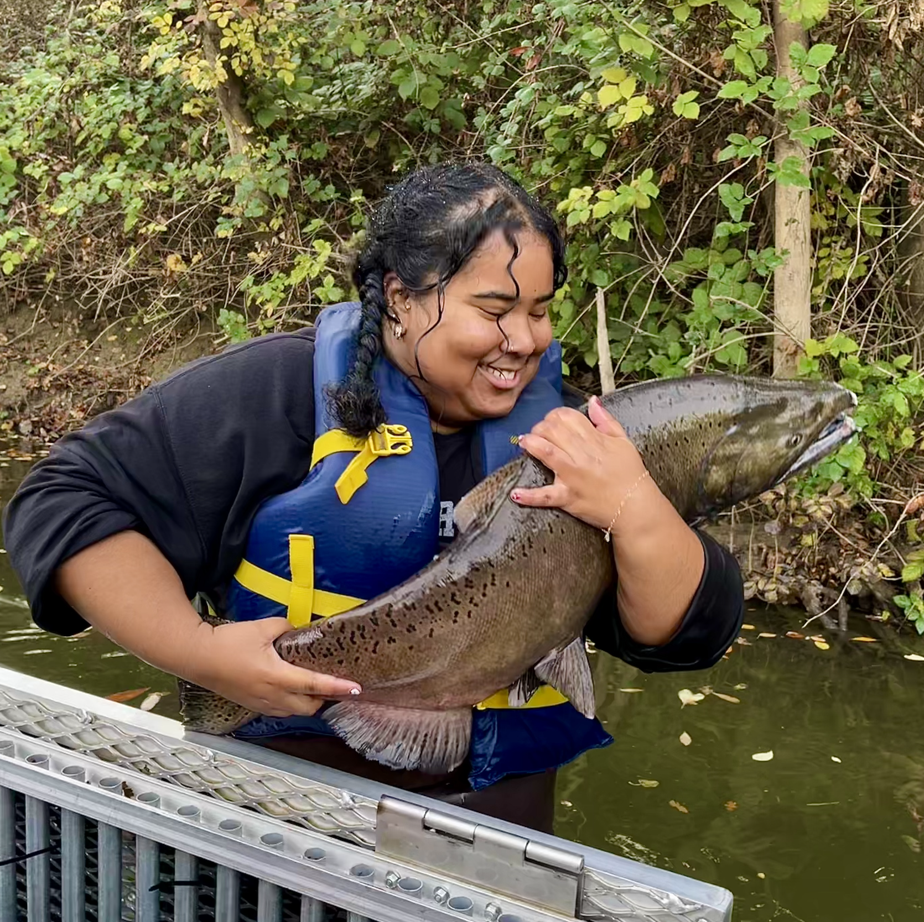
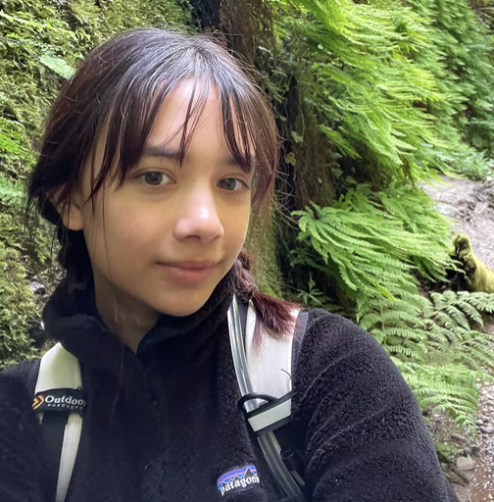
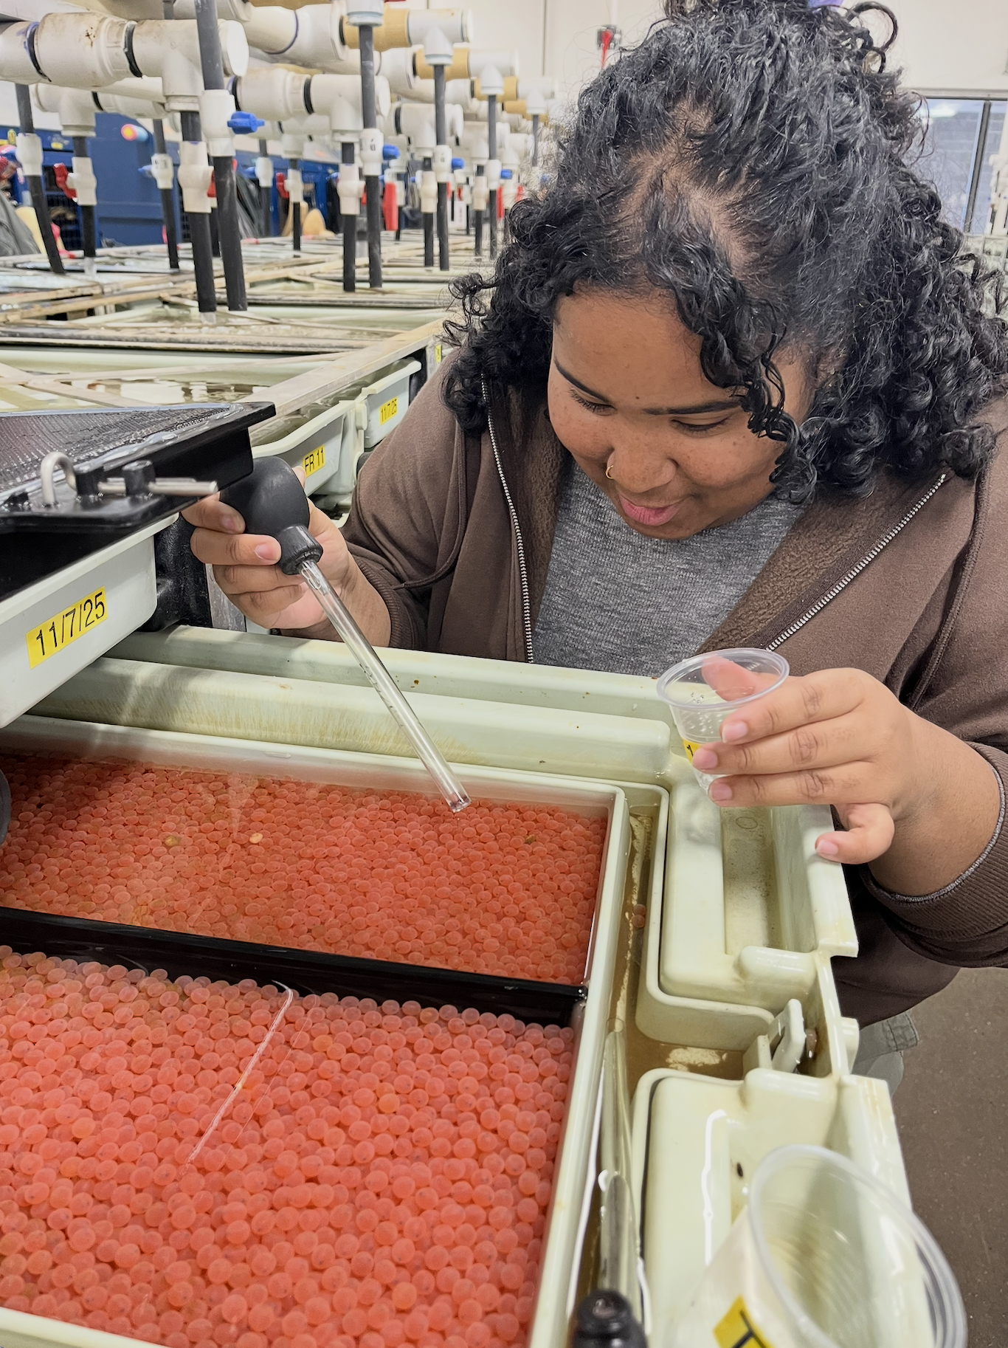
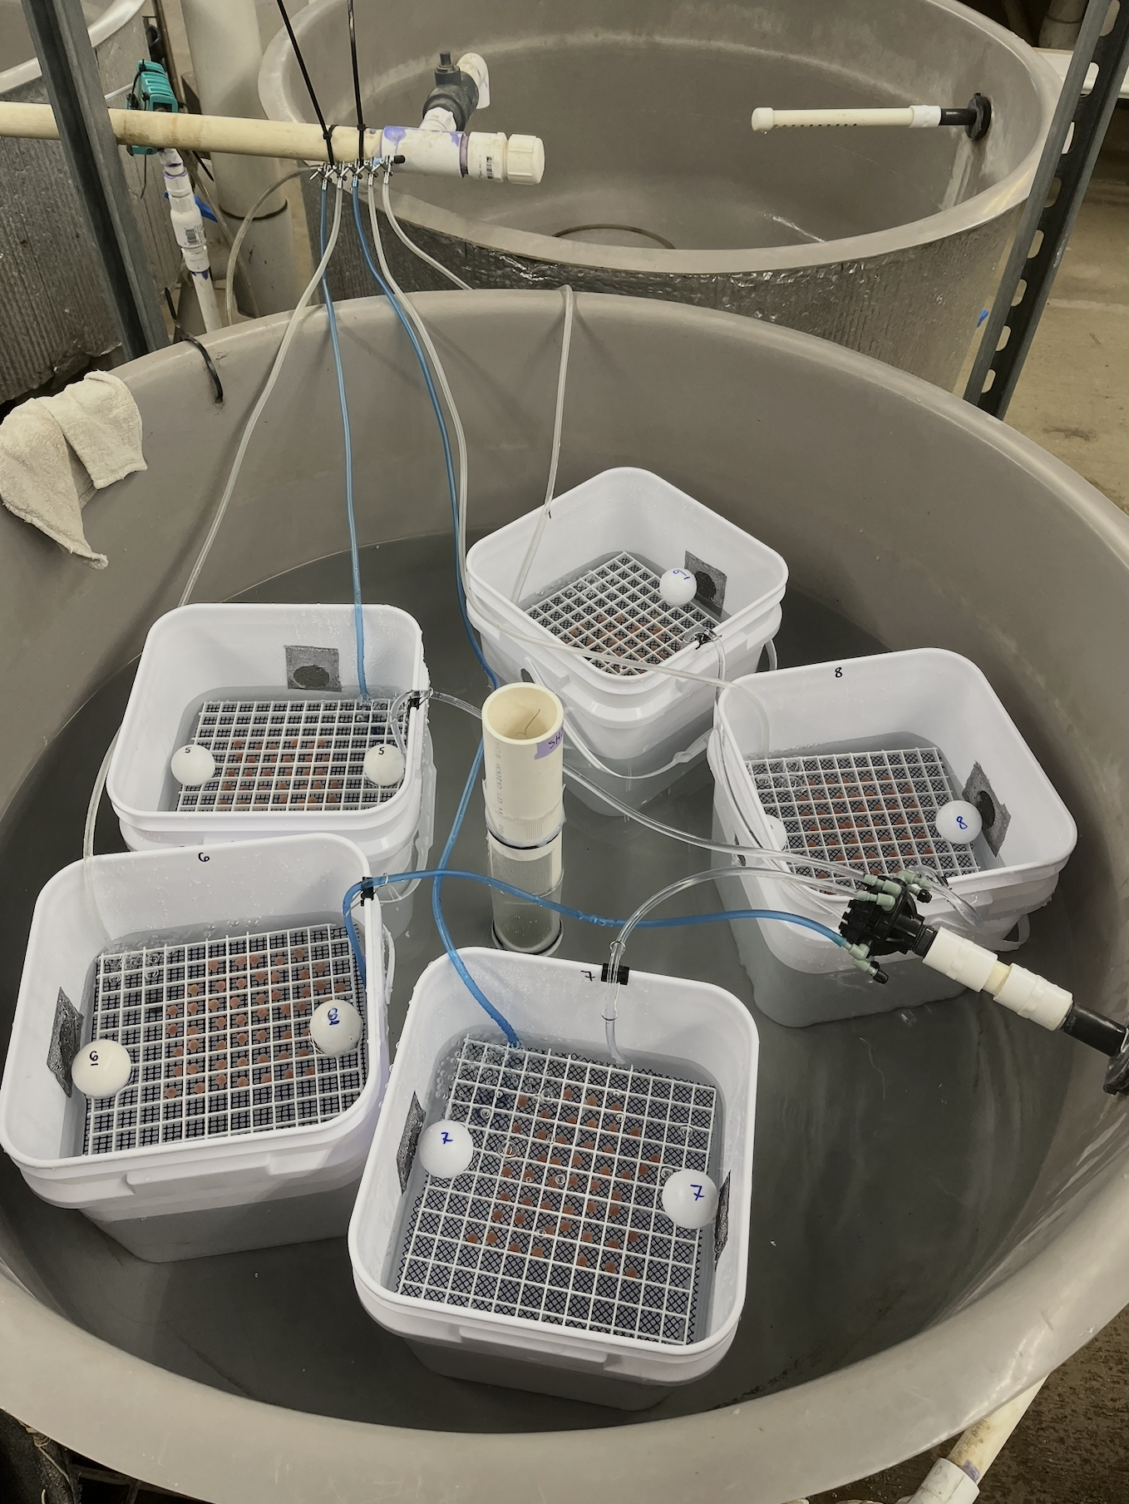
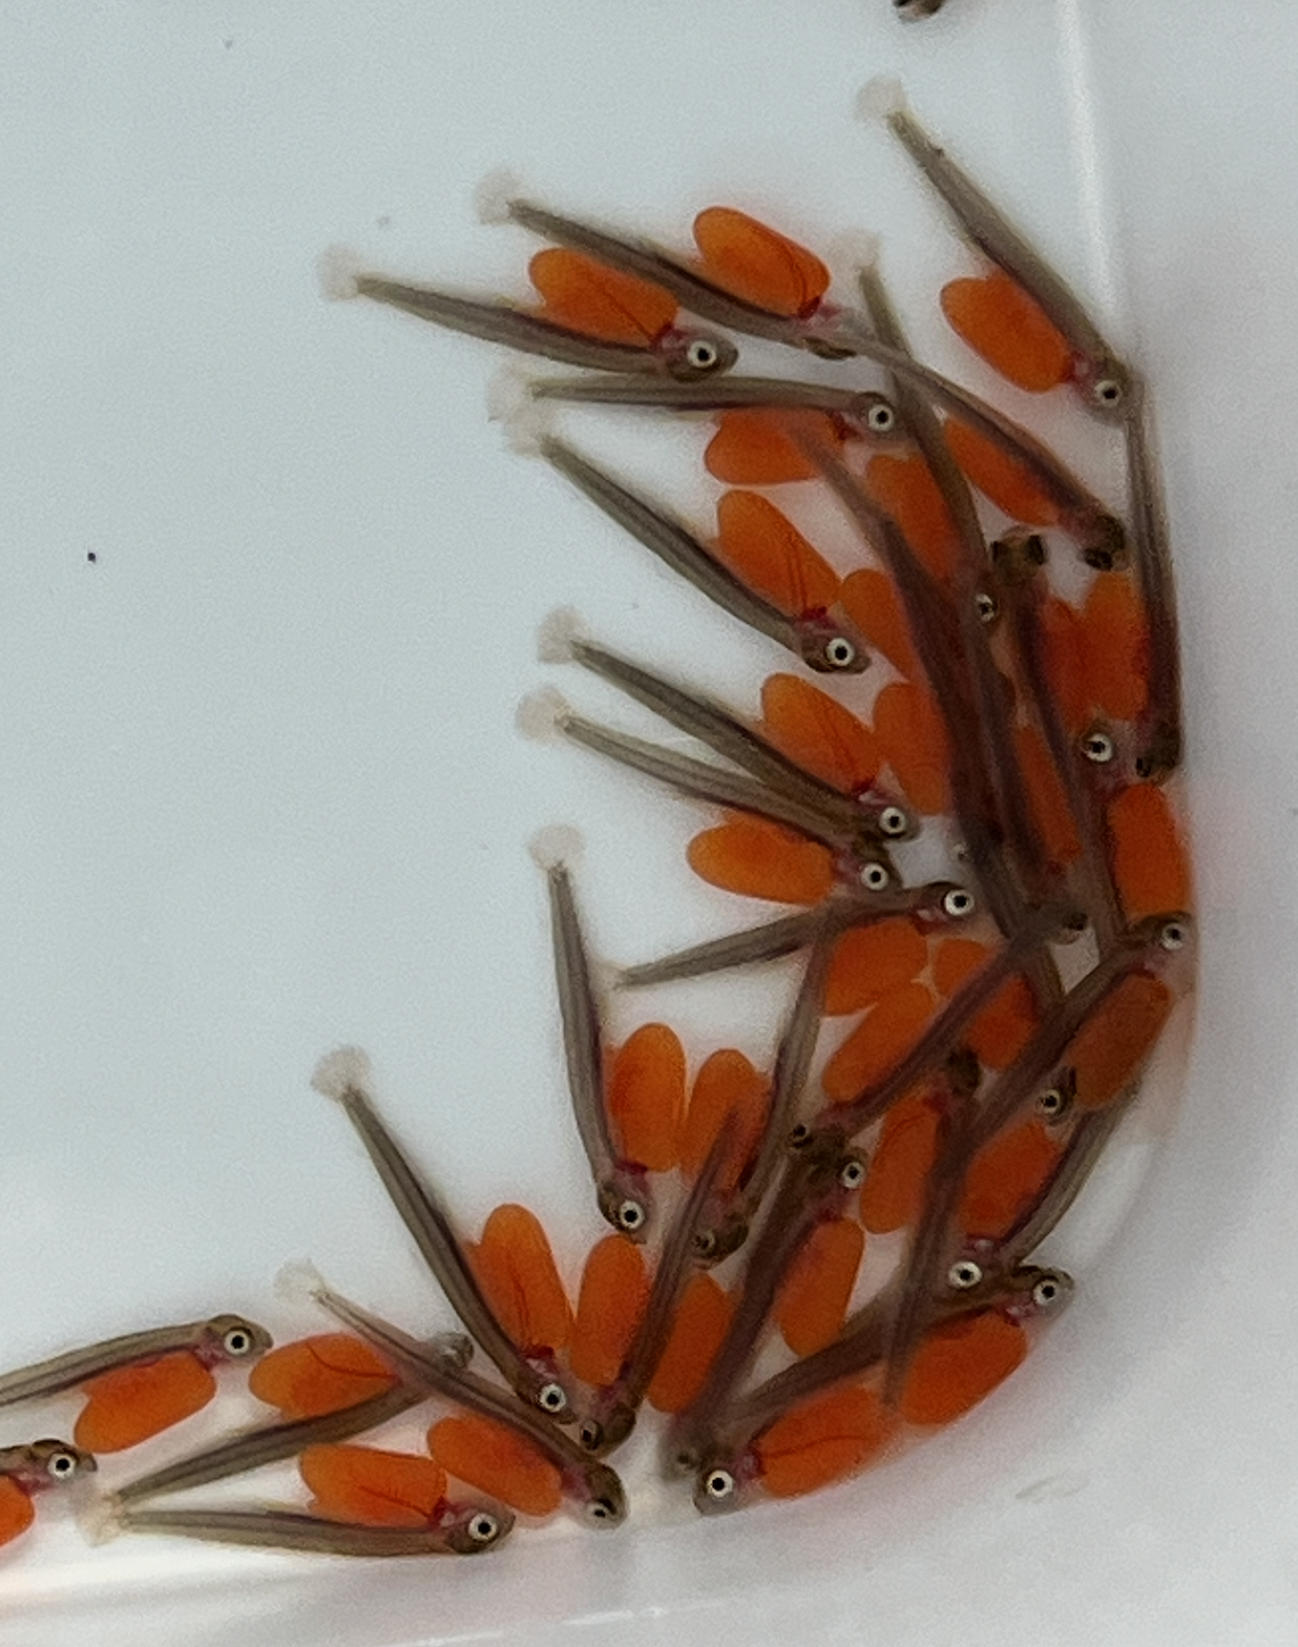
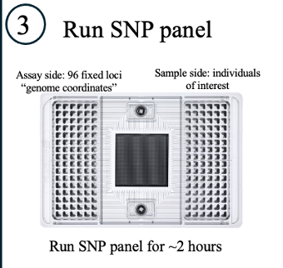
Feather River Hatchery test
Obtained green eggs from the Feather River Hatchery
  Nine families and parental tissue
Juliette Dalicano
Undergraduate Researcher
Lila Magbilang Undergraduate Researcher
Extracted DNA
and ran on SNP panel
Sequencing & SNP Discovery
Parentage simulation with candidate SNPs
In lab validation
Preliminary results
Pedigree construction
Future directions
Feather River family test
Notes:
Need to update the blue bar arrows at the top to add these sections in

Slide 11
Feather River Hatchery test results
Nine families
  72 offspring
  20 parents
Juliette Dalicano
Undergraduate Researcher
Lila Magbilang Undergraduate Researcher
Offspring-Parent Match Accuracy
Count of Offspring-Parent Matches
Sequencing & SNP Discovery
Parentage simulation with candidate SNPs
In lab validation
Preliminary results
Pedigree construction
Future directions
Feather River family test
72/72 correct
100%
67/72 correct
93%
67/72 correct
93%
Notes:
Need to update the blue bar arrows at the top to add these sections in

Slide 12
Feather River Hatchery test results
Nine families
  72 offspring
  20 parents
Juliette Dalicano
Undergraduate Researcher
Lila Magbilang Undergraduate Researcher
Offspring-Parent Match Accuracy
Count of Offspring-Parent Matches
Sequencing & SNP Discovery
Parentage simulation with candidate SNPs
In lab validation
Preliminary results
Pedigree construction
Future directions
Feather River family test
72/72 correct
100%
67/72 correct
93%
67/72 correct
93%
Notes:
Need to update the blue bar arrows at the top to add these sections in

Slide 13
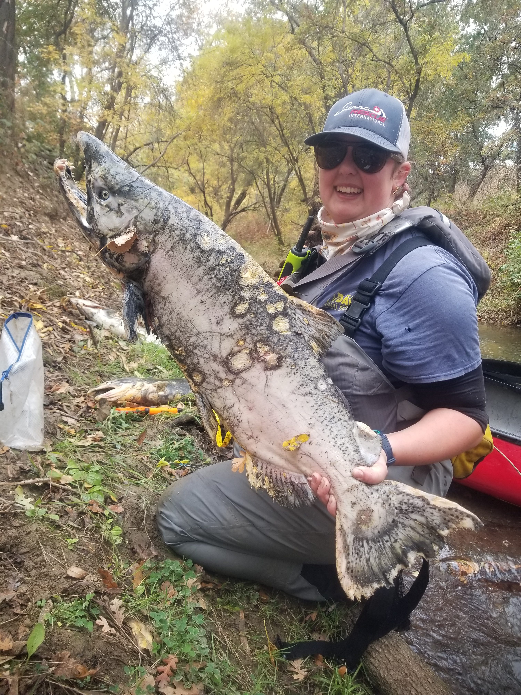
Carcass tissue type study—Lead: Anne Boyd
  Different tissue types from same fish
    Tissue types: Caudal, dorsal, heart, muscle, pectoral, skin, operculum scrape
    SNP panel efficacy of different tissue types
    qPCR to assess Chinook specific copy number of different tissue types
  Decision tree for managers to make quick and effective in the field decision for sampling
Sequencing & SNP Discovery
Parentage simulation with candidate SNPs
In lab validation
Preliminary results
Pedigree construction
Future directions
Feather River family test
Anne Boyd

Slide 14
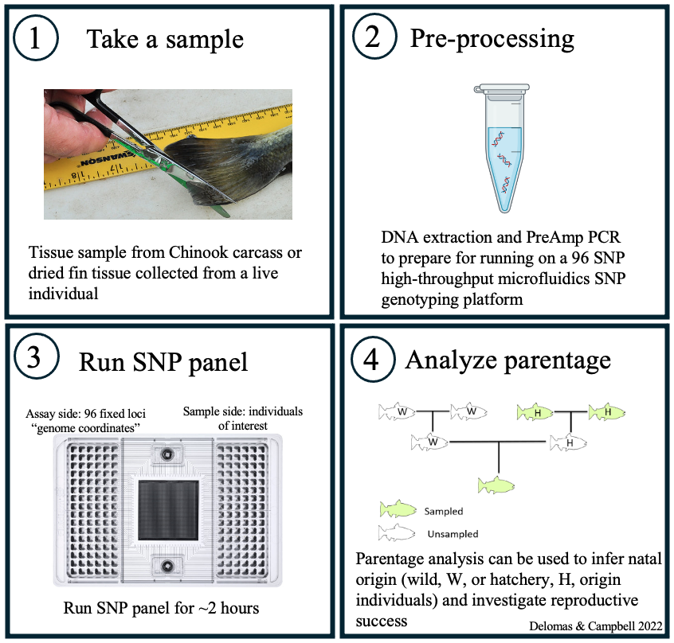
In lab validation
Lila Magbilang Undergraduate Researcher
In lab validation
Tissue samples: fin & carcass to ensure that loci work in the lab
SNP panels have high efficacy with carcass/degraded tissue (unlike RADseq)
Allow us to score and determine the final set of loci expected to work on carcass tissue
Sequencing & SNP Discovery
Parentage simulation with candidate SNPs
In lab validation
Preliminary results
Pedigree construction
Future directions
Feather River family test
Notes:
Need to update the blue bar arrows at the top to add these sections in

Slide 15
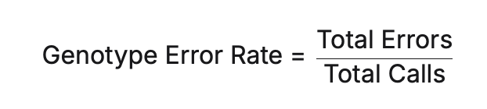
In lab validation preliminary results
Lila Magbilang Undergraduate Researcher
Ran the SNP panel on:
Older tissue and carcass samples -- 61 SNPs work reliably
  Ran the panel on three replicates of carcass only tissue
  Genotyping error rate = 1.2%
  Reran the same simulations with the same parameters
    Output: positive LOD scores for the correct assignments
Sequencing & SNP Discovery
Parentage simulation with candidate SNPs
In lab validation
Preliminary results
Pedigree construction
Future directions
Feather River family test
Notes:
Need to update the blue bar arrows at the top to add these sections in

Slide 16
Planned spring and summer work
Pedigree construction
Running the rest of the samples on the panel
  2020-current
  Wallace and Lisbon Weir samples
Analyze the output in both CERVUS and in COLONY for concordance
  Positive LOD in CERVUS
Sequencing & SNP Discovery
Parentage simulation with candidate SNPs
In lab validation
Preliminary results
Pedigree construction
Future directions
Feather River family test
Notes:
Colony can produce assignments when the genotype of one of the parents is missing either due to missing parental sample or due to failure to produce a parental genotype from an existing sample
Colony can assign parentage and relatedness and uses a maximum likelihood method to do so colony uses a maximum likelihood to assign parentage and sibship

Slide 17
Future Directions
COLONY analysis
  Natal origin
  Assess reproductive success of Putah spawners with returning offspring by analyzing breeding patterns (# breeders), combining with water quality variables, spawning timing and location
Sequencing & SNP Discovery
Parentage simulation with candidate SNPs
In lab validation
Preliminary results
Pedigree construction
Future directions
Feather River family test

Slide 18
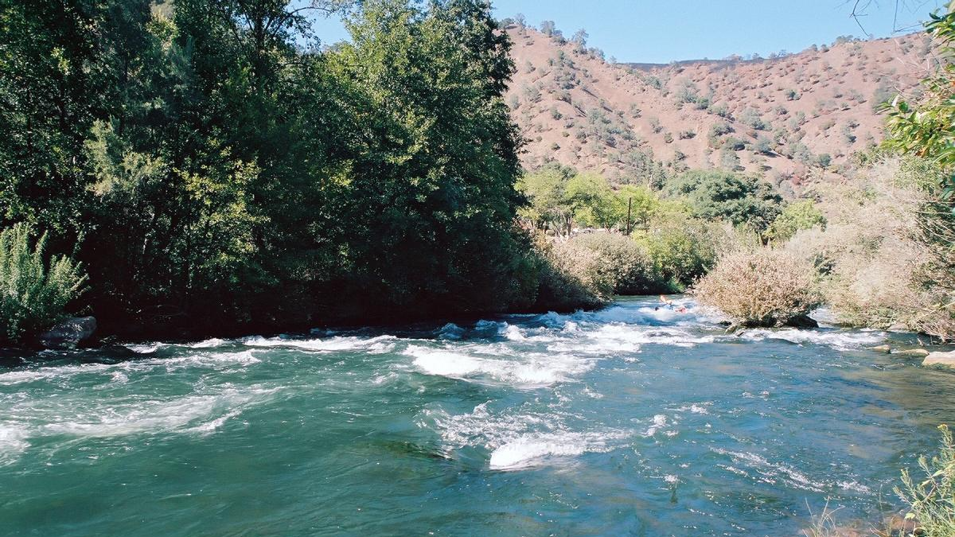
Acknowledgements
Major advisor: Dr. Andrea Schreier, Genomic Variation Laboratory, UCD
Lab mates: Dr. Emily Funk, Dr. Mac Campbell, Lila Magbilang, Juliette Dalicano
Funding:
Solano County Water Agency
Putah Creek Council
Dr. Max Stevenson
Dr. Nann A. Fangue
Dennis E. Cocherell
Anne Boyd
Alexandra Wampler
Peter Aronson
Bryson Zheng

